Slide 1
Chapter 12
LANGUAGE SKILLS IN ADOLESCENTS AND ADULTS

Slide 2
PowerPoint Outline
I. Introduction
II. Bilingualism
III. Literacy
IV. Syntax and morphology
V. Semantics
VI. Pragmatics

Slide 3
I. INTRODUCTION**
Cognitive growth continues throughout life
Vocabulary and pragmatics skills esp. continue
to grow
But with aging, slow decline in lang comprehension, understanding syntactically complex sentences, and inferencing—due to cognitive overload or processing difficulties in working memory

Slide 4
II. BILINGUALISM**
If a child is exposed to a second language after age 8, they will have an accent
Early exposure to a second language (before age 8) leads to better judgments of grammatical correctness and a native-like accent
Fluent bilingualism has great linguistic and cognitive benefits for children and adults

Slide 5
Research in Canada (Ellen Bialystok) showed:

Slide 6
III. LITERACY**
A. Foundations
Pleasure reading may ↓ in adolescence, especially for boys
The biggest change in adolescents and adults is in executive function —ability to engage actively with print and to read and write with purpose

Slide 7
B. Paper vs. Digital Books, Social Media, and Screen Time**
Posnick-Goodwin. The great divide: Print or digital? California Educator, 19(7), 37-39.
Looked at the preferences of current students and research about digital vs. print books

Slide 8
Posnick-Goodwin :

Slide 9
Naomi Baron Words Onscreen**
Growth of ebooks has slowed substantially
Young adults in the U.S., Germany, and Japan overwhelmingly preferred print to ebooks for academics (studying), assuming the cost of the books was the same

Slide 10
Baron (continued; this slide not on exam)**
It takes 33 pounds of minerals to make a single eReader compared with 2/3 of a pound to make a printed book
Minerals for the eReader include rare minerals like columbite-tantalite, generally mined in African conflict-filled areas where profits support warlords

Slide 11
Baron (continued; this slide not on exam)**
Producing an eReader requires 100 kilowatt-hours of fossil fuels, which produce 66 pounds of carbon dioxide compared to 2 kilowatt hours and 100 times less in greenhouse gases for a printed paper book
Recycling an eReader to extract its minerals is usually done in poor countries by children who are exposed to huge health risks from toxins
Paper books can be recycled as a renewable resource

Slide 12
Take a moment…**
Write what you think are the merits of print/paper vs. digital books
For students with language impairment, which do you think might be better? Why?

Slide 13
Ungar:** https://www.psychologytoday.com/us/blog/nurturing-resilience/201801/teens-and-dangerous-levels-cell-phone-use
Teens and Dangerous Levels of Cell Phone Use
Many teens are on the phone 8 hours a day; 2 hours is recommended

Slide 14
Ungar (continued):

Slide 15
Pew Research Center**:
Gen Z has shown less interest in Facebook and engages more with other social media sites such as Twitter, Snap Chat, Instagram, etc.
Persons ages 18-24 years of age are most likely to use Snapchat and Instagram. Of the 18-24 year old Instagram users, 76% of report that they visit Instagram on a daily basis; 60% of them visit Instagram several times a day (not on exam)

Slide 16
Take a moment for a writing reflection--what would you do?:**
You are working with Eddie, a 15 year old with a language impairment and with few friends. He is not adept at using social media, and doesn’t like to talk to people. As part of your therapy, will you try to get him onto social media? Why or why not?

Slide 17
IV. SYNTAX AND MORPHOLOGY

Slide 18
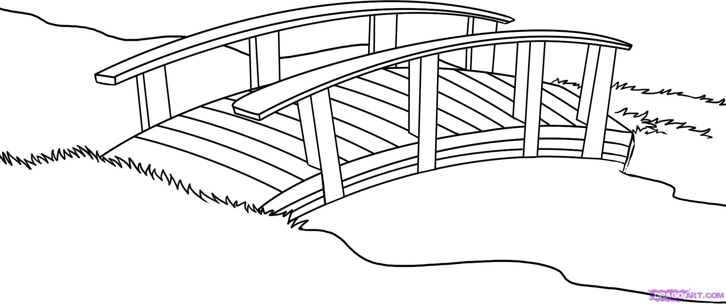
Utterance 2
Utterance 1

Slide 19
Adverbial disjuncts… (p. 403)

Slide 20
Adverbial conjuncts:

Slide 21
V. SEMANTICS

Slide 22
Fogle, 2023:
Cognitive-linguistic disorders most common in older adults:

Slide 23
VI. PRAGMATICS**
A. Conversational Abilities
Teen utterances are contingent (related to what was just said)
Adults use topic shading: this utterance includes some aspect of the preceding utterance but shifts the focus of concern

Slide 24
Example:**
Speaker A: “Can you believe that Game of Thrones is going into another season?”
Speaker B: “Yeah, some of my favorites are going into another season too. Can’t wait till the next season of Big Bang Theory. I wonder what’s going to happen with Sheldon and Amy.”

Slide 25
B. Narratives

Slide 26
C. Speaking Styles

Slide 27
D. Gender Differences (according to your textbook chapter 12)

Slide 28
Genderlect (according to textbook)

Slide 29
Your textbook says:**
Remember cultural influences and how we are raised
Women use ↑ polite words like please, thank you
Men talk ↑ in public and ↓ at home
Men tend to lecture, while women view themselves as conversation facilitators

Slide 30
According to your textbook:

Slide 31
Is Sheldon contingent? Does he share Amy’s feelings?
The Big Bang Theory Amy Sheldon date night
https://www.youtube.com/watch?v=ClvpNWU0A8Q

Slide 32
PowerPoint Outline
I. Introduction
II. Bilingualism
III. Literacy
IV. Syntax and morphology
V. Semantics
VI. Pragmatics

