Slide 1
LANGUAGE LEARNING AND TEACHING PROCESSES IN YOUNG CHILDREN (chapter 6)

Slide 2
PowerPoint Outline**
I. The Role of the Environment in Language Development
II. Cognition and Language
III. Toddler Learning Strategies
IV. Adult Conversational Learning Techniques
V. Print vs. E-Books for Young Children

Slide 3
I. THE ROLE OF THE ENVIRONMENT IN LANGUAGE DEVELOPMENT**
Development of language rests upon several major variables that interact with one another
1. The child’s cultural and linguistic environment is a big influence upon language learning
2. Each child has unique characteristics that she brings to the language learning situation

Slide 4
For a child to develop language optimally…**
She needs language stimulation from her environment
In many cultures, adult interaction with infants and young children differs from mainstream U.S. expectations

Slide 5
For example…**
Most American mothers use infant-directed speech: high pitch, shorter sentences, longer pauses, repetition
However, other cultures may be silent with infants; children also may not be read to

Slide 6
According to your textbook, in some cultures it is believed that…**
Children should be seen and not heard
Children learn by observation, not interaction
Comprehension is more important than production

Slide 7
Socioeconomic status makes a difference…**
Low-SES children’s vocabularies may develop more slowly
Being unsheltered--very negative impact
Low-SES moms may not read as much
High levels of prohibitions (e.g., “no!!” “don’t!”) result in poorer language skills for children

Slide 8
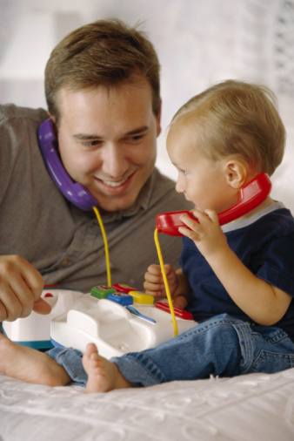
Mainstream Americans…**
View their children as conversational partners
Believe in playing with their children

Slide 9
However, in an ASHA Leader article:**
There was an article entitled From Couching to Coaching
It was talking about what a lot of my former students have told me: when they do home visits for early language intervention, the parents sit on the couch on their phones and don’t want to be involved—they want the SLP alone to “fix it.”

Slide 10
The question was:** (p. 48 of article)
How do we get families off the couch and working with us on improving the child’s communication during mealtimes, tooth-brushing, and other daily routines?

Slide 11
ASHA Leader article —why parents disengage:**
1. Believe home visit is time for Early Interventionist (EI) to take over
2. Don’t see need to be involved in what EI does
3. Feel overwhelmed by child’s special needs and believe they lack the training to make a difference

Slide 12
ASHA Leader article suggestions:**
1. Find out-what do parents want the child to do and when? E.g., be able to tell parent what they want to eat at meal times to avoid a tantrum
2. Realize that today, many parents don’t get down on the floor and play with their children—no time

Slide 13
ASHA Leader article:**
Best thing: Use routines that parents already have to engage in multiple times a day
Meal times, brushing teeth, getting dressed, diaper changes
Weave communication tx into daily activities

Slide 14
ASHA Leader article—coaching the parent involves:

Slide 15
Nature News 2022: https://www.nature.com/articles/d41586-022-00027-4

Slide 16
II. COGNITION AND LANGUAGE**
Cognition and language are intertwined and develop in parallel fashion
Cognitive skills are especially related to grammatical constructions like because and before & after

Slide 17
Word acquisition is guided by 2 types of knowledge structures**
Event-based knowledge: sequences of events or routines that are temporal or causal and organized toward a goal

Slide 18
A child uses this event-based knowledge to form scripts**
For example, if a child goes to daycare, takes swimming lessons, or goes to Sunday school, she has knowledge of those events—they are a script for her
Preschoolers especially rely on this type of knowledge

Slide 19
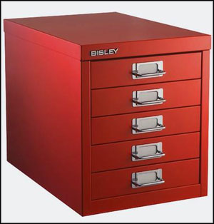
Taxonomic knowledge:
Food
Animals
School items

Slide 20
III. TODDLER LEARNING STRATEGIES**
A. Formula
Verbal routine or unanalyzed chunk of language—memorized units often used in everyday conversation
Mark McKibbin at 2 years old: “Thanks, and have a nice day!”

Slide 21
B. Selective Imitation**
Toddlers imitate a part of or all of an utterance
Used in the acquisition of words, morphology, and syntactic-semantic structures
Cute funny baby imitating his father (motions only)

Slide 22
C. Evocative Utterance**
Child names entities; makes a statement
“Car.”
Adult gives evaluative feedback that confirms or negates what the child said
Child then maintains or modifies meaning

Slide 23
D. Interrogative Utterance**
The child is unsure of the word, and asks “what’s that?”
They are requesting information

Slide 24
IV. ADULT CONVERSATIONAL TEACHING TECHNIQUES**
A. General Facts
Children learn language faster when parents converse (as opposed to teaching and instructing)
There are definite language-learning advantages for children who attend preschools where the curriculum emphasizes language and literacy

Slide 25
B. Expansions and Extensions**
1. Expansion: more mature version of the child’s utterance in which word order is preserved
Ch: “Daddy drive.”
Adult: “Daddy is driving.”

Slide 26
2. Extension:

Slide 27
C. Turnabouts**
Utterance that both responds to the previous utterance and, in turn, requires a response
Ch: We went to the zoo!
Dad: Zoos are fun. What animals did you see?

Slide 28
Types of turnabouts are in Table 6.6 on p. 177—just know these:**
Fill-ins (My dog likes to _______)
Wh-questions (Why does the dog scratch himself? When do we eat breakfast?)
Yes-no questions (Do you think the dog has fleas?)

Slide 29
Summary of new research on child-directed speech:**
Amount of talk directed to children from 0-3 years predicts academic success at ages 9 and 10 yrs. old
Parents of language-advanced children spoke much more to those children than parents of less-advanced children

Slide 31
The more TV in a child’s day…**
The lower her language scores

Slide 32
**Christakis and colleagues studied the impact of TV and its noise on parent-child interactions in homes

Slide 33
Christakis et al. found that:**
Each hour of audible TV was associated with significant reductions in:
1. Child vocalizations, vocalization duration, and conversational turns
2. Adult male and female word count

Slide 34
Constant noise in the home is also associated with:

Slide 35
Devices like phones make a difference too:**
More people on earth own a mobile device than a toothbrush
The average person has a 7-second attention span; a goldfish has an 8 second span

Slide 36
ASHA Leader:

Slide 37
V. PRINT VS. E-BOOKS FOR PRESCHOOLERS**
A. Premise
The American Academy of Pediatricians (2020) clearly states little-no screen time for children from 0-2 years, except for video chatting with relatives
Research shows that school-aged children may benefit from e-book advantages (e.g., dictionaries, highlighting key words)

Slide 38
In terms of paper vs. e-books books for preschool children (2-5 years)**
Research is mixed
E-books--more exciting, initially engage children’s attention more effectively than paper books

Slide 39
But….**
What is their effect on dialogic reading and children’s comprehension?
Dialogic reading: interactive reading between caregivers and children

Slide 40
Disadvantages: (Willoughby, Evans, & Nowak http://www.eetconference.org/wp-content-uploads/

Slide 41
Parrish-Morris, Mahajan, Hirsh-Pasek, Golinkoff, & Collins. Once upon a time: Parent-child dialogue and storybook reading in the electronic era. Mind, Brain, and Education, 7(3), 200-211.**
Studied 165 parent-child dyads reading e-books and traditional paper books
Children’s story comprehension and parent-child dialogic reading were negatively affected by the presence of electronic features

Slide 42
Parrish-Morris et al. continued:

Slide 43
ASHA Leader:**
Cited a study done at University of Michigan Children’s Hospital
bit.ly/print-books

Slide 44
ASHA Leader**
Recorded videos of parents reading to toddlers in 3 conditions:
1. Basic e-book (no sound effects or hot spots)
2. Enhanced e-books (e.g., with sound, animation)
3. Print books

Slide 45
ASHA Leader article—Number of children’s verbalizations during reading

Slide 46
Dr. Perri Klass:
Journal of the American Medical Association, parents and children 10-16 months of age

Slide 47
Ma et al., American Academy of Pediatricians:

Slide 48
PowerPoint Outline
I. The Role of the Environment in Language Development
II. Cognition and Language
III. Toddler Learning Strategies
IV. Adult Conversational Learning Techniques
V. Print vs. E-Books for Young Children

