Slide 1
Specific Strategies for Children with Developmental Language Disorder, Sensory Processing Disorder, and Fine Motor Delays

Slide 2
I. Introduction and Background
II. Foundational Principles and Nature of SPD
III. Eight Sensory Systems
IV. Implications for Speech and Language
V. Sensory Diet
VI. Specific Therapy Materials and Activities for Integrating Language, Sensory, and Fine Motor Skills

Slide 3
I. Introduction and Background My personal interest in Sensory Processing Disorder:
My son Mark was diagnosed with SPD, dyslexia, and ADHD

Slide 4
II. Foundational Principles and Nature of SPD** It is increasingly being found that children with special needs such as Developmental Language Disorder (DLD) and Autism Spectrum Disorder (ASD) have accompanying sensory and fine motor deficits

Slide 5
Research over the years has clearly shown** that sensory processing deficits, often described under the term sensory processing disorder (SPD), are a co-morbid problem that can accompany childhood apraxia of speech, autism spectrum disorder, attention deficit hyperactivity disorder (ADHD), and DLD

Slide 6
Sensory Integration Dysfunction/Sensory Processing Disorder
Notes:
Statistics:
1979 Ayers estimated 5-10% have SI probs significant enough to warrant intervention
Today
According to Dr. Lucy Jane Miller, the statistics report a minimum of 1 in 20 children in the US have SPD. This is the only published statistic and is based on her research thus far.
“It is when the brain is so disorganized that a person has difficulty functioning in daily life that the person has a diagnosis of SID” Kranowitz

Slide 7
Galina-Simal et al., 2020—in children with SPD:

Slide 8
STAR Institute, 2023:**
Pioneering occupational therapist, psychologist, and neuroscientist A. Jean Ayres, Ph.D., likened SPD to a neurological “traffic jam” that prevents certain parts of the brain from receiving the information needed to interpret sensory information correctly.

Slide 9
Delgado-Lobete et al. (2020) tell us that

Slide 10
Possible Causes of SI Dysfunction

Slide 11
III. Eight Sensory Systems
Notes:
Far – 0versensitive Near - under sensitive
Inetroception
Internal sensations
hunger/thirst
hot/cold
pain/discomfort

Slide 12
Vestibular system:

Slide 13
Proprioception:

Slide 14
Interoception…

Slide 15
Where to Start?

Slide 16
Modulation

Slide 17
IV. Implications for Speech and Language**
Communication is a result of our (sensory) experiences – learning to communicate by hearing, seeing, touching, and moving about the world . . . . . There is a reciprocal relationship among sensory experiences and language.
A well integrated sensory system becomes the vehicle for nonverbal expressions (gestures, smiles, frowns) and later for the production of speech and language

Slide 18
Over-Responsive

Slide 19
Under-Responsive (passive)

Slide 20
The Sensory Seeking Person
Notes:
Your instinct is to calm them down
Seekers can become even more disorganized if input is not provided in an =organized and structured manner

Slide 21
Mixed Response

Slide 22
V. Sensory Diet**
Term coined by Patricia Wilbarger
“The optimum sensorimotor input a person needs to feel alert, exert effortless control, and perform at peak.”
The strategic use of sensory activities

Slide 23
Childdevelopment.com 2023:**
Lists sensory activities as part of a sensory diet that helps to keep a child feeling calm and sensorily organized. These activities help children to attend, learn and behave to the best of their ability.

Slide 24
Childdevelopment 2023:

Slide 25
We can have home and school modifications:**
:These can include extracurricular activities

Slide 26
School modifications (cont.)

Slide 27
With Brain Gym, we can do cross crawls and waves to cross midline and increase alertness

Slide 28
Auditory Supports

Slide 29
Olfactory (Smell) Supports

Slide 30
Chewing things:**
Children with SPD often like to chew things for extra sensory stimulation
Mark would chew his sleeve and even Styrofoam flotation device
Offer alternatives

Slide 31
We need to provide children with appropriate, clean items to chew on (Chewlry)

Slide 32
Tactile Supports**
These kids need things to keep their hands busy

Slide 33
Vestibular Supports

Slide 34
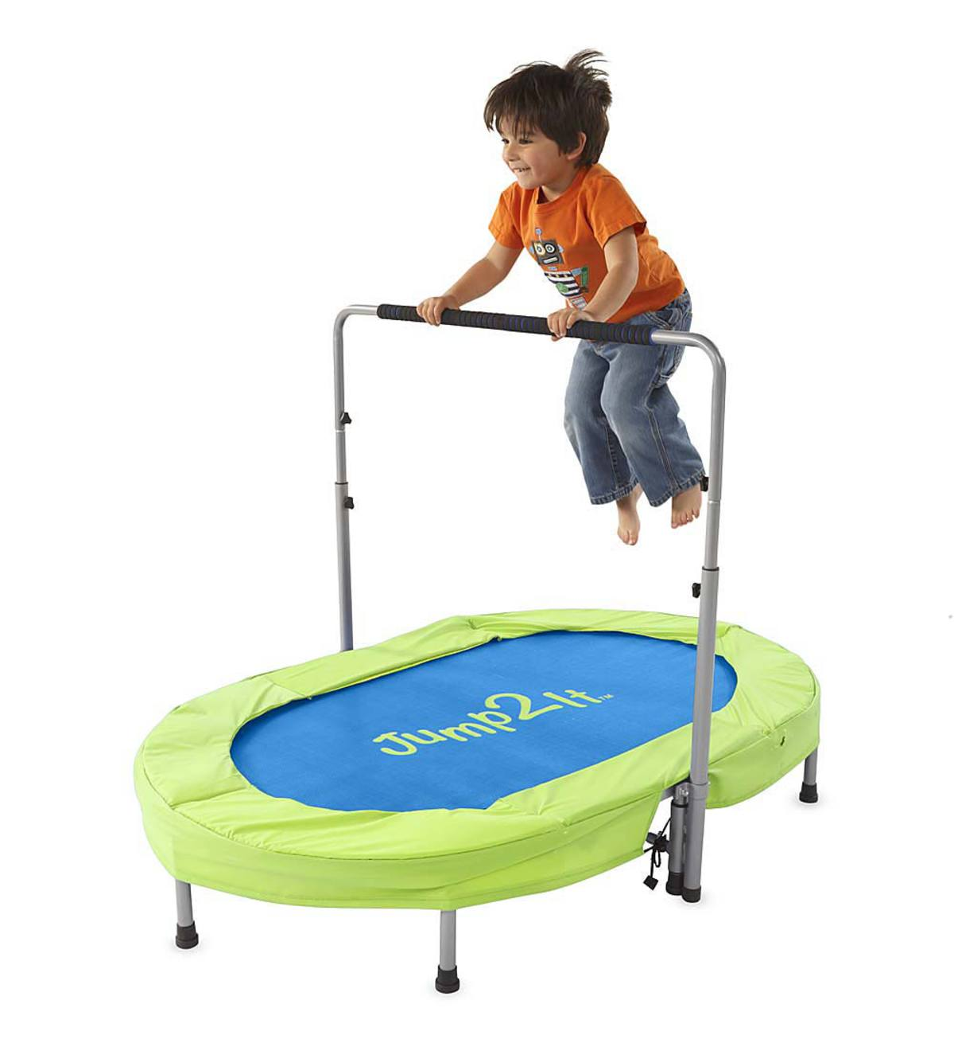
Vestibular support—jump on a miniature trampoline

Slide 35
This youtube video shows how to incorporate sensory activities into therapy**
https://www.youtube.com/watch?v=vM2MGreq88Q
Speech & sensory therapy made 'fun' for kids

Slide 36
VI. Specific Therapy Ideas for Integrating Language, Sensory, and Fine Motor Skills**
Many children with developmental language disorder (DLD) have deficits in listening and speaking
They may have SPD and fine motor deficits as well
Fine motor deficits directly impact writing

Slide 37
In this section….**
We will discuss specific activities and materials that address all 3 areas: language, sensory skills, and fine motor skills
For each activity, specific suggestions will be given for integrating all 3 skill areas into one fun, easy, inexpensive activity!

Slide 38
In terms of language, we will focus especially on:**
Listening and following directions
Auditory memory
Learning new vocabulary words
Describing objects according to label, size, shape, color, function, how they feel
Working on basic concepts such as over, under, on top, bottom, left, right, side—spatial terms

Slide 39
We also need to focus on:**
Parts of speech like verbs, nouns, adjectives
Verbs or action words are especially important because it is well-documented that children with DLD have difficulty with verbs
Expanding expressive language
Knowledge of categories
Opposites
Synonyms—very important for building more sophisticated vocabulary

Slide 40
We will also discuss social skills including:

Slide 41
Fine Motor/ Writing Problems—Our Primary Goals:

Slide 42
Appropriate body positioning includes:

Slide 43
To improve shoulder stability:**
Wheelbarrow walks—hold the child’s feet and have him walk on his hands
Have the child do pushups against the wall
Encourage prone or quadraped position—when watching TV/reading etc., lie on the floor propped on elbows

Slide 44
Sensory Play at Home: Proprioceptive Games**
https://www.youtube.com/watch?v=SWtmkjd45so

Slide 45
There are many activities to increase muscle tone in the small muscles of the hand!

Slide 46
Have the child:**
Move small objects from one hole to another, emphasizing concepts like left, right, up, down, forward, back
Label each object and tell its function—what it does—and what it is made of
Give the child directions of increasing length and complexity such as “Put a cotton ball under a straw.” “Put two cotton balls on top of a bottle lid.”

Slide 47
Go to Celeste Roseberry Youtube channel**
https://www.youtube.com/watch?v=qYDBuWJlsJI&t=13s
Intervention for vocabulary and phonological awareness skills
This student has been diagnosed with a learning disability, and we are using kinetic sand

Slide 48
Incorporate language by having the child:**
Follow directions: “Pick up the orange frog and put it in the second strawberry basket.”
“Pick up two objects and put them in the first strawberry basket.”
“Count and tell me how many items are in the second strawberry basket.”
Describe the items: name, color, texture, function

Slide 49
Language activities:**
“How does the slappy hand feel? Is it hard or soft? Is it stretchy? What color is it? Tell me a sentence about the slappy hand.”
“Slap the hand onto a picture/word in the middle of the page. Now the bottom of the page. Now the top of the page.”

Slide 50
In sum, sensory integration:

Slide 51
A great youtube video for how to integrate sensory activities into speech-language therapy**
https://www.youtube.com/watch?v=1AERJdldapQ
How To Use Sensory Play for Language Speech Therapy Tips

Slide 52
I. Introduction and Background
II. Foundational Principles and Nature of SPD
III. Eight Sensory Systems
IV. Implications for Speech and Language
V. Sensory Diet
VI. Specific Therapy Materials and Activities for Integrating Language, Sensory, and Fine Motor Skills

Slide 53
We can make therapy much more enjoyable! ☺

Slide 54
Resources
Sensory Integration and the Child
By A. Jean Ayres
An Introduction to Sensory Integration
By Nan Arkwright
The Out-of-Sync Child
By Carol Kranowitz
A Parents Guide to Understanding Sensory Integration
By Sensory Integration International
Building Bridges Through Sensory Integration
by Ellen Yack, Shirley Sutton, and Paula Aquilla
Pre-Feeding Skills
by Suzanne Evans Morris, PH.D. CCC-SLP & Marsha Dunn Klein, M.Ed., OTR/L

Slide 55
Resources (cont.)
Building Bridges Through Sensory Integration
By Ellen Yack, Shirley Sutton, and Paula Aquilla
Pre-Feeding Skills
By Suzanne Evans Morris, PH.D. CCC-SLP & Marsha Dunn Klein, M.Ed., OTR/L
Self-Reg How to Help Your Child (and You) Break the Stress Cycle and Successfully Engage With Life
By Dr. Stuart Shanker
Raising a Sensory Smart Child
By Lindsey Biel, M.A. OTR/L and Nancy Penske

Slide 56
Resources (cont.)
American Occupational Therapy Association
http://www.aota.org
Phone: 301-652-2682
American Occupational Therapy Association of California http://www.healthcaresource.com/otac/
Phone: 916-567-7000
Sensory Integration International
http://home.earthlink.net/sensoryint/
Phone: 310-787-8805

Slide 57
Resources (cont.)
Sensory Resources
http://
www.sensoryresources.com/
Phone 1-888-357-5867
Southpaw Enterprises (SI Products and Resources)
http://www.spouthpawenterprises.com/html/home.asp
Phone 1-800-228-1698
Sensational Brain Co.
www.sensationalbrain.com

Slide 58
Resources (cont.)
www.sensorysmarts.com
Wild, Gwen, MOT, OTR/L and Jones, Lyle, MBA (2012) Parent’s Perception of Effectiveness of Sensory Diets for Children: A Multiple Case Study Analysis
Arnie and His School Tools
By Jennifer Veenendall
Sensational Kids: Hope and Help for Children with Sensory Processing Disorder (SPD)
by Lucy Jane Miller

Slide 59
Resources (cont.)
STAR Institute (2022). Understanding sensory processing disorder. https://sensoryhealth.org/basic/understanding-sensory-processing-disorder

