Slide 1
Gathering and Analyzing a Language Sample

Slide 2
PowerPoint Outline
I. Purpose of a Language Sample
II. Obtaining the Language Sample
III. MLU Norms
IV. Group Activity: LSA

Slide 3
I. Purpose of a Language Sample:

Slide 4
Language samples are ideal for evaluating young children

Slide 5
Pavelko et al. Use of language sample analysis by school-based SLPs: Results of a nationwide survey. Language, Speech, and Hearing Services in Schools, 47(3), 246-258. doi:10.1044/2016_LSHSS-15-0044.

Slide 6
When I gave a workshop for 500 SLPs in Houston, TX**
I asked how many used language samples when assessing ELLs
Not one hand went up!!

Slide 7
However, in the case of populations such as multicultural and low-SES, we need to try because norm-referenced tests are biased**
Communication Disorders Quarterly Vol 38(4), 231-241.
Abel, A.D., Schuele, M., Arndt, K.B., Lee, M.W., & Blankenship, K.G. Another look at the influence of maternal education on preschoolers’ performance on two norm-referenced measures.

Slide 8
In this study, they compared the performance of low- and mid-SES preschoolers (typically developing)

Slide 9
Thus….**
Use of language sampling is very important with populations such as low-SES children!

Slide 10
When analyzing a LS:

Slide 11
Hao et al. A narrative evaluation of Mandarin-speaking children with language impairment. Journal of Speech, Language, and Hearing Research, 61, 35-359.

Slide 12
However…(Hao et al. continued)

Slide 13
For example (this slide not on the exam)**
So we, like, went to Disneyland you know? And, like there was this thing, this ride…this ride that was just totally awesome. I, like, totally loved it. (27 words)
We went to Disneyland and I loved this awesome ride. (10 words)

Slide 14
II. Obtaining the LS (review from 112)

Slide 15
Fogle, 2019:

Slide 16
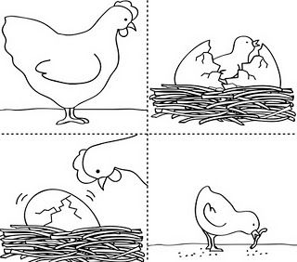

Slide 17
III. MLU Norms (PRAXIS!)**
18-24 mos. MLU = 1.5 to 2.0
2-2 ½ yrs. MLU = 2.0-2.5
2 ½ to 3 yrs. MLU = 2.5-3.0
3-4 yrs. MLU = 3.0-4.0
4-5 yrs. MLU = 4.5+
    5-6 yrs. MLU= 8+ words, compound and complex sentences

Slide 18
PowerPoint Outline
I. Purpose of a Language Sample
II. Obtaining the Language Sample
III. MLU Norms
IV. Group Activity: LSA

Slide 19
IV. Group Activity
Together, we will analyze the language sample in your copy book

Slide 20
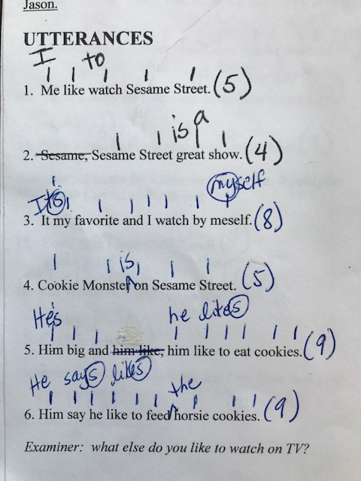

Slide 21
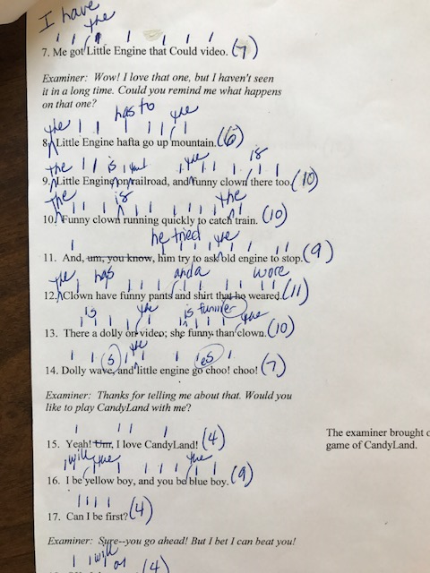

Slide 22
