Slide 1
The Foundations of Language Intervention: Reasoning and Research
Chapters 2, 4

Slide 2
PowerPoint Outline**
I. Introduction
II. Intervention: Playing the Game
III. Dynamic Assessment
IV. Systematic Learning Supports
V. Developing a Growth Mindset

Slide 3
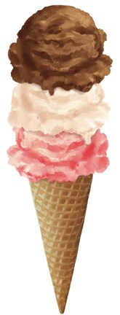
I. INTRODUCTION: The Cone of Language Learning**
Start at base--medical/physical issues
Sensory processing is next (OT)
Attention and memory
Next--oral language
Finally, pre-literacy and literacy skills
Literacy
Oral language
Attention, memory
Sensory Processing
Medical/physical

Slide 4
**
If we focus on fixing the problem at the source or base of the cone, then when that problem is fixed, the impact of these interventions spreads upward
Medical problems are not within our scope, but we can indirectly refer (e.g., for PE tubes, needed surgery, glasses, etc.)

Slide 5
II. INTERVENTION: PLAYING THE GAME**
In basketball, you have a series of tasks (run, dribble, shoot)
The end goal is to play the game well
Language is the same way—there are skills and strategies, but the end goal is effective communication in social and academic settings and living a productive and happy life ☺

Slide 6
As your book says on p. 114:

Slide 7
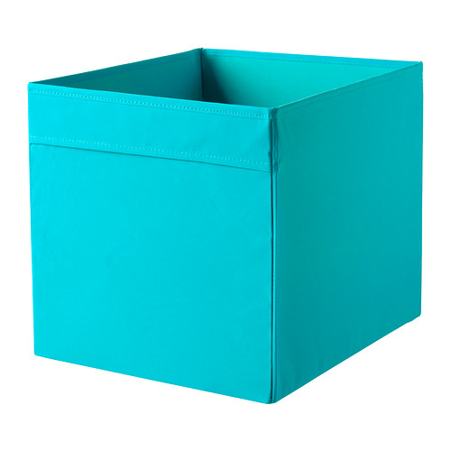
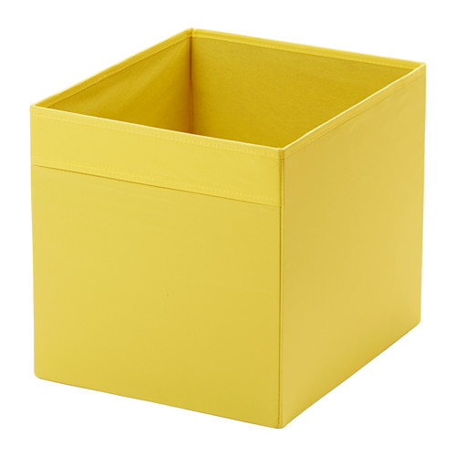
In the old days, you had 2 boxes:**
Behaviorist drill and kill, discrete trials, no context, lots of flashcards
Whole language—immerse children in rich literature, but no direct teaching of skills

Slide 8

Hierarchical Skill Intervention**
Focus solely on target skill (e.g., teaching verb + -ing)
March up the ladder, focusing on one rung at a time
Drill
Past -ed
Plural -s
-ing

Slide 9
Celeste Roseberry youtube channel
Using Drill to Improve Sight Word Recognition
https://www.youtube.com/watch?v=j-rwf8vnKkQ&t=16s

Slide 10
Often, drill requires the child to imitate the SLP through use of elicited imitation:**
SLP: Say “I see the boy petting the cat.”
Child: “I see the boy petting the cat.”
For years, we thought that was sufficient, but new research proves that there is more to it

Slide 11
Eisenberg et al. Use of imitation training** for targeting grammar: A narrative review. Language, Speech, and Hearing Services in Schools, 51, 205-225.
A meta analysis of 21 studies showed: elicited imitation was more effective than modeling in teaching new concepts to children with LI
But, there was less carryover to conversational speech—children just increased accuracy in drill contexts

Slide 12
Eisenberg et al. recommended:

Slide 13
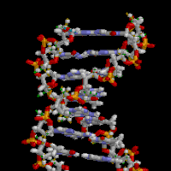
. Contextualized Skill Intervention**
Tx goals are explicitly addressed and also embedded in communicative contexts
Goal: mix drill on explicit skills with whole activities such as a story, thematic unit (like Native American/First People tribes), and other classroom curriculum

Slide 14
RISE:**
Repeated opportunities in an intense schedule with systematic support of explicit learning goals
Active engagement + multiple exposures = success!
Involves mixing whole and part activities along the way

Slide 15
Ukrainetz recommends combining drill and whole context learning—for example:**
SLP drills on irregular plural cards (this is one mouse—these are 2____) (drill/parts)
Play a game of Go Fish with the cards (whole)
Child drills SLP with cards and tries to catch SLP doing them incorrectly (drill/parts)
Write/tell a story with the cards (whole)

Slide 16
The SLP and or teacher can do this…

Slide 17
4th grade science: recycling lesson**
Here are the vocabulary words you will use to work on plural –s:
Wastes, pollutants, plastics, amounts, habitats, beaches
On an index card, pick one of the words above and write how you will work on it in therapy using this paradigm:
1. parts 2. whole 3. parts 4. whole

Slide 18
For example, with the word “beaches”**
1. Part—have the child repeat these words after me: beaches, shells, grains of sand, rocks, waves (drill)
2. Whole—Draw a picture that has all these objects and discuss the picture
3. Part—Have the child create sentences using each word (e.g., The shells are pretty.) [drill]
4. Whole—Watch a youtube video about conserving our beaches and discuss it afterwards, using the plural –s correctly

Slide 19
III. DYNAMIC ASSESSMENT**
DA evaluates the child’s ability to learn when provided with instruction
DA: determine whether a student has an underlying DLD or is a typical learner with environmental issues
DA tells us what kind of learning supports work best for each student

Slide 20
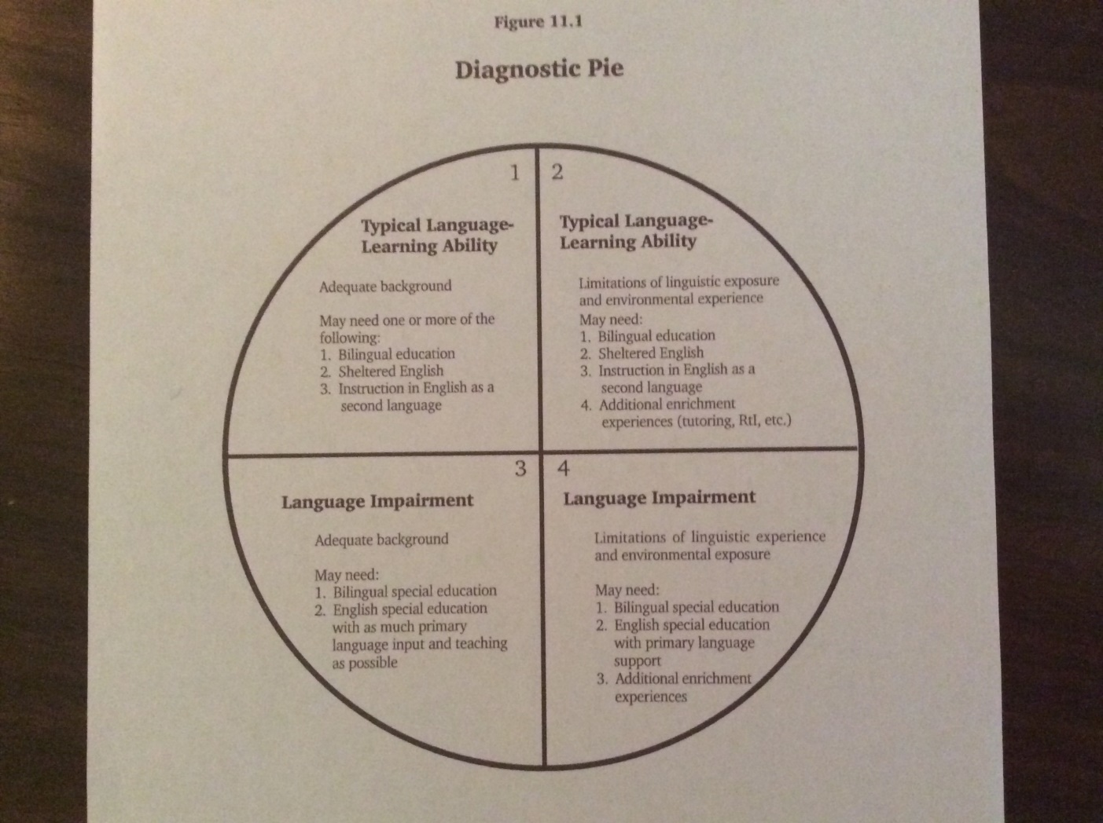
Diagnostic Pie (Roseberry-McKibbin, 2022)

Slide 21
IV. SYSTEMATIC LEARNING SUPPORTS**
A. Structural Learning Support
Simplify learning activities
Make sure environment is not distracting
Use oral and print language to support each other

Slide 22
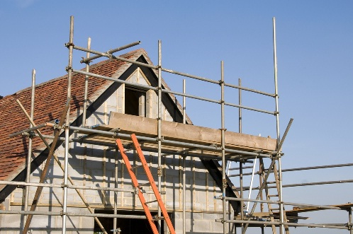
B. Interactive Learning Support
2 types: linguistic and regulatory scaffolds

Slide 23
1. Linguistic scaffolds (p. 130)

Slide 24
More linguistic scaffolds (p. 130)

Slide 25
2. Regulatory scaffolds**
Help student become a better learner
Include developing sustained attention, helping student manage challenges

Slide 26
Regulatory scaffolds can include growth mindset work**
This is based on the research of Carol Dweck at Stanford
I have been using it very effectively for the last few years with ages 3-22

Slide 27
V. DEVELOPING A GROWTH MINDSET(regulatory scaffolds)

Slide 28
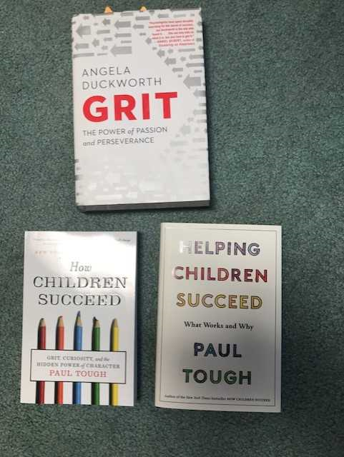
Other favorites (not on exam)**

Slide 29
When children are little:**
High levels of warmth and nurturance from caregivers promote bonding, attachment, and a secure foundation
However, when children reach early adolescence, motivated by a very different kind of nurturance—being challenged to work hard and improve themselves—a growth mindset

Slide 30
The research of Carol Dweck**
Divided people: 1) fixed mindset (FM), 2) growth mindset (GM)
FM: intelligence, other skills are inborn and static--not amenable to change

Slide 31
Those with a growth mindset…**
Believe that intelligence and overall skills can be improved with hard work
Students who believe that they can improve their intelligence and overall performance are more academically successful than those with a fixed mindset

Slide 32
We have believed for years in a “fixed brain,”**
or that we are born with a certain fixed amount of innate intelligence
Recent findings in neuroscience and cognitive psychology show: the brain has a great deal of plasticity and can be taught, even into older age
(I love the story of a student’s grandma, who began studying Spanish when she was 80!)

Slide 33
In Dweck’s research…**
Conducted a study with low-SES 7th graders in Texas. Over the school year, each student in the study worked with a college student mentor
Students in the control group heard standard messages about how drugs could interfere with academic achievement

Slide 34
Students in the experimental group…

Slide 35
Again, the experimental students heard that:**
The brain is like a muscle-- grows stronger with use
Every time you stretch yourself and learn something new, brain forms new connections

Slide 36
In other words…**
Experimental group heard: intelligence is not fixed—it’s malleable, can be ↑with hard work, grit, and perseverance
Good study habits were also taught

Slide 37
The researchers reported that:**
The image of new connections forming proved extremely motivating to the students in the pilot studies
They reported that as they paid attention in class or studied difficult material, they pictured their neurons growing new connections; and that when they considered not studying, they warned themselves that they would be missing a chance to form new connections

Slide 38
Students were taught that:**
The brain grows new connections every time we face challenges and learn, and that great mathematicians and scientists are people who have engaged in this process more than other people

Slide 39
We can also explain that it’s like trees growing out to touch each other**

Slide 40
At the end of the year, Dweck et al compared the 2 groups’ scores on Texas’ standardized achievement tests:

Slide 41
The researchers concluded:**
It is important, particularly if this era of high stakes testing continues, for students to understand that these tests assess current skills and not long-term potential to learn
This is critical since many students make take their disappointing achievement test scores as a measure of their fixed, underlying ability and become discouraged about their academic futures

Slide 42
Interestingly, the researchers also found that:**
Students with a fixed mindset are threatened by challenges, effort, and mistakes--these are things threaten to reveal the limits of students’ ability
We portray effortless achievement as the sign of true talent. Many bright students, praised for their easy successes, may believe that they are gifted only when things come easily to them.

Slide 43
We can help students by…**
Teaching them about the new science of brain plasticity and the new view of talent and giftedness as dynamic attributes that can be developed.
Too often, the brain is believed to be static, and talent and giftedness are seen as permanent, unchanging personal attributes that automatically bring later success

Slide 44
**Our research (Cimpian, Arce, Markman, & Dweck, 2007; Kamins & Dweck, 1999; Mueller & Dweck, 1998) has shown that giving students praise for their intelligence, as opposed to praise for process (such as effort or strategy) makes students think that their abilities are fixed, makes them avoid challenging tasks (so they can keep on looking intelligent), makes them lose confidence and motivation when the task be-comes hard, impairs their performance on and after difficult problems, and leads them to lie about their scores afterwards.

Slide 45
On the other hand….**
Process praise (e.g., for effort or strategy) leads students to seek and thrive on challenges.

Slide 46
Process praise is best:

Slide 47
**Process praise contributes to much better outcomes than intelligence or product praise
“You are such a hard worker. I’m really excited about how you’re stretching yourself now and working to learn hard things.”
It may take more time for you to catch on to this and be comfortable with this material, but you if you keep at it like this you will.”

Slide 48
I never say:

Slide 50
Examples of what to say:**
“Let’s go around and have each of you share something hard you learned today that you didn’t know before.”
“Who had a good struggle? Let’s share what we struggled with today”
“Get ready for a terrific struggle! Are you ready? Here we go.”
“That was a lot of hard work. Can you just imagine all the connections you grew today?”
“Who thinks they made a really interesting mistake?”
“Who else made a terrific mistake that will help us learn?”

Slide 51
Me with a defiant (and huge!) 15-year old with Fetal Alcohol Syndrome and a history of violence:**
Dr. R.: “Kiree, I want you to do 50 productions of sentences with slow, careful speech.”
Kiree: “No way. I can’t.”
Dr. R.: (after the hour was up): “Just so you know, you did 120 good productions. You didn’t even think you could do 50! Look at you! “

Slide 52
Recent research concludes:

Slide 53
A study cautions that too much screen time can decrease students’ grit and perseverance**
Pressman, R.M., Owens, J.A., Evans, & Nemon, M.L. The American Journal of Family Therapy, 42 (5), 347-363.
“Examining the interface of family and personal traits, media, and academic imperatives using the learning habit study.”
They studied family routines in 46,000 U.S. homes of children in grades K-12 via an online survey.

Slide 54
Major findings:

Slide 56
If we have time….**
The 74 explains how to teach your baby grit
Youtube video
https://www.youtube.com/watch?v=92z9fD4rotU
13-month old babies tried harder on a difficult task if they saw an adult struggle and persevere on a hard task!

