Slide 1
ASSESSMENT AND TREATMENT OF SCHOOL-AGED STUDENTS WITH WORKING MEMORY DEFICITS

Slide 2
Power Point Outline**
I. Introduction
II. Types of Memory
III. Assessment of WM Skills
IV. Intervention for Deficits in memory Skills
V. New Techniques for Targeting Phonological Awareness

Slide 3
I. Introduction**
Recent research: strong relationship between working memory (WM) and language development
WM affects the rate at which children learn new vocabulary, comprehend language, acquire literacy skills, and gain academic knowledge

Slide 4
Gray et al. (2022). Working memory predicts new word learning over and above existing vocabulary and nonverbal IQ. Journal of Speech, Language,and Hearing Research 65 (3), 1044-1069**
Subjects: 167 English-speaking 7-8 year olds who were typically developing
The subjects completed a battery of assessments of working memory (WM)

Slide 5
Gray et al. 2022 found:

Slide 6
Children’s WM skills when they enter school…

Slide 7
Research out of Princeton: https://www.princeton.edu/news/2021/03/31/attention-and-working-memory-two-sides-same-neural-coin

Slide 8
Fogle, 2023:**
When you walk across the grass once, it springs back quickly; there’s no trace of your steps
When you walk across it many times, a path emerges
That’s how we build neural pathways and memories

Slide 9
Morrow, E.L., & Duff, M.C. (2020). Sleep supports memory and learning: Implications for clinical practice in speech-language pathology. American Journal of Speech-Language Pathology, 29, 577-585. **
Sleep disturbances affect quality of tx for clients
Poor sleep quality affects memory and learning, especially long-term memory
SLPs: educate caregivers about poor sleep and its short- and long-term negative impact on memory and learning

Slide 10
II. Types of Memory**
Montgomery et al. (2021, April). A new memory perspective on the sentence comprehension deficits of school-age children with developmental language disorder: Implications for theory, assessment, and intervention. Language, Speech, and Hearing Services in Schools, 52, 449-456.

Slide 11
Montgomery et al.:

Slide 12
Long term memory considerations:

Slide 13
Remember the primacy and recency effects:**
We best remember what came first and what came last

Slide 14
Working memory:**
Temporary memory used in information processing
WM is information that is in an active or accessible state and is used to complete some form of mental activity

Slide 15
I picture working memory like driving while you are listening to Siri after having looked at a map**
1. Look at the google map and get the visual
2. Drive and listen to Siri tell you what to do while retaining the visual google map in your head ☺

Slide 16
III. Assessment of WM Skills

Slide 17
Examples of WM:

Slide 18
To relate WM to the classroom setting, assess the child’s abilities in:

Slide 19
To assess the child’s ability to retain words in mind while identifying common features**
“Listen: banana, strawberry, apple. All of these are _______”
“Jupiter, Mars, Earth, Venus. All of these are______”

Slide 20
CELF-5 subtests that address working memory as well as language:

Slide 21
IV. Intervention for Deficits in Memory Skills**
A. Modify the Environment to Reduce Demands on WM
Repeat info, have visuals, slow down….what else?
Lists of required tasks, stop and have child summarize

Slide 22
How to Optimize Working Memory in the Classroom
https://www.youtube.com/watch?v=pK9aJdWOVSE
Great little video that is not on the exam

Slide 23
B. Direct Memory Intervention Techniques

Slide 24
There are some computerized programs:**
CogMed Working Memory Training
Fast ForWord Language

Slide 25
Kathy Kohnert and colleagues:
Nonlinguistic interactive games and computer tasks can positively impact lang skills

Slide 26
Roseberry’s Recommendation:**
Order Simon Trickster app for your iPad
Let the child play it as a reward ☺

Slide 27
https://www.youtube.com/watch?v=NudoGrbvJHM
Supersized Simon Swipe at KID group studio
Youtube video
You can get the app or a much smaller game+

Slide 28
Use instruments!

Slide 29
Music, rhythm, and movement:

Slide 30
B. Other direct intervention techniques:

Slide 31
There are various ways to encode more deeply—elaborative encoding:**
1. Visualization; if you exaggerate the picture with color and movement, better
2. Reauditorization (repeating things out loud) builds a phonological representation
3. Writing things down

Slide 33
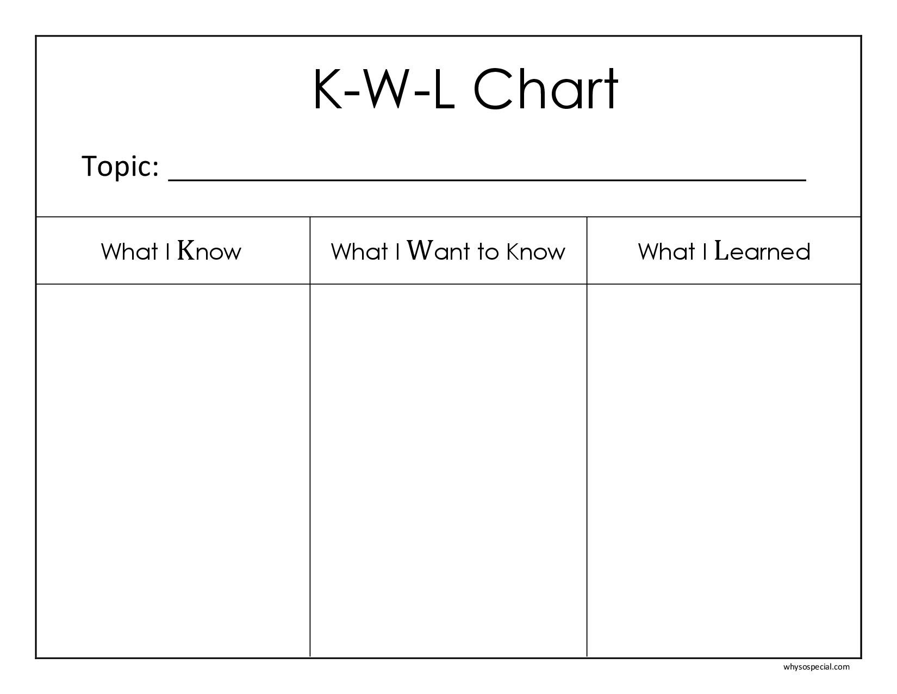
Activate prior knowledge through KWL charts:

Slide 34
An example:
telepractice
It’s good for clients in remote areas
How do I use it successfully with kids in tx?
With children, it’s mostly about cooperative caregivers

Slide 35
Creating novelty--here is an example of how to engage these ideas to memorize spelling words:** (Essay question on test 2)
Day 1: Read words in meaningful sentences
Day 2: Break words into chunks using magnetic letters
Day 3: Spell words aloud into your phone using an animated, interesting voice. Play the recording back as you look at the words. Make a picture of each word in your brain, exaggerating its characteristics.

Slide 36
Day 4: Write words using different media—**chalk, pencil, crayon, tracing in sand
Day 5: Write each word 10x with a pen/pencil. Go over words with a friend, quiz each other

Slide 37
Introduce emotion**
Tell stories that elicit positive or negative emotions in the listener
Children will remember info better!

Slide 38
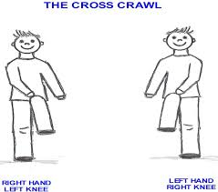
Use brain gym exercises to cross midline—this enhances concentration**

Slide 39
Let’s cross midline now!
https://www.youtube.com/watch?v=ZbZSe6N_BXs
Pharrell Happy ☺

Slide 40
Singer, B.D., & Bashir, A. Language, Speech, and Hearing Services in Schools, 49, 449-462**
Our field is really beginning to question the use of computer programs that “build memory”
The very most current thinking is that use of decontextualized, computer-based treatment approaches to increase the verbal working memory capacity of children with SLI are not likely to transfer to authentic learning contexts

Slide 41
Singer & Bashir:

Slide 42
Singer & Bashir use:

Slide 43
Singer & Bashir continued:**
Students represent their thoughts visually with a visual schema or frame that develops over time as they actively process the information

Slide 44
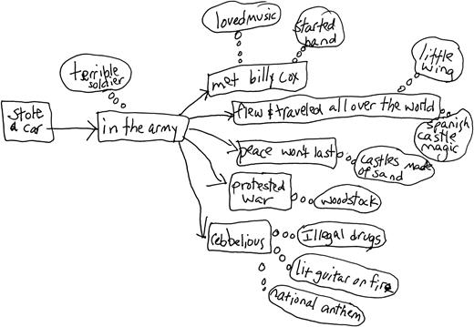
Singer & Bashir**

Slide 45
Senter et al. (2024). SLP interventions for children with executive function deficits: A systematic literature review. LSHSS 54 336-354.**
They conducted a systematic review of the literature to provide research-based suggestions for SLPs who work with students with executive function deficits, including working memory
The most effective strategies are teaching and rehearsing graphic organizers (like Singer and Bashir) and self talk scripts

Slide 46
Examples of self talk scripts (think growth mindset)**
“This is tough, but I can do it with hard work.” ...
“I can stop and make a plan before starting.” ...
“I can breathe in and out to stay calm.” ...
“I am in control of my choices.

Slide 47
Larson, C., & Weismer, S.E. (2022). Working memory performance in children with Developmental Language Disorder: The Role of domain. Journal of Speech, Language, and Hearing Research, 65, 1906-1920.**
Examined role of WM in 9-13 year old children with DLD
Subjects in this study with DLD performed worse on WM tasks than typically-developing Ss

Slide 48
Larson & Weismer (2022) recommended:

Slide 49
V. New Techniques for Targeting Phonological Awareness**
Much recent research also ties memory to phonological awareness
We will build on your prior knowledge of PA with some new research and hands-on activities

Slide 50
Spoonerisms are very helpful in building phonological awareness skills:

Slide 51
Practice changing these sentences into spoonerisms:**
I love teaching this class. I tove leaching clis thass.
It is fun to study child language.
I am working to become a speech-language pathologist.
The holidays are coming soon.

Slide 52
Practical strategy from Dr. Carol Hammer, ASHA:**
We will make Elkonin boxes
Write 5-letter words on strips of paper
Start by having the child touch each phoneme with their finger as they move along and sound it out
Then, cut the strips into fifths so that you have individual letters
Play a game where you make new words
See how many words you can make! ☺

Slide 53
Power Point Outline
I. Introduction
II. Types of Memory
III. Assessment of WM Skills
IV. Intervention for Deficits in WM Skills
V. New Techniques for Targeting Phonological Awareness

