Slide 1
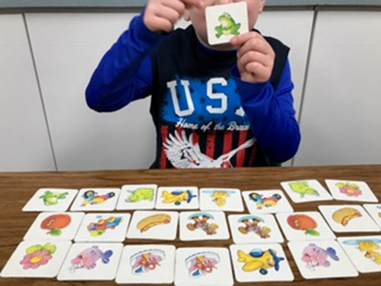
Trauma-Informed Intervention for Students with Communication Disorders: Practical Strategies and Materials Celeste Roseberry-McKibbin, Ph.D., CCC-SLP San Juan Unified School District Sacramento State University

Slide 2
To get the full PowerPoint with all the pictures:
Go to my website
https://webpages.csus.edu/celeste/
Click on the Workshops link

Slide 3
To connect on social media:
Instagram:
dr.celesteroseberry
Tik Tok:
@celesteroseberry
Facebook: Celeste Roseberry

Slide 4
Outline
I. Introduction
II. Possible Effects of Trauma on Language and Cognition in Mainstream and Diverse Children
III. Trauma-Responsive Strategies for Intervention for Students with Communication Disorders
IV. Restorative Justice Strategies for Addressing Hurtful Behavior
V. Stress Reduction Techniques
VI. Implementing a Growth Mindset

Slide 5
II. Possible Effects of Trauma on Language and Cognition of Children
We have increasing numbers of students coming to school who have experienced trauma
This is due to reasons such as the Covid-19 pandemic, wars (leading to increased numbers of immigrants and refugees), displacement, etc.

Slide 6
I was blessed to work face to face through the whole pandemic…
From March 2020-March 2021, I did F2F intervention with preschoolers in our special day class with no vaccine
I also assessed diverse students F2F whose cases were urgent
I didn’t’ get Covid! ☺

Slide 7
I have the perspective…
Of having worked F2F before, during, and after the pandemic
It’s been a revelation to see how today, children’s background exposure is SO limited

Slide 8
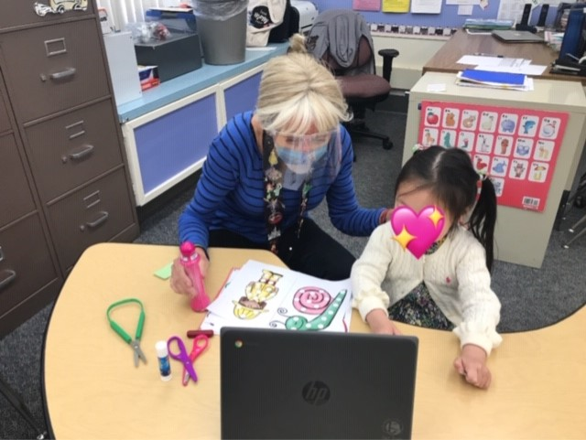

Slide 10
Remember the words of wisdom from Indigenous education scholar Eve Tuck (Unangax̂)
She asks that we turn away from damage-centered trauma approaches and create space for the complexities of resilience, determination, and desire for change in our students and communities
She emphasizes a strengths-based approach where students’ and families’ resilience is emphasized

Slide 11
Basically, we…
Tap into the base of knowledge and core of resilience that trauma-exposed clients bring to the intervention process

Slide 12
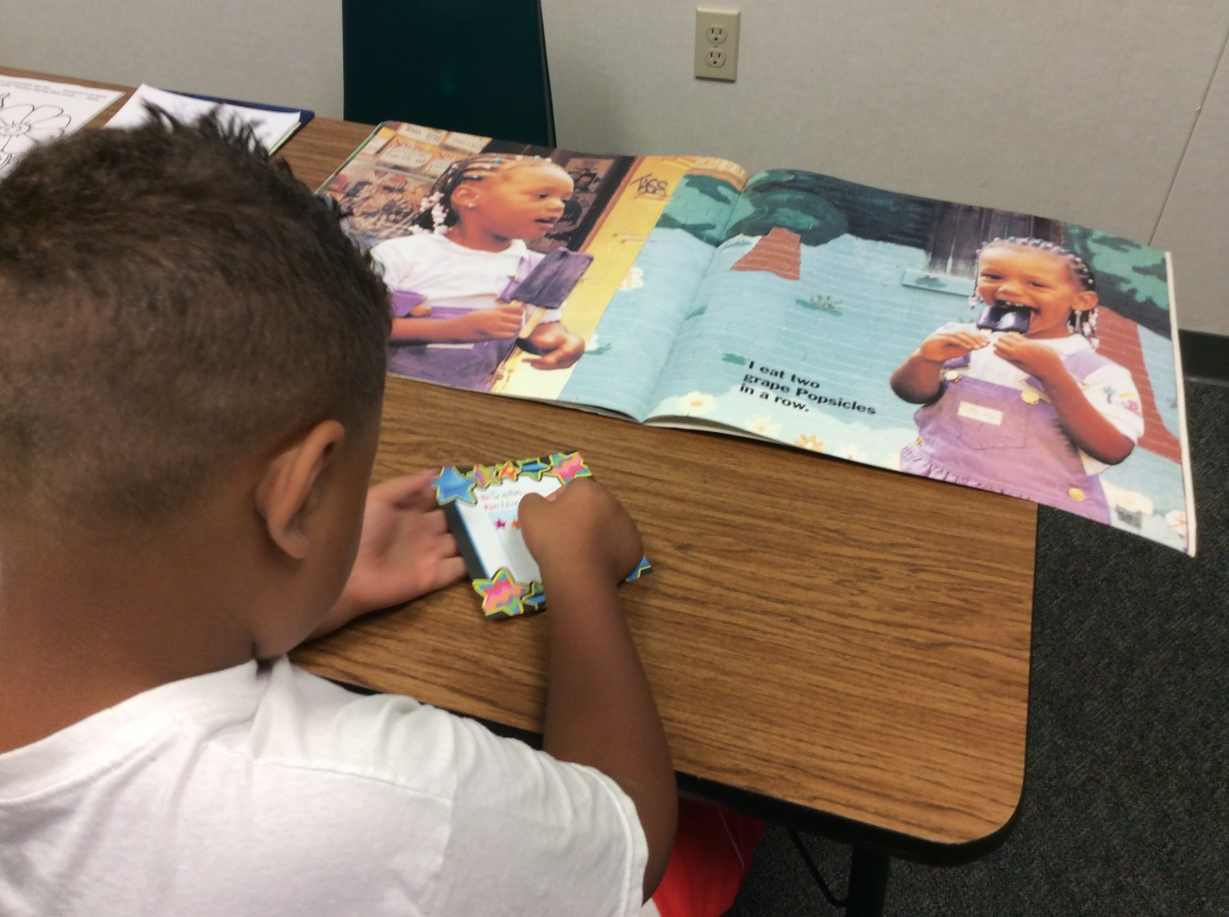
Experiences that can induce trauma include:
1. High mobility and interrupted school opportunities
2. Being unsheltered
3.Experiencing chaos (e.g. multiple people coming in and out of the house)
4. Living in crime-prone areas
5. Experiencing neglect/abuse (NA)

Slide 13
The most commonly-occurring form of maltreatment is neglect
Neglect is not necessarily tied to poverty
Many forms of neglect occur within the context of adequate resources
Complex trauma can occur when children experience neglect and/or abuse
Complex trauma--long-lasting negative physical, emotional, and cognitive consequences

Slide 14
Recent research:
Has shown that mothers experiencing poverty are prone to depression
Depression can lead to neglect, which impacts expressive language skills especially

Slide 15
II. Possible Impacts of Trauma on Language and Cognition—Deficits in:
Vocabulary
Narrative cohesion
Social skills/pragmatics (TOM—taking others’ perspectives)
Reading
Phonological awareness
Self-regulation/impulse control
Memory

Slide 16
Deficits in working memory…
Are often created by trauma-induced stress which leads to increased cortisol production

Slide 17
Because some students have difficulty with impulse control
They may act out physically and try to harm themselves, other students, and even you
With my teen young men who have tried to commit murder, I always sit across the table and right near the open door so I can run if necessary

Slide 18
For SLPs who work with children, it is recommended to:
Take a basic self-defense class
Wear flat, comfortable shoes for running!
Avoid hoop earrings
Nope!!
Also a no!!

Slide 19
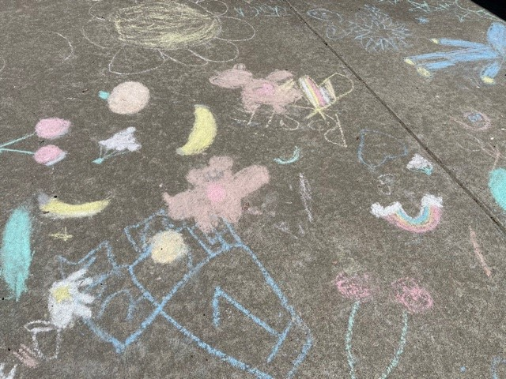
IV. Trauma-Responsive Strategies for Intervention for Students
Art can be a great way for students to express themselves
At Ethel Philips Elementary, therapists and social workers help students expresss themselves with sidewalk chalk

Slide 20
Provide caregivers with resources:
Food, shelter, free medical services (e.g., dentists)
Point out what caregivers are already doing right
Provide caregivers with support groups if possible

Slide 21
Be consistent! At CSHA with CSUS alum Lorraine H., who works at the Stockton Juvenile Facility—”Keep your promises.” Use reflective listening—make them feel heard, even though you have no solution

Slide 22
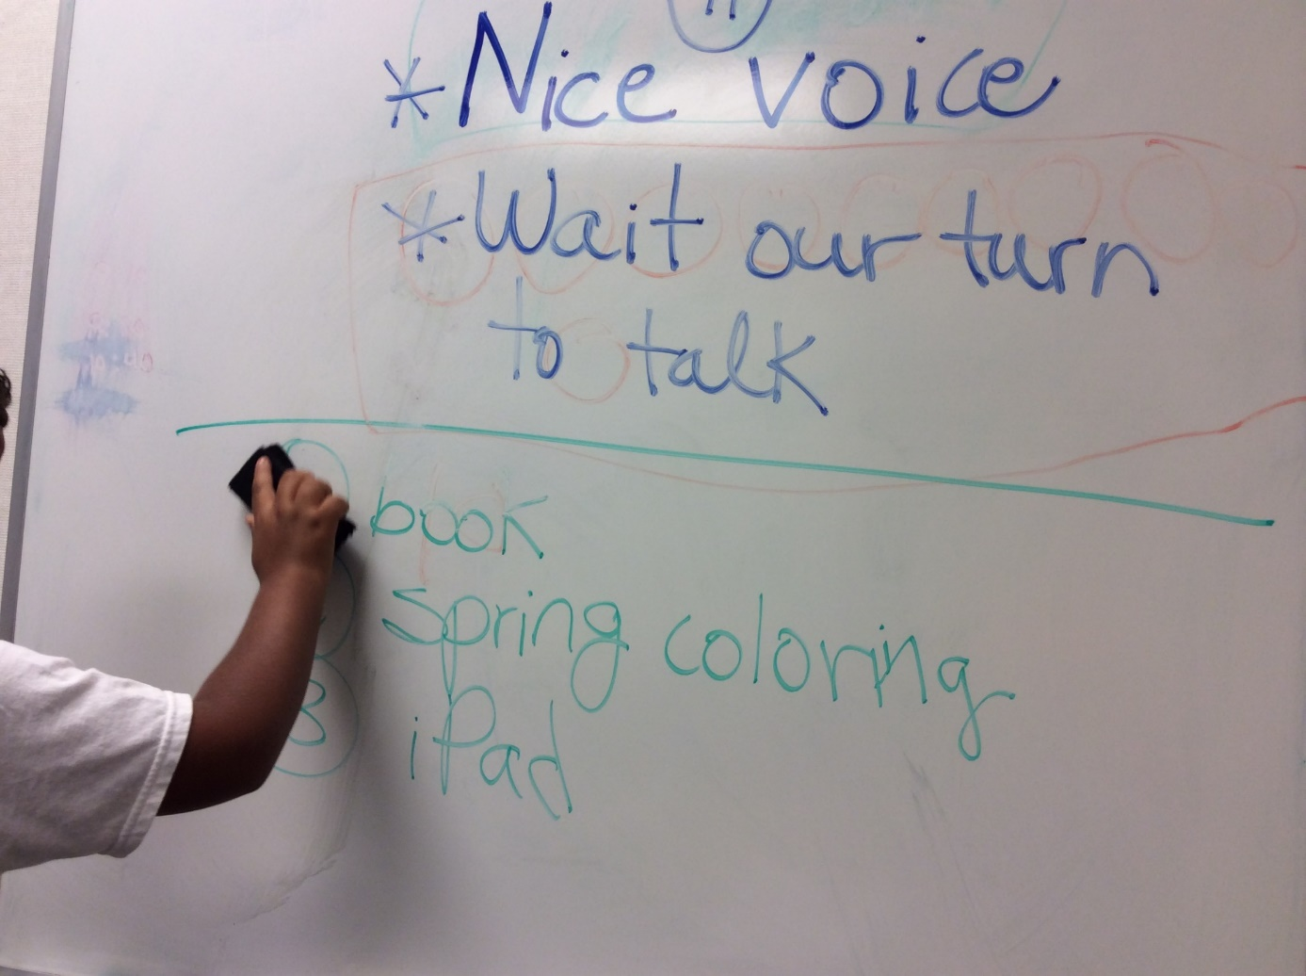
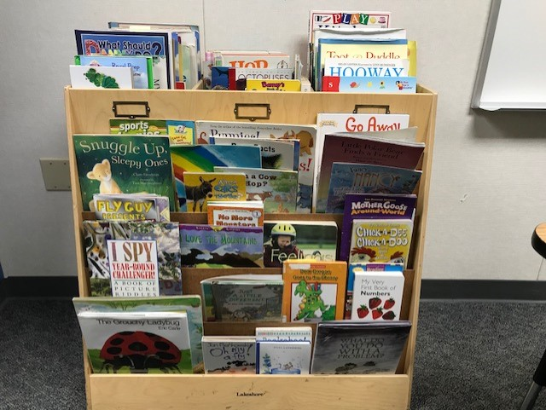
Provide the student with some control over the environment:
Have a list of activities and have them pick which one they want to do first
Have them erase activities as they are completed
Let them choose a book to read

Slide 23
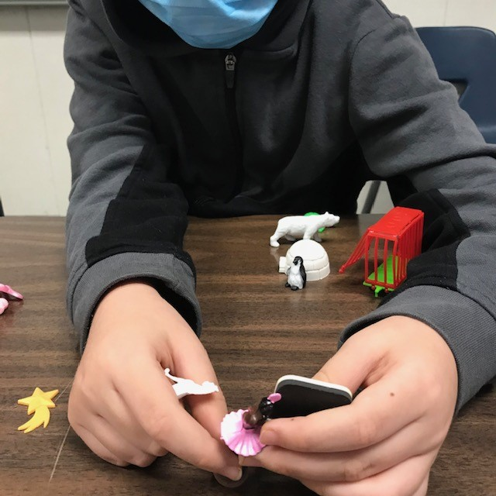
Provide hands-on sensory experiences and physical play

Slide 25
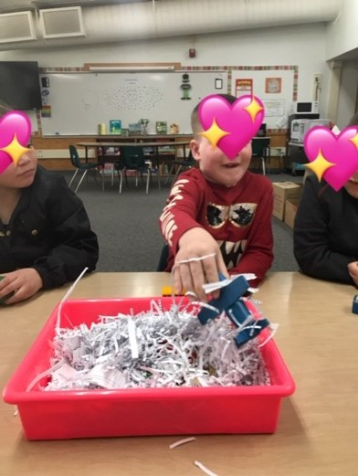

Slide 26
Kids loooove shaving cream! And our little therapy room smells heavenly!

Slide 27
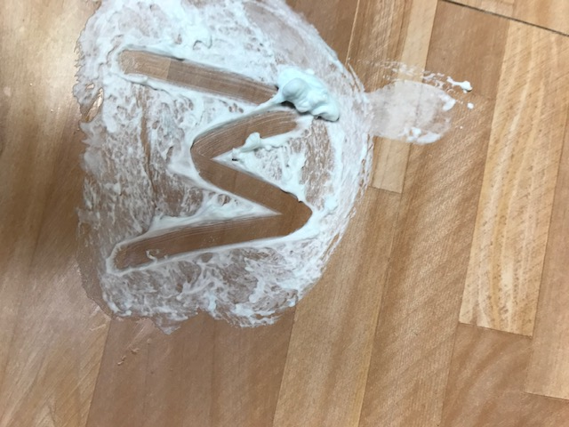
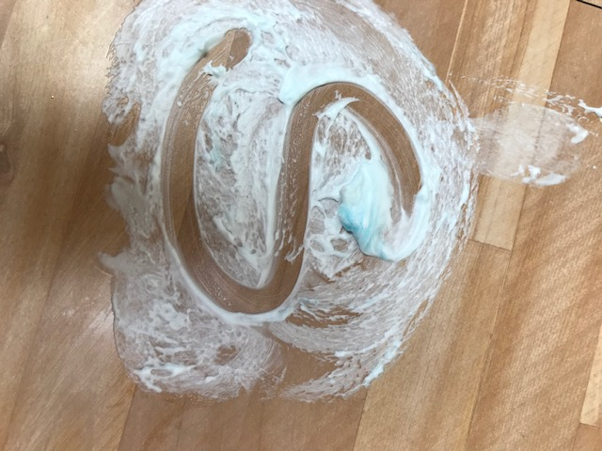
Shaving cream gives good tactile feedback in writing letters and words:

Slide 28
Haley traces her name in the sanitizing spray at the end of therapy

Slide 29
Melissa and Doug

Slide 30
Soft sensory balls are comforting

Slide 32
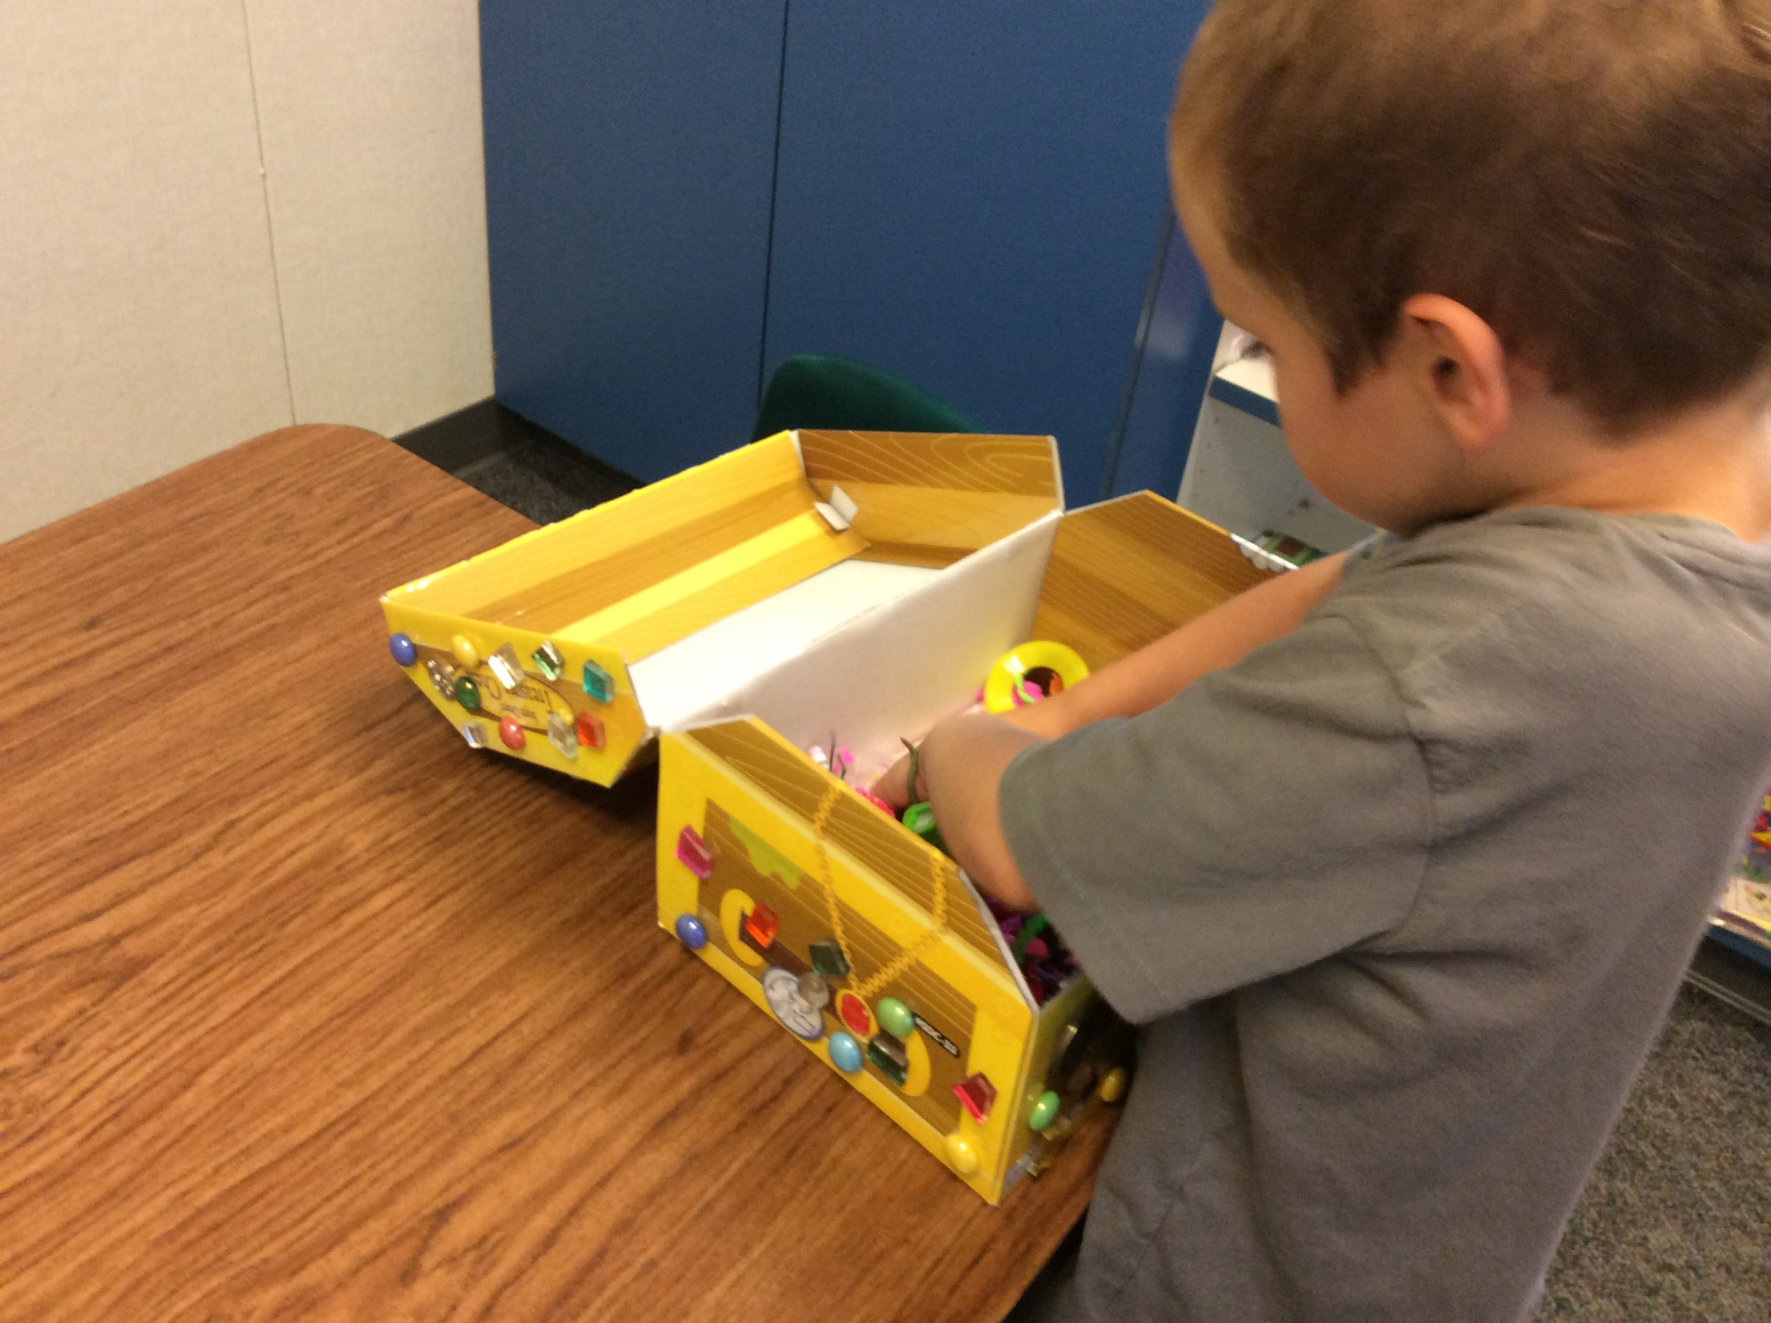

Slide 33
Incorporate a growth mindset—it’s about hard work and effort!

Slide 35
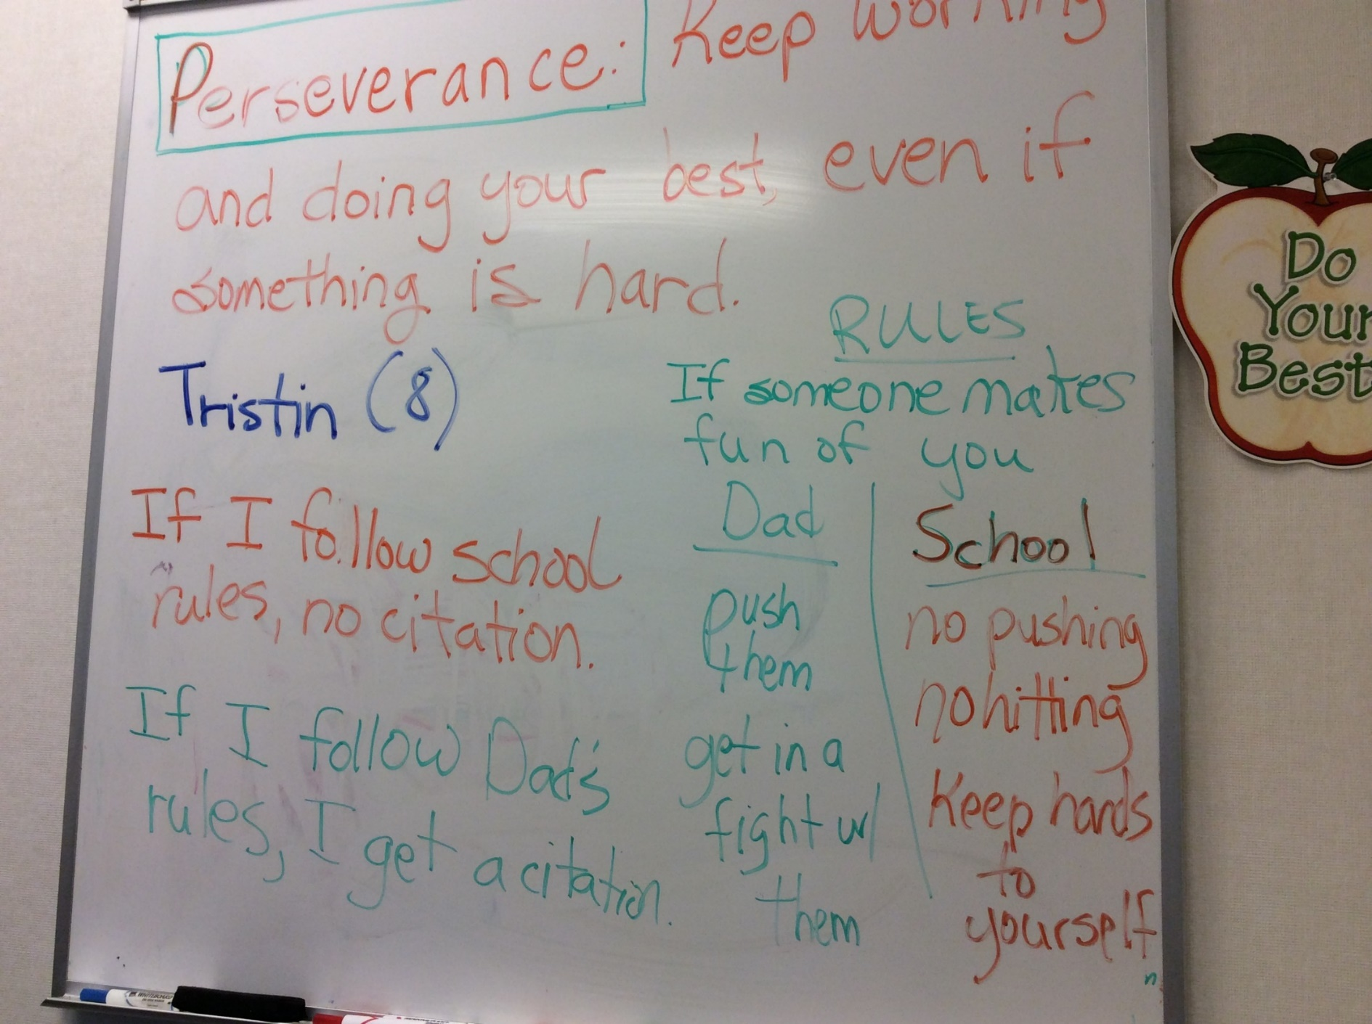
Discuss the language of feelings
Give students the vocabulary to describe what they are feeling
Talk about ways to handle negative emotions without hurting others

Slide 36
“Sarah,” 7 years, reads all but 2 sight words fluently and tells me her story

Slide 37
Social stories (e.g., Carol Gray )
I also like Michelle Winner-Garcia’s stories and materials
We can show videos that are funny and help kids see the impact of their behavior on others—without hurting their feelings
We ask “How is Donkey annoying? What could he do instead?”
https://www.youtube.com/watch?v=BY9Kxa6AdZ0

Slide 38
Explicitly teach empathy and theory of mind skills
Help students learn how to feel and respond to the emotions of others
Help them learn to express empathy
Help them learn appropriate school behavior

Slide 39
There are great youtube videos:
Following Expectations at School Video Social Story
https://www.youtube.com/watch?v=uDafP7lbmvI
Choosing a Tool to Stay Calm at School Video Social Story
https://www.google.com/search?q=Choosing+a+Tool+to+Stay+Calm+at+School+Video+Social+Story&rlz=1C1GCEA_enUS1076US1076&oq=Choosing+a+Tool+to+Stay+Calm+at+School+Video+Social+Story&gs_lcrp=EgZjaHJvbWUyBggAEEUYOTIHCAEQIR

Slide 40
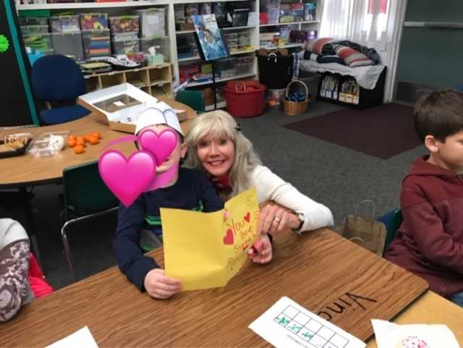
Use play to teach positive ways to share emotions face to face through verbal and nonverbal means (Vincent)

Slide 41
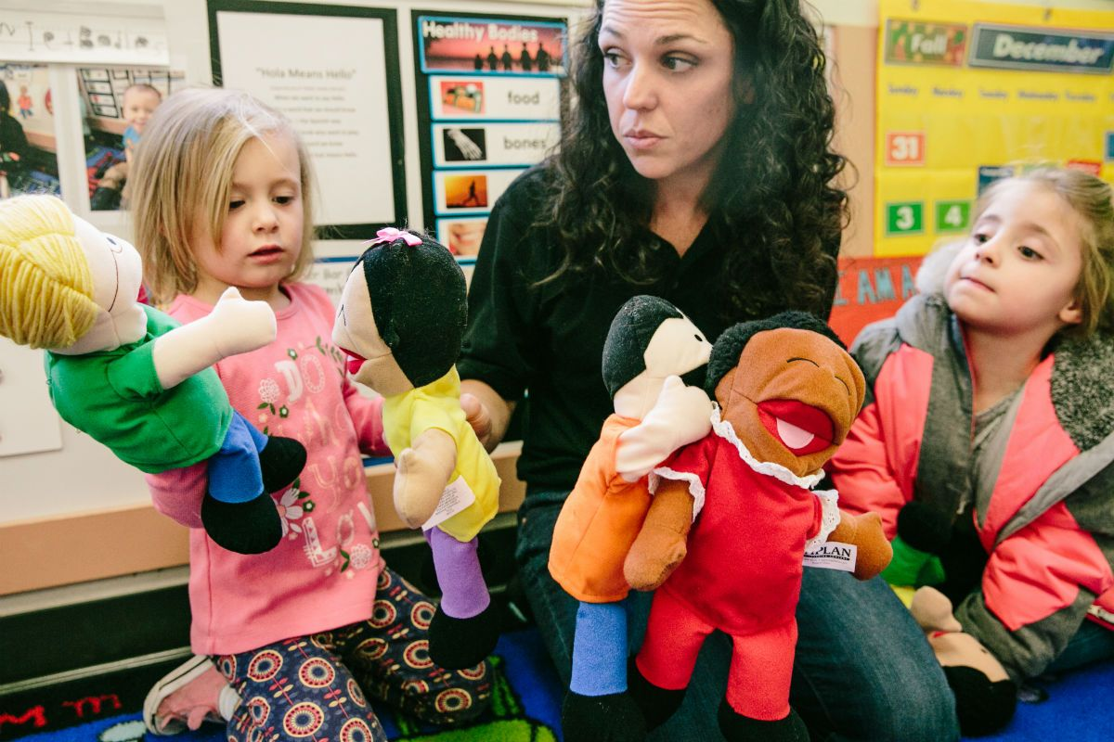
Puppets can help students express their feelings

Slide 42
Kimochis—Ellen Pritchard Dodge—for young children:

Slide 43
For older students—these are activities at the high school where I serve high-risk teen young men:

Slide 44
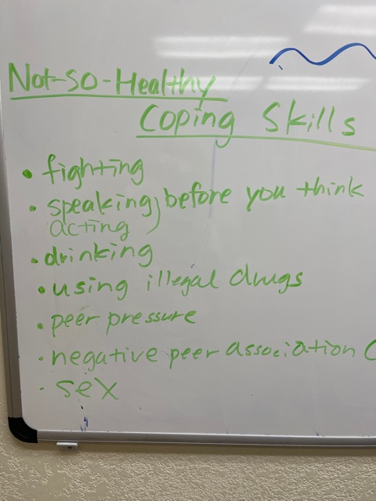

Slide 45
Start each therapy session:
With a “high and low” of the day
“We got a new puppy!”
“My uncle just got out of prison!”

Slide 46
Discussion starters after a traumatic event:
What has this been like for you?
How have you been taking care of yourself?
How have you been taking care of others?
Where have you seen helpers?
How can we support each other?
How did you help your family during or after the disaster?
How could you help your family if you were in another disaster?
Did anything good or positive happen because of the disaster?
Did you learn anything?
What has this experience made you grateful for?

Slide 47
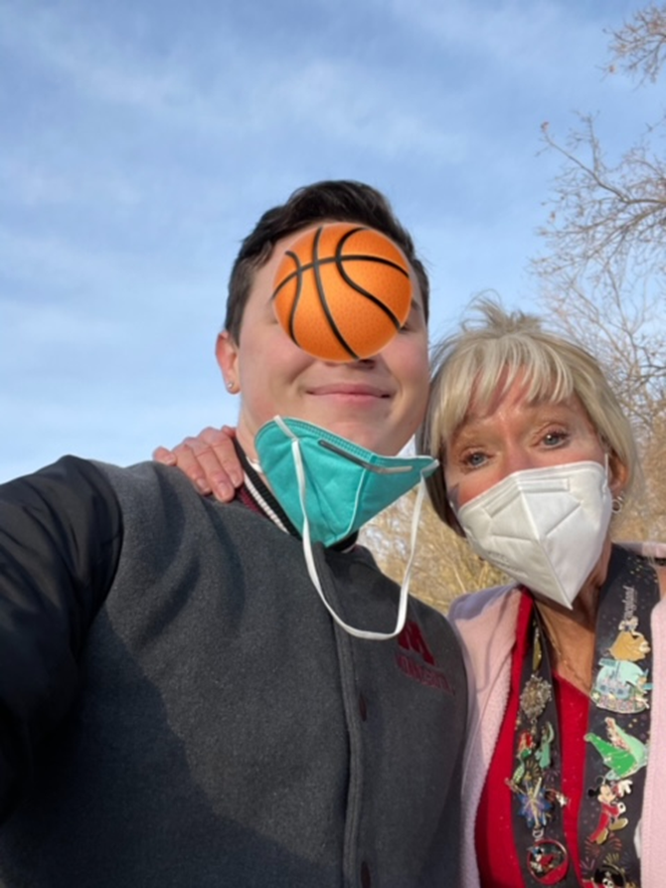
Ramon as we are walking along practicing /r/:
My uncle just got sentenced to life. He is 24. When he was 19, as part of gang activity he shot and killed 2 teenagers.

Slide 48
For older students…
Dialogue journals help
They write out their thoughts in a safe space
The professional then writes responses
A reciprocal relationship is established

Slide 49
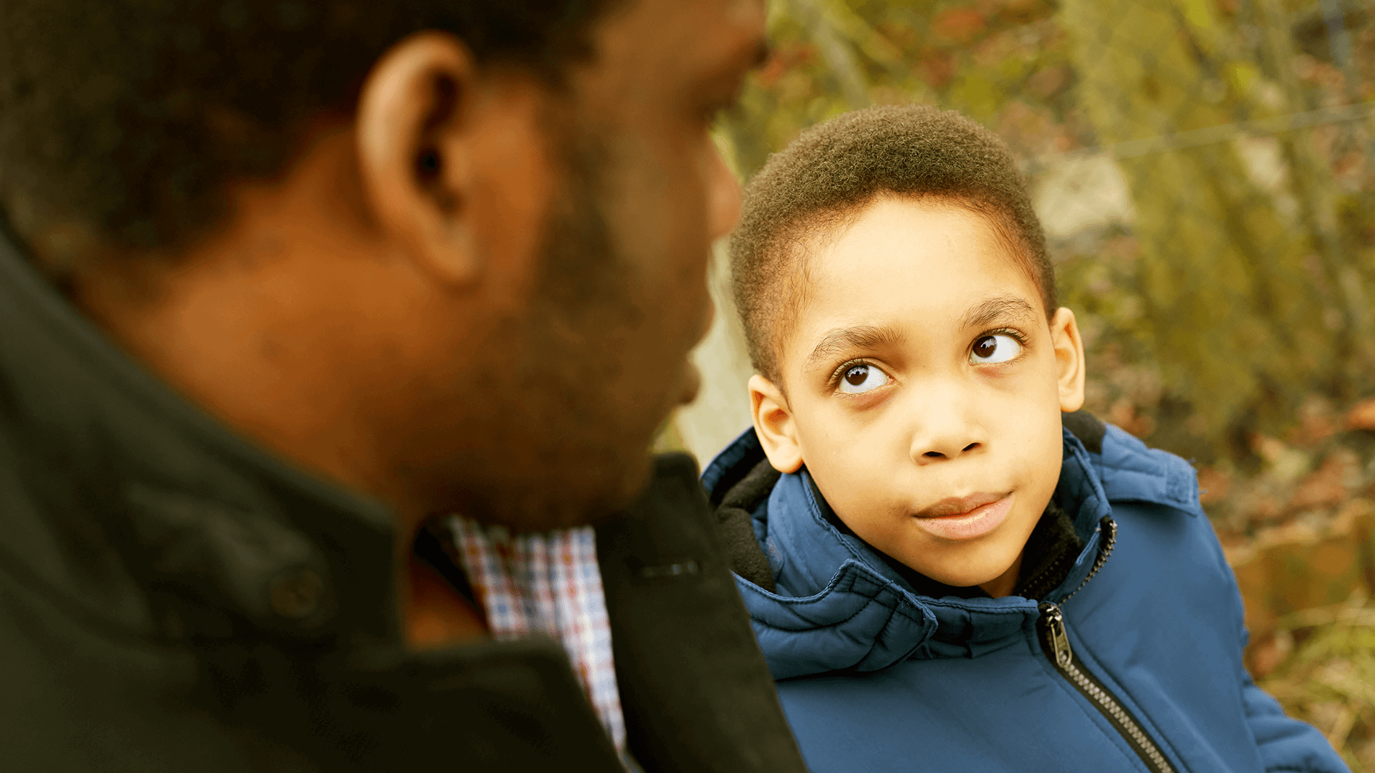
Caring mentors are very helpful
In some studies, they have found positive emotional and academic outcomes when children/students meet with mentors 1-4 hours per week
In some high schools, there is a service learning component where you need to do X hours of community service to graduate from high school
College students are a great resource—Generation Z is documented to be the best of all generations at caring for and bettering their communities

Slide 50
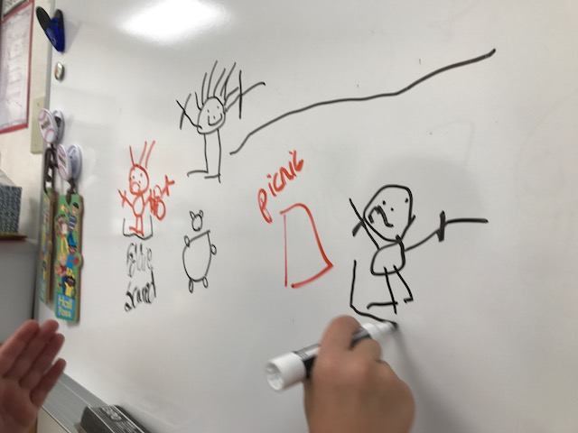
Target narrative skills
Make story books where students draw out and write about their daily routines
Help them draw out stories sequentially

Slide 51
Train students:
To use positive self talk and a growth mindset
Many have learned helplessness as a result of trauma

Slide 52
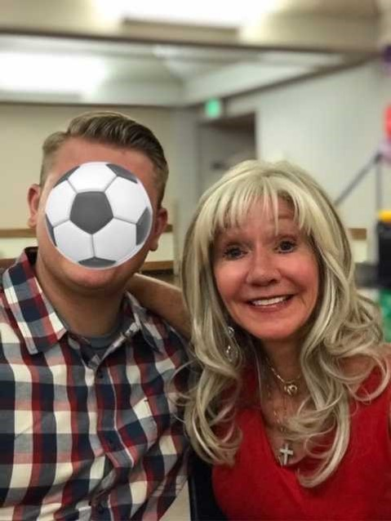
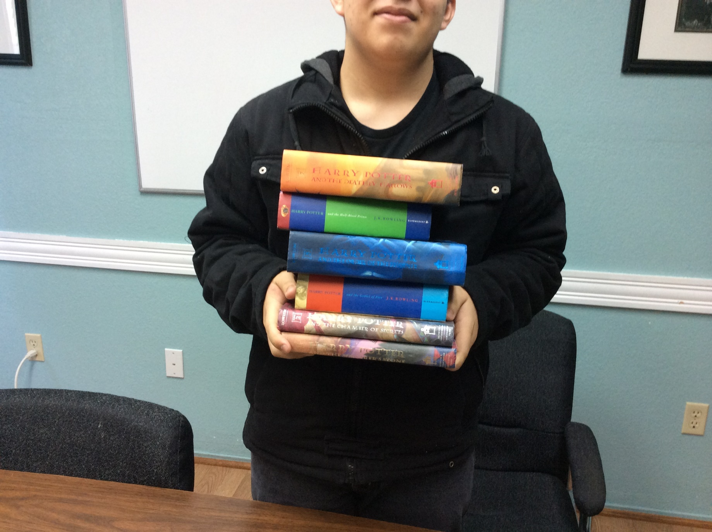
V. Restorative Justice Strategies for Addressing Hurtful Behavior
The high security school where I see my teen young men is a restorative justice facility

Slide 53
It’s important…
To not ask “What is wrong with the student?”
Instead, ask “What happened to the student?”
This uses a restorative lens and helps work toward healing

Slide 54
Principles of Restorative Justice—Help Students:
1. Take responsibility for their actions
2. Learn how they can rectify the harm they have done
3. Restore relationships with individuals they have harmed
4. Reflect on how their behavior affects others
5. Improve their interpersonal communication skills

Slide 55
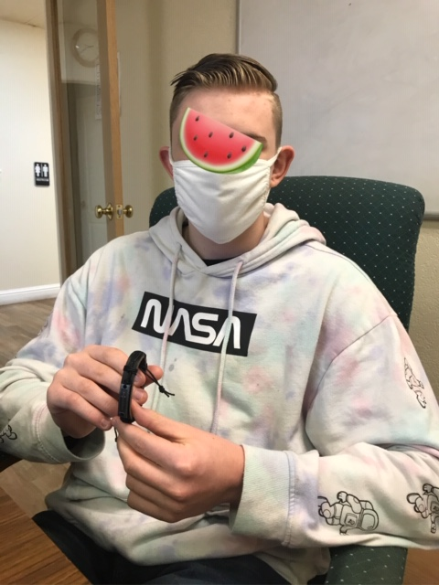
VI. Stress Reduction Techniques
Jappa meditation helps Emlin, who is very nervous and has Tourette’s

Slide 56
Fidget toys can be helpful:

Slide 57
If the child is scared to go to a new setting:
Have them take a transfer object such as a toy car, blanket, stuffed animal

Slide 58
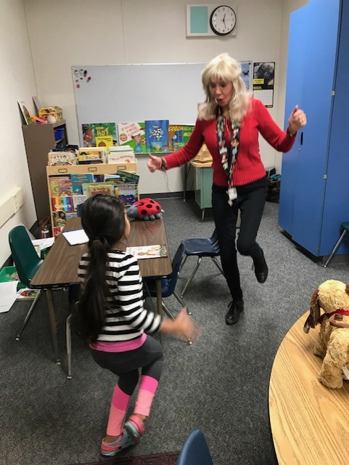
Exercise is the best!

Slide 59
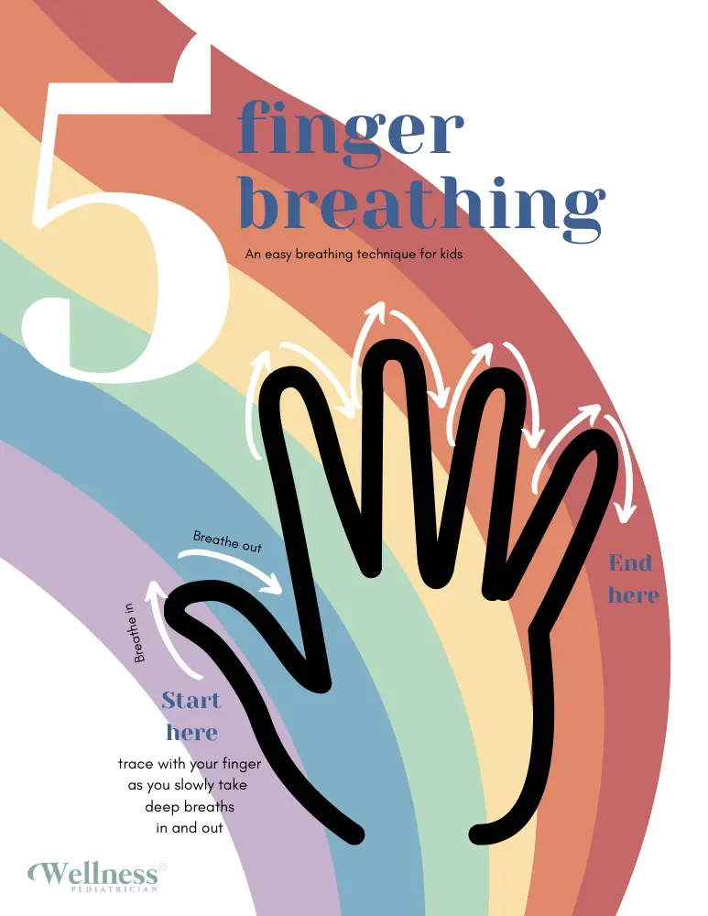
Practice Finger Breathing with a Partner—Great Stress Management Tool!
Stretch one hand out so that you have space between your fingers.
Hold up your pointer finger from the other hand.
Start at the bottom of your thumb. Use your pointer finger to trace up your thumb as you slowly breathe in through your mouth.
When you get to the top of your thumb, slowly breathe out your nose as you trace down the other side.
Repeat for all fingers until you have traced your whole hand.

Slide 60
I’m beginning every therapy session with deep breathing and affirmations

Slide 61
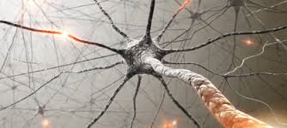
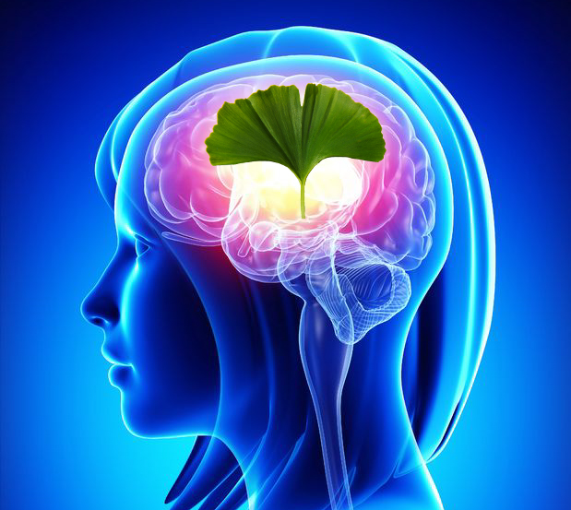
VI. IMPLEMENTING A GROWTH MINDSET TO SUPPORT TRAUMA-INFORMED INTERVENTION

Slide 62
Many trauma-exposed students…
Exhibit learned helplessness
Using a growth mindset approach to therapy helps all aspects of life!

Slide 63
When children are little:
High levels of warmth and nurturance from caregivers promote bonding, attachment, and a secure foundation
However, when children reach early adolescence, they are motivated by a very different kind of nurturance
This includes being taken seriously and challenged to work hard and improve themselves—a growth mindset

Slide 65
The research of Carol Dweck
Divided people into 2 types: those who have a fixed mindset, and those who have a growth mindset
Those with a fixed mindset believe that intelligence and other skills are inborn and static, or not amenable to change

Slide 66
Those with a growth mindset…
Believe that intelligence and overall skills can be improved with hard work
Students who believe that they can improve their intelligence and overall performance are more academically successful than those with a fixed mindset

Slide 67
We have believed for years in a “fixed brain,” or that we are born with a certain fixed amount of innate intelligence
Recent findings in neuroscience and cognitive psychology have shown that the brain has a great deal of plasticity and can be taught, even into older age
(I love the story of a student’s grandma, who began studying Spanish when she was 80!)

Slide 68
In Dweck’s research…
They conducted a study with low-SES 7th graders in Texas. Over the school year, each student in the study worked with a college student mentor
Students in the control group heard standard messages about how drugs could interfere with academic achievement

Slide 69
Students in the experimental group…
Heard growth mind-set messages from their mentors
For example, mentors would say “intelligence is not a finite endowment, but an expandable capacity that increases with mental work.”
“The brain is like a muscle—the more you use it, the stronger it gets.”

Slide 70
Again, the experimental students heard that:
The brain is like a muscle that grows stronger with use, and that every time you stretch yourself and learn something new, your brain forms new connections

Slide 71
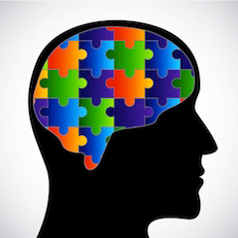
In other words…
The experimental group heard the message that intelligence was not fixed—it was malleable, and could be increased with hard work, grit, and perseverance

Slide 72
The researchers reported that:
The image of new connections forming proved extremely motivating to the students in the pilot studies
They reported that as they paid attention in class or studied difficult material, they pictured their neurons growing new connections; and that when they considered not studying, they warned themselves that they would be missing a chance to form new connections

Slide 73
Students were taught that:
The brain grows new connections every time we face challenges and learn, and that great mathematicians and scientists are people who have engaged in this process more than other people

Slide 74
At the end of the year…
Dweck and colleagues compared the 2 groups’ scores on Texas’ standardized achievement tests
The students who’d heard growth mindset messages did significantly better than those who heard anti-drug messages
The girls who heard the growth mindset messages scored 10 points higher in math than the controls, closing the math male-female gap completely

Slide 75
The researchers concluded:
It is important, particularly if this era of high stakes testing continues, for students to understand that these tests assess current skills and not long-term potential to learn
This is critical since many students make take their disappointing achievement test scores as a measure of their fixed, underlying ability and become discouraged about their academic futures

Slide 76
Interestingly, the researchers also commented that:
Throughout our research, we have seen that students with a fixed mindset are threatened by challenges, effort, and mistakes, for these are the things that threaten to reveal the limits of the students’ ability
In our schools and in our society, we too often portray effortless achievement as the sign of true talent. Many bright students, praised for their easy successes, may come to believe that they are gifted only when things come easily to them

Slide 77
We can help students by…
Teaching them about the new science of brain plasticity and the new view of talent and giftedness as dynamic attributes that can be developed.
Too often, the brain is believed to be static, and talent and giftedness are seen as permanent, unchanging personal attributes that automatically bring later success

Slide 78
Process praise is best:
Process praise/feedback includes feedback about strategies, effort, perseverance, challenge-seeking, improvement, etc.,
This is much more successful than person praise/feedback, which refers to the intelligence or talents of the student, or outcome praise/feedback, which puts the focus on the final product

Slide 79
Process praise is best
Process praise contributes to much better outcomes than intelligence or product praise
“You are such a hard worker. I’m really excited about how you’re stretching yourself now and working to learn hard things.”
It may take more time for you to catch on to this and be comfortable with this material, but you if you keep at it like this you will.”
“

Slide 80
Thus, when we teach new skills, it is important for us to emphasize that skills in this area are acquired through instruction and personal application
This is not to deny that students may learn at different rates, but it is meant to emphasize that these skills are not the domain of a special few

Slide 81
Examples of what to say:
“Let’s go around and have each of you share something hard you learned today that you didn’t know before.”
“Who had a good struggle? Let’s share what we struggled with today”
“Get ready for a terrific struggle! Are you ready? Here we go.”
“That was a lot of hard work. Can you just imagine all the connections you grew today?”
“Who thinks they made a really interesting mistake?”
“Who else made a terrific mistake that will help us learn?”

Slide 84
Me with a defiant (and huge!) 15-year old with Fetal Alcohol Syndrome and a history of violence:
Celeste: “Kiree, I want you to do 50 productions of sentences with slow, careful speech.”
Kiree: “No way. I can’t.”
Celeste (after the hour was up): “Just so you know, you did 120 good productions. You didn’t even think you could do 50! Look at you! “

Slide 85
Recent research concludes:
Low-SES students can succeed when they receive constant encouragement and messages about how hard work, grit, and perseverance can change things for the better
It’s all about character, conscientiousness, and good habits—and these can be developed!

Slide 86
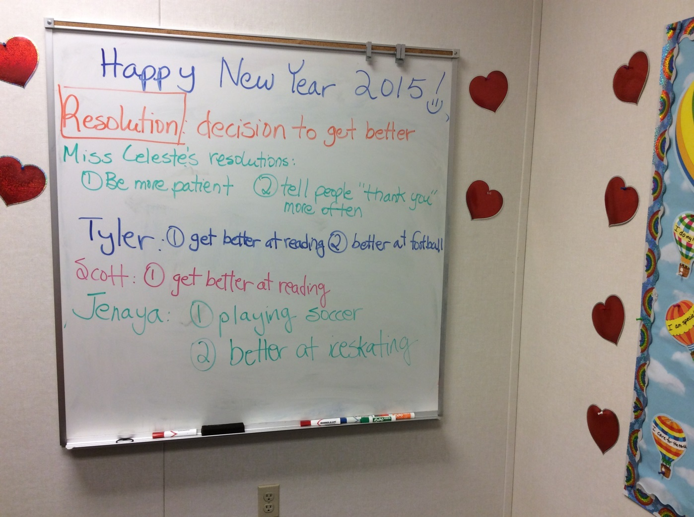
How have I applied this?

Slide 89
My latest:

Slide 91
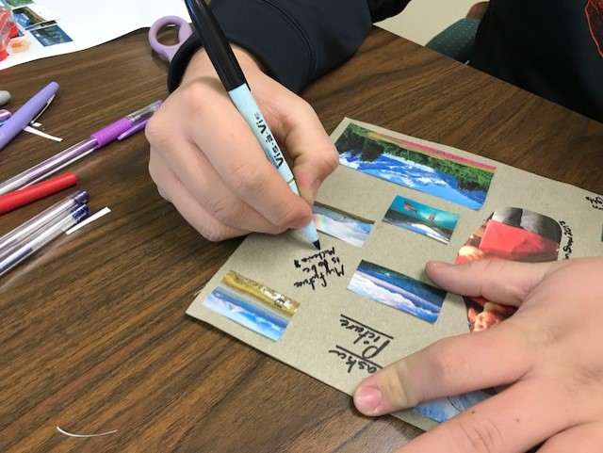
Vision board for Sammy--17

Slide 92
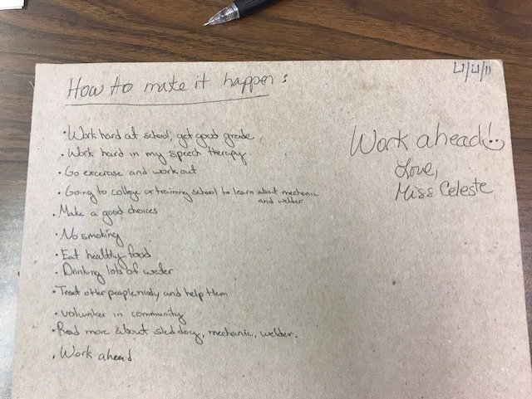

Slide 93
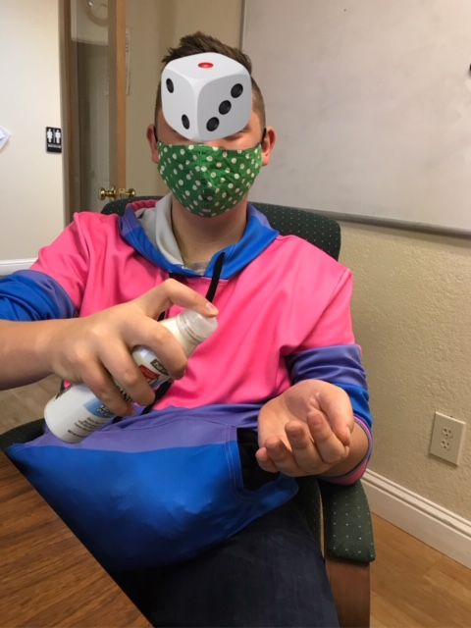
Treston: 13 years old with repaired cleft palate
Not doing his homework
Acting out in the group home
We did a trip to the future on the whiteboard
He wants to be a nurse and earn $100,000 a year

Slide 94
Treston wants:
Nice home in a good area
Pug
Yard
Spouse
Food
Utilities
Vacations to Hawaii, Greenland, Iceland
We talked about how much all this would cost a year

Slide 95
How does he get there? He came up with all this and wrote it on the whiteboard himself
Graduate from high school with good grades
Proper hygiene
Be organized and neat
Be active and exercise
Fulfill assigned tasks in the group home (which he wasn’t doing)
Do chores
Better social skills
Control his temper
Get better at bio/life science

Slide 96
I emphasized that if he wanted to be a nurse…
People had to understand his speech!
Thus, carryover homework was imperative

Slide 97
For many students….
No one has ever connected the dots
No one has ever talked about what they want and the path to get it

Slide 99
Outline
I. Introduction
II. Possible Effects of Trauma on Language and Cognition in Children
III. Trauma-Responsive Strategies for Intervention for Students with LI
IV. Restorative Justice Strategies for Addressing Hurtful Behavior
V. Stress Reduction Techniques
VI. Implementing a Growth Mindset

Slide 100
References
Ciolino, C., Hyter, Y.D., Suarez, M., & Bedrosian, J. (2021). Narrative and other pragmatic language abilities of children with a history of maltreatment. Perspectives of the ASHA Special Interest Groups, 6, 230-241.
Clements, A.D., Haas, B., Cyphers, N.A., Hoots, V., & Barnet, J. (2020). Creating a communitywide system of trauma-informed care. Progress in Community Health Partnerships. 14, 499–507. 10.1353/cpr.2020.0055
Coalition for National Trauma Research (CNTR; 2021). Retrieved from https://www.east.org/content/documents/cntr_infopiece.pdf.
Grossman, S., Cooper, Z., Buxton, H., Hendrickson, S., Lewis-O'Connor, A.,, Stevens, J., Wong, L.Y., & Bonne, S. (2021). Trauma-informed care: Recognizing and resisting re-traumatization in health care. Journal of Trauma and Acute Care Surgery, 20;6(1). doi: 10.1136/tsaco-2021-000815. PMID: 34993351; PMCID: PMC8689164.
Gutowski, E. R., Badio, K. S., & Kaslow, N. J. (2022). Trauma-informed inpatient care for marginalized women. Psychotherapy. Advance online publication. https://doi.org/10.1037/pst0000456

Slide 101
Hwa-Froelich, D.A. (2023). Social communication disorder in children exposed to maltreatment. In D.A. Hwa-Froelich (Ed.), Social communication development and disorders (2nd ed.) (pp. 267-303). Routledge.
Hyter, Y.D. (2020). Language, social pragmatic communication, and childhood trauma. In D.M. Scott (Ed.), Cases on communication disorders in multicultural populations (pp. 54-87). IGI Global.
Hyter, Y.D. (2021). Childhood maltreatment consequences on social pragmatic
communication: A systematic review of the literature. Perspectives of the ASHA
Special Interest Groups, 6, 262-287.
Roseberry-McKibbin, C. (2022). Multicultural students with special language needs: Practical strategies for assessment and intervention (6th ed.). Oceanside, CA: Academic Communication Associates.
Westy, C. (2023). Disruptive behavior disorders and social communication disorder. In D.A. Hwa-Froelich (Ed.), Social communication development and disorders (2nd ed.) (pp. 304-340). Routledge.

Slide 102
Other Selected References
Centers for Disease Control and Prevention (2021). Adverse Childhood Experiences Prevention Strategy. Atlanta, GA: National Center for Injury Prevention and Control, Centers for Disease Control and Prevention. Retrieved from https://www.cdc.gov/injury/pdfs/priority/ACEs-Strategic-Plan_Final_508.pdf
Centers for Disease Control and Prevention (2019). Preventing Adverse Childhood Experiences: Leveraging the Best Available Evidence. Atlanta, GA: National Center for Injury Prevention and Control, Centers for Disease Control and Prevention. Retrieved from https://www.cdc.gov/violenceprevention/pdf/preventingACES.pdf
Centers for Disease Control and Prevention (2019). Adverse Childhood Experiences: Preventing early childhood trauma to improve adult health. Retrieved from https://www.cdc.gov/vitalsigns/aces/pdf/vs-1105-aces-H.pdf
Felitti, V. J., Anda, R. F., Nordenberg, D., Williamson, D. F., Spitz, A. M., Edwards, V., Koss, M. P., & Marks, J. S. (1998). Relationship of childhood abuse and household dysfunction to many of the leading causes of death in adults. The Adverse Childhood Experiences (ACE) Study. American Journal of Preventive Medicine, 14(4), 245–258. https://doi.org/10.1016/s0749-3797(98)00017-8
Picker Institute, 2013. Principles of Patient-Centred Care.

