Slide 1
ADHD and Sensory Processing Disorder
Chapter 9

Slide 2
You don’t have to read about auditory processing disorders
Bottom of page 202-209

Slide 3
Outline
Foundations of ADHD
Speech and Language Difficulties (ADHD)
Assessment—ADHD
Treatment--ADHD

Slide 4
Specific Strategies for Children with Developmental Language Disorder, Sensory Processing Disorder, and Fine Motor Delays
Foundational Principles and Nature of SPD
8 Sensory Systems
Sensory Diet

Slide 5
I. FOUNDATIONS OF ADHD

Slide 6
A. 3 Primary Issues
Inattention—difficulty selecting what to attend to, focusing long enough; difficulty concentrating; difficulty planning, organizing, and executing activities
Hyperactivity—excessive physical movement; can’t sit still; bounces from one activity to another
Impulsivity—difficulty regulating behavior; “acting without thinking,” problems waiting their turn

Slide 7
ADHD….
Persists into adulthood
80% of children with learning disabilities have ADHD
Is highest among Whites
Especially blond, blue-eyed people (not on exam)

Slide 8
CHADD, 2023:
ADHD-combination of factors—genetics, dopamine imbalance, insufficiency of neurotransmitters
Strong genetic link
May be behavior and social problems—relationships too

Slide 9
ADHD is most likely due to…
Impairment in executive function portion of the brain that controls impulsivity

Slide 10
II. SPEECH AND LANGUAGE DIFFICULTIES (ADHD)
Mostly associated with language disorders (not speech sound disorders)
Pragmatics is a huge issue!
These children may interrupt more, introduce random topics, say awkward things
Difficulty with executive function—thinking, organizing, planning

Slide 11
III. ASSESSMENT-ADHD
Usually it’s observations and having parents and teachers fill out questionnaires
In the schools, the psychologist does this
We can evaluate speech and language, especially pragmatics
Testing them 1:1 in a quiet room generally tells us nothing about pragmatics—we need to observe the child in everyday settings with other children

Slide 12
I will sometimes
Do playground duty or bus duty and observe interactions with peers
You can observe in the classroom, at recess, and in the cafeteria

Slide 13
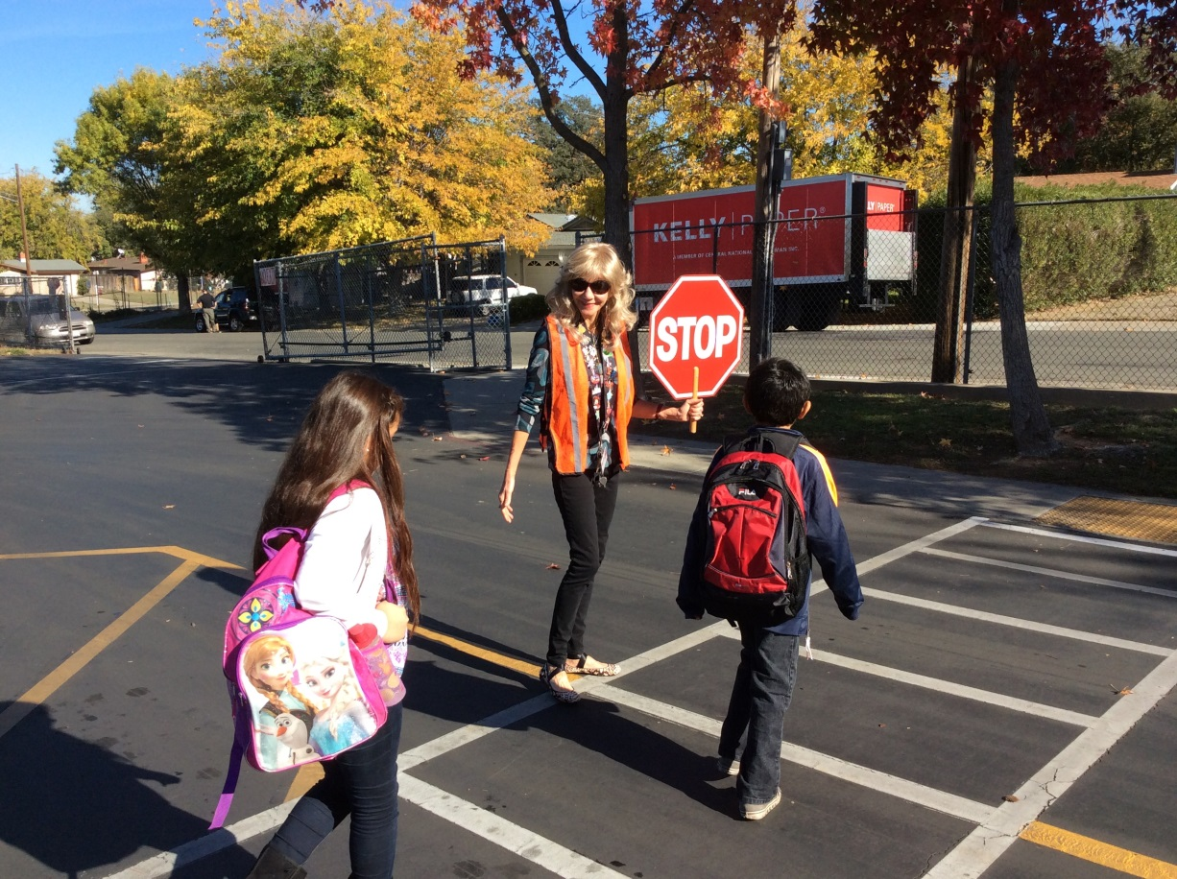

Slide 14
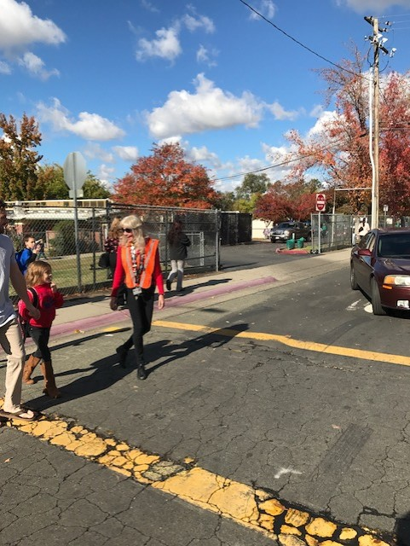
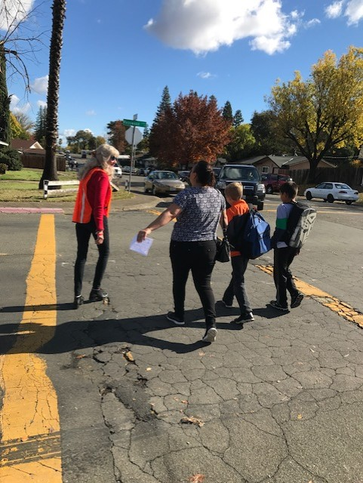
\

Slide 15
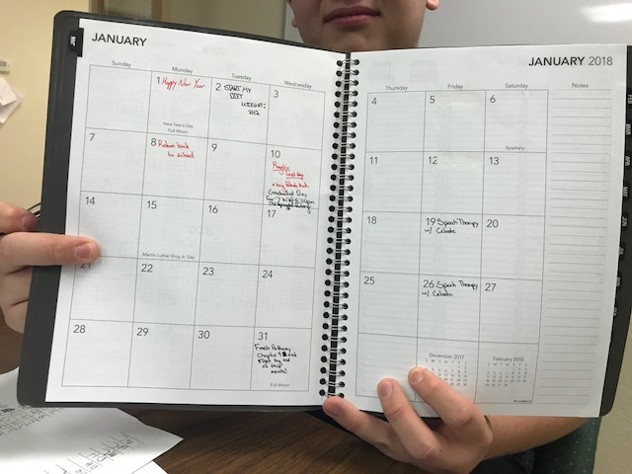
IV. TREATMENT--ADHD
Medication is popular
I like to work with kids (including teens) on planning and organizing

Slide 16
Help them organize their thoughts to avoid verbal mazes**
Adult: What did you do for Halloween?
Child: It was fun…there were costumes, my mom took us to a haunted house, I was Spiderman, we ate candy, oh, before we left home my dad made us promise to be safe…

Slide 17
Turntaking skills
Memory, especially for info presented auditorially
Contingency—what they say must relate to what other person just said

Slide 18
You can use colored blocks or pegs to show a child an abrupt topic shift:

Slide 19
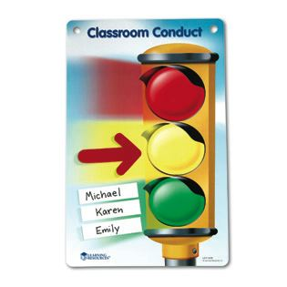
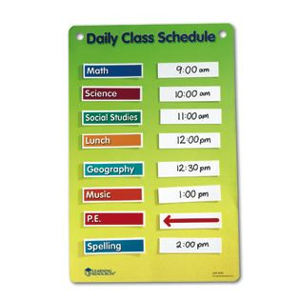
Visual aids
Therapy rooms and classrooms--highly structured
“movement breaks”
Sit in the front of the classroom
Repeat directions back

Slide 20
True-False
The term contingency means that when we talk, we relate to something the other person said.

Slide 21
Specific Strategies for Children with Developmental Language Disorder, Sensory Processing Disorder, and Fine Motor Delays

Slide 22
I. Foundational Principles and Nature of SPD** It is increasingly being found that children with special needs such as Developmental Language Disorder (DLD), ADHD, and Autism Spectrum Disorder (ASD) have accompanying sensory and fine motor deficits

Slide 23
Sensory Integration Dysfunction/Sensory Processing Disorder
An irregularity or disorder in brain function that makes it difficult to integrate sensory input effectively
Consequences may appear in the areas of:
Motor learning
Social/Emotional components
Speech/Language components
Attention Disorders
Notes:
Statistics:
1979 Ayers estimated 5-10% have SI probs significant enough to warrant intervention
Today
According to Dr. Lucy Jane Miller, the statistics report a minimum of 1 in 20 children in the US have SPD. This is the only published statistic and is based on her research thus far.
“It is when the brain is so disorganized that a person has difficulty functioning in daily life that the person has a diagnosis of SID” Kranowitz

Slide 24
In children with SPD:
Brain doesn’t process sensory inputs correctly
Can lead to inappropriate behavioral and motor responses that negatively impact learning, behavior, coordination, lang
May cause anxiety, stress, and depression

Slide 25
STAR Institute, 2023:**
Pioneering occupational therapist, psychologist, and neuroscientist A. Jean Ayres, Ph.D., likened SPD to a neurological “traffic jam” that prevents certain parts of the brain from receiving the information needed to interpret sensory information correctly.

Slide 26
II. Eight Sensory Systems
Far (distal) – Tell us what is going on in the world around us
Visual
Auditory
Olfactory (smell)
Gustatory (taste)
Tactile
Near (proximal) – Tell us what is going on in our own bodies
Vestibular
Proprioceptive
Interoception
Notes:
Far – 0versensitive Near - under sensitive
Inetroception
Internal sensations
hunger/thirst
hot/cold
pain/discomfort

Slide 27
Vestibular system:
Provides our brain with information about motion, head position, spatial orientation
Involved with motor functions that allow us to keep our balance, stabilize our head and body during movement, and maintain posture.

Slide 28
Proprioception:
Body's ability to sense movement, action, and location
Examples: being able to walk or kick without looking at your feet; being able touch your nose with your eyes closed
Difficulties occur when there is a reduction in the sense that tells the body where you are in space (e.g., Mark would bump into other children)

Slide 29
Interoception…
Helps you understand and feel what's going on inside your body
Ch may have trouble knowing when they feel hungry, full, hot, cold or thirsty
Can be very late to potty train

Slide 30
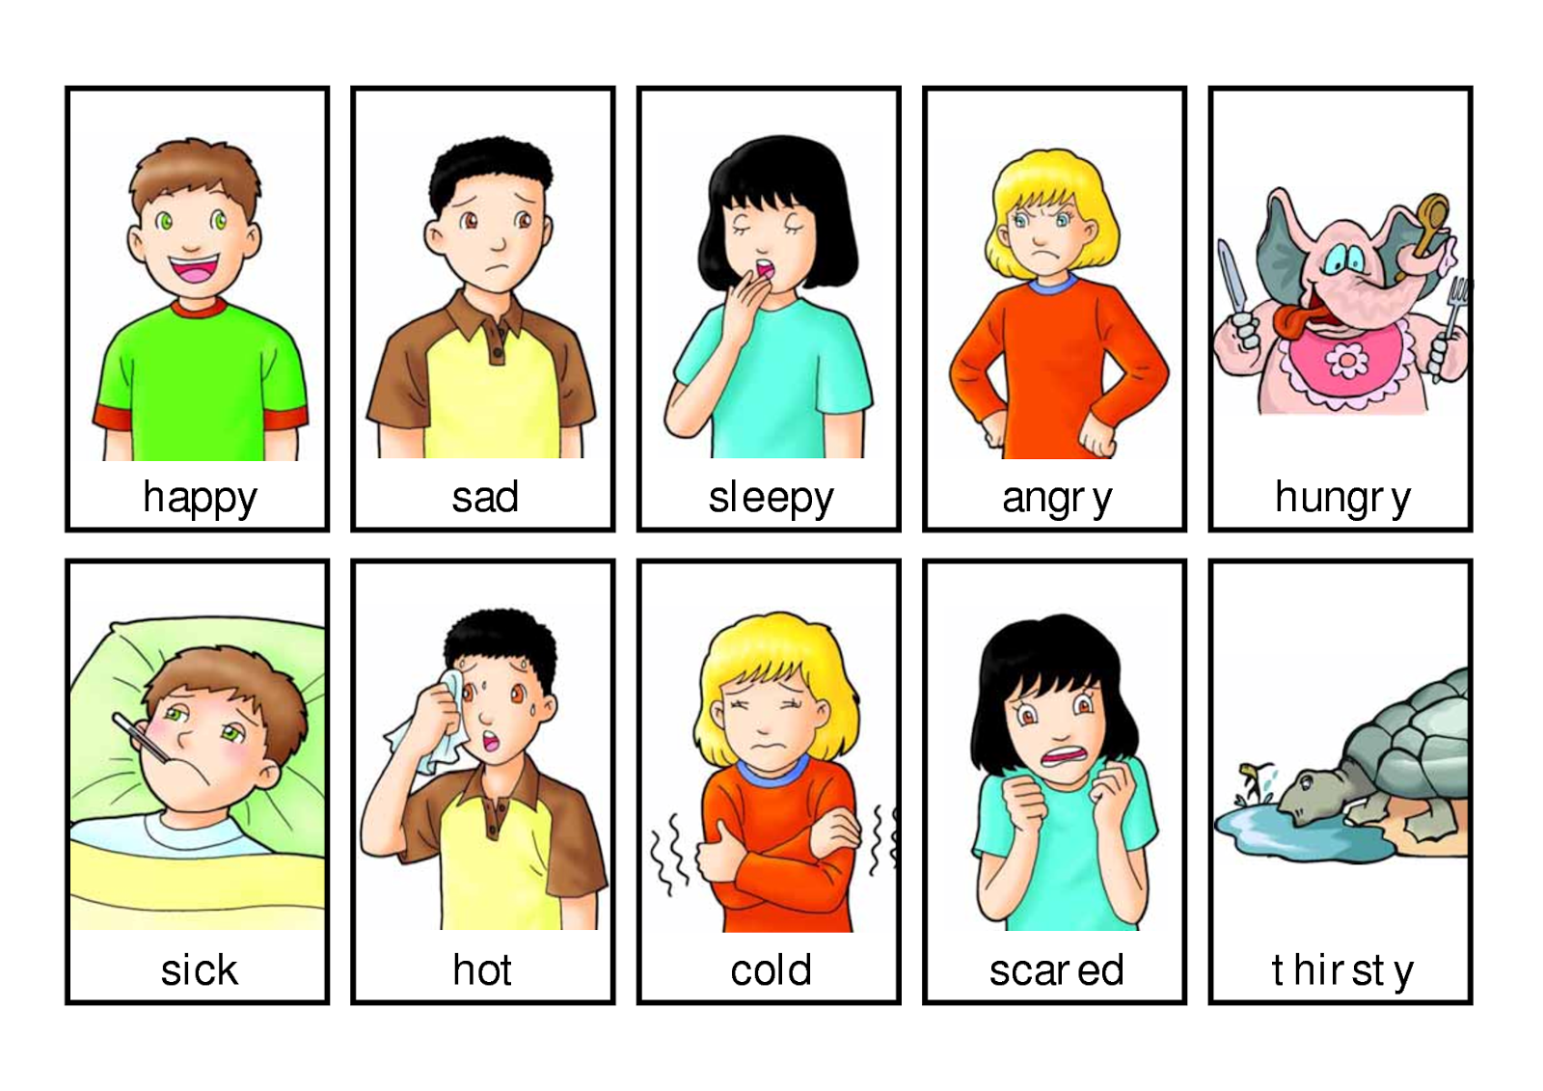
Where to Start?
Start with the near senses
Child needs to know what is going on with their body before they can interpret information in the environment

Slide 31
Modulation
Allows us to focus on what’s most important
Teaching Self-Modulation
Recognizing sensory needs
Teachable moments
Recognizing how different types of activities can be calming, alerting, or “just right”

Slide 32
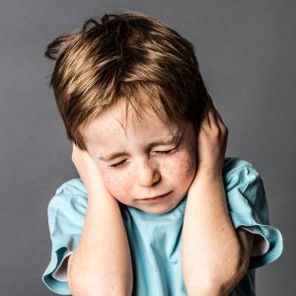
Over-Responsive
AKA “sensory defensive”
Over-responsiveness of the nervous system
May be generalized or specific to a particular sensory system
Avoiders
Primarily need calming activities

Slide 33
Under-Responsive (passive)
Under-active response of the nervous system to incoming stimuli
Bump on a log
May be passive and oblivious to stimuli
Needy
Need alerting/stimulating experiences

Slide 34
Sensory Seeking Person
Due to under-responsivity, is in constant motion
Thrill seeker
“Needers” – behaviors are attempts to reach high threshold level for sensory registration
Need alerting/stimulating activities
Notes:
Your instinct is to calm them down
Seekers can become even more disorganized if input is not provided in an =organized and structured manner

Slide 35
Mixed Response
Many people with ASD have both over-responsivity in some systems and under-responsivity in other systems
Common ASD pattern: over-responsive to far sensory systems and under-responsive to near sensory systems

Slide 36
III. Sensory Diet**
Term coined by Patricia Wilbarger
“The optimum sensorimotor input a person needs to feel alert, exert effortless control, and perform at peak.”
The strategic use of sensory activities

Slide 37
Childdevelopment.com 2023:**
Lists sensory activities as part of a sensory diet that helps to keep a child feeling calm and sensorily organized. These activities help children to attend, learn and behave to the best of their ability.

Slide 38
Proprioception involves:
A.. The body's ability to sense movement, action, and location
B. Knowing when you are hungry or thirsty
C. Being able to keep our balance and maintain posture
D. Awareness of what is socially appropriate in different situations
E. Choosing the appropriate vocabulary words in sentences

Slide 39
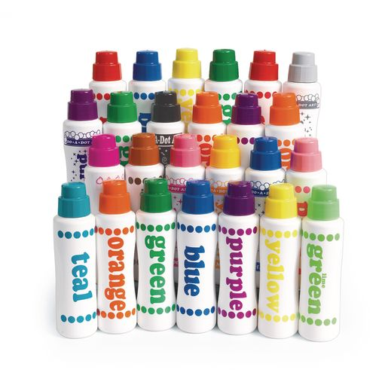
Paint dots are fun too:
Do A Dot Art

Slide 40
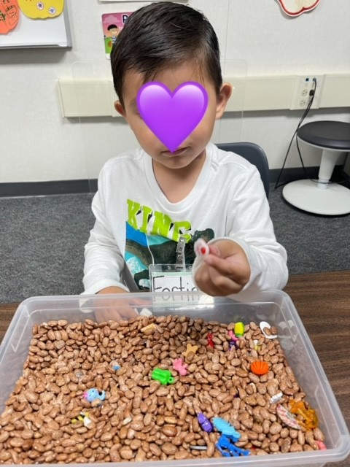
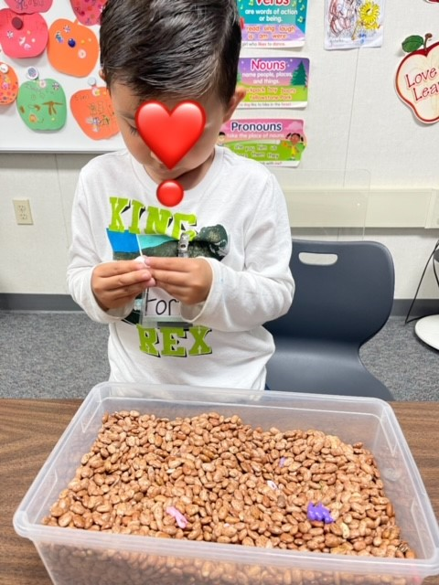
Tactile Supports**
These kids need things to keep their hands busy

Slide 41
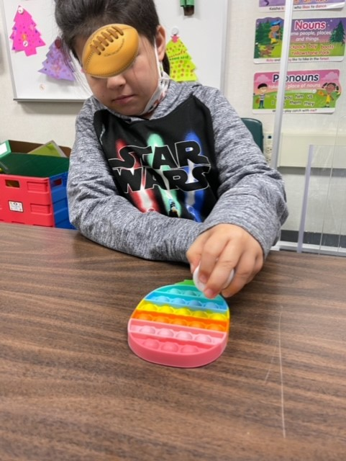
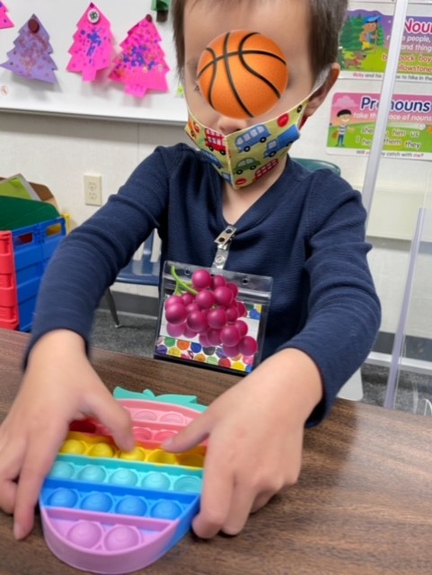
Pop it toys are highly motivating fidget toys and can be used for articulation drill on speech sounds

Slide 43
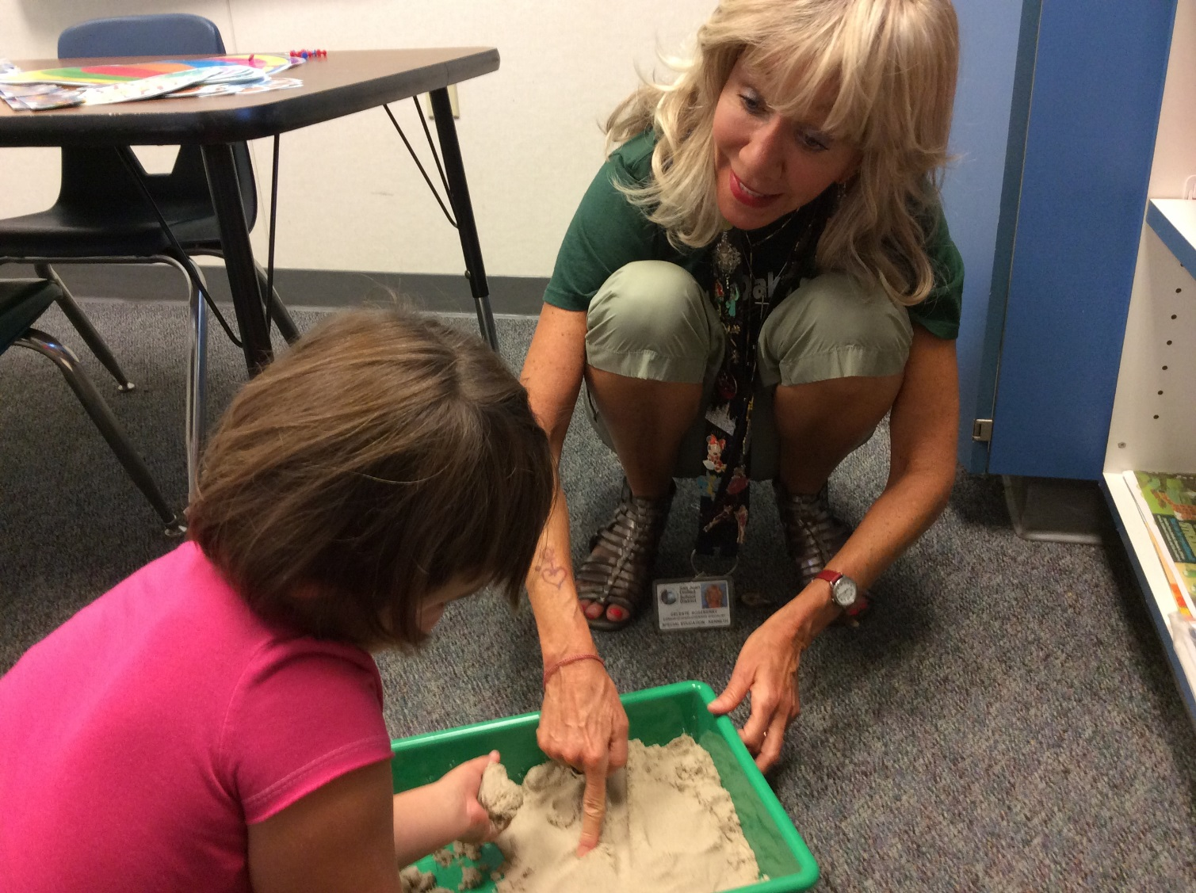
Kinetic Sand Activities

Slide 45
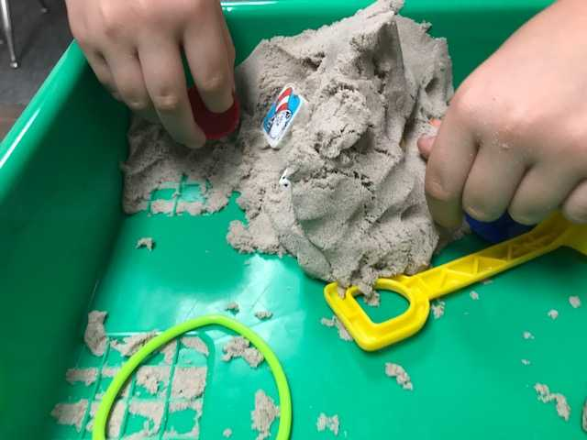

Slide 47
Finding /r/ objects in the sand

Slide 48
Sensory bins with shredded paper are sanitary and fun!

Slide 49
The children draw out an object and describe it: label, function, composition, color, etc. They also use the word in a sentence with their target sound like /r/

Slide 50
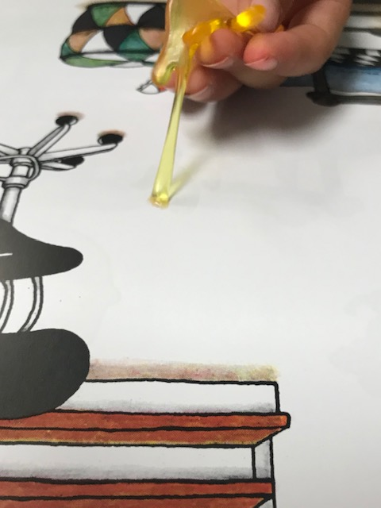
Slappy Hands (available online)

Slide 52
Kids loooove shaving cream! And our little therapy room smells heavenly!

Slide 54
Reflection**
You are a public school SLP who has many students on your caseload with ADHD and SPD. List and briefly describe 3 ways you will make sure your speech room is organized/arranged/decorated to make this a welcoming and appropriate space for them.
List and briefly describe 3 different materials/activities you will use with these students that we did not already discuss.

