Slide 1
Chapter 10
Autism Spectrum Disorder and Developmental Disabilities

Slide 2
Outline
I. Developmental Disabilities
II. Autism Spectrum Disorder
III. Additional Considerations for Individuals with Autism Spectrum Disorder and Developmental Disabilities

Slide 3
I. DEVELOPMENTAL DISABILITES**
A. Foundations
The term Developmental Disability (DD) encompasses intellectual disability (ID) and physical disabilities like cerebral palsy
We will focus on ID

Slide 4
General characteristics of individuals with ID include:

Slide 5
World wide, 1-2% of people have ID**
Most have mild ID
ID is almost twice as common in low- and middle-income countries compared to high income countries

Slide 6
Risk factors for ID:

Slide 7
B. Speech and Language Characteristics of Persons with DDs**
Speech sound disorders
May speak more slowly
Receptive language skills commensurate with mental age with expressive skills being much more limited
Understand concrete information better than abstract information

Slide 8
For example:**
They might have difficulty understanding the term “acquatic”
But they will easily understand “water”

Slide 9
Expressive language is one of the most challenging areas for children with DD:**
Limited vocabulary
Few synonyms (e.g., happy, delighted, glad, joyful)
Difficulty describing characteristics of objects (color, size, shape, function)
Limited conversational skills

Slide 10
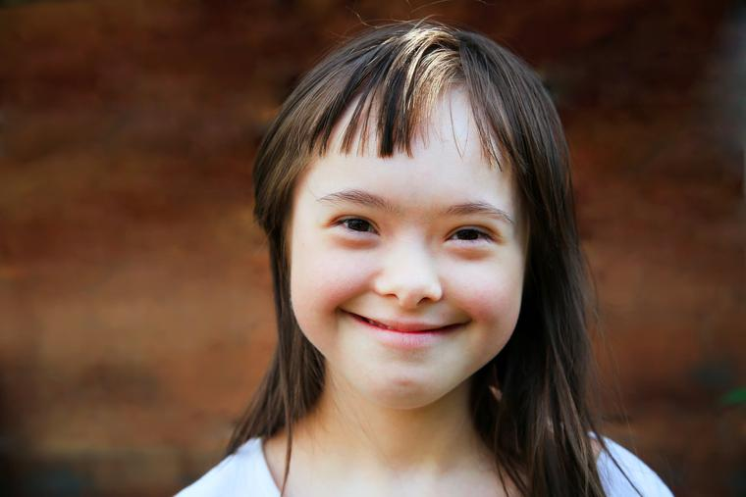
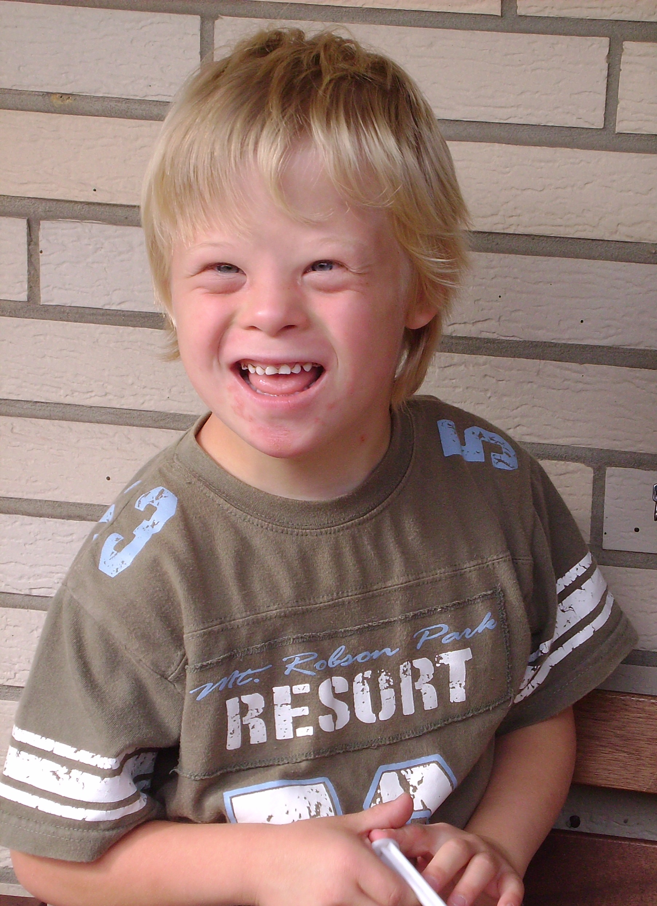
C. Down Syndrome—Trisomy Syndrome—Chromosome 21**
More common in older moms
Small head, ears, other distinguishing physical characteristics
May be short in stature
Often happy, cheerful, affectionate
Many get some education

Slide 11
In terms of speech, children with Down Syndrome

Slide 12
Children with Down Syndrome:

Slide 13
Check out this TEDx talk by a woman with Down Syndrome!
https://www.youtube.com/watch?v=HwxjoBQdn0s

Slide 14
II. AUTISM SPECTRUM DISORDER**
A. Background
1 in 36 children have ASD
Not on exam: in Sacramento, the rate of children with ASD increased by 400% in recent years
Highest incidence is in Qatar; lowest is in France

Slide 15
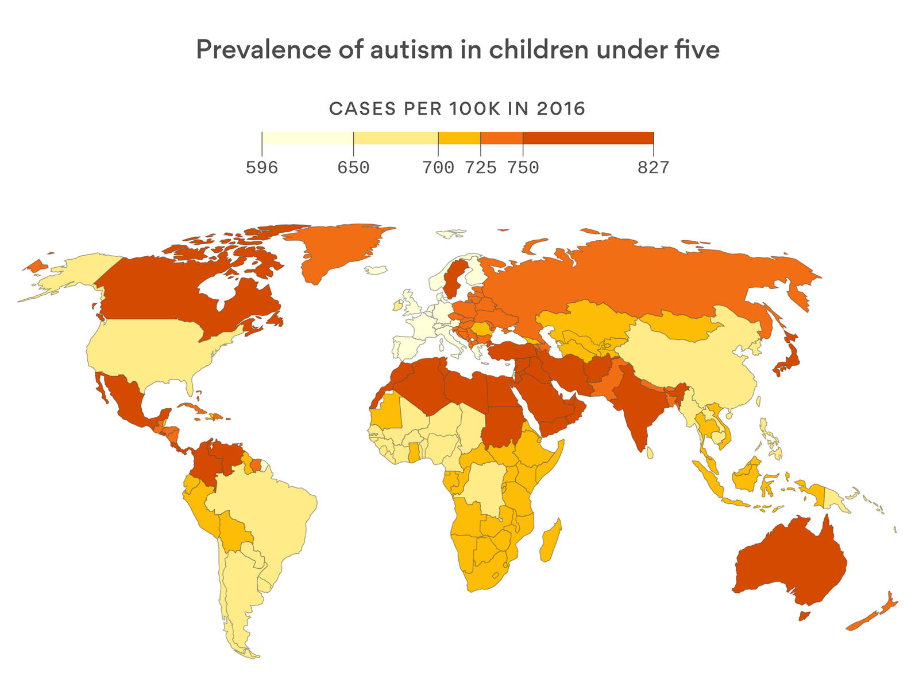
Not on exam:

Slide 16
Conditions associated with ASD:**
Genetics
Maternal exposure to pesticides and heavy metals during pregnancy (field workers are very vulnerable)

Slide 17
B. Common Characteristics of Children with ASD:**
Lack of attempts to connect with caregivers
Reduced joint attention
Extreme distress reactions
May fixate on particular objects
Possible repetitive behaviors
Inflexible adherence to routines
Restricted interests

Slide 18
Communication “Red Flags” Worldwide

Slide 19
Unfortunately, children from bilingual homes may be overlooked and undiagnosed:**
Pediatricians tell parents that “your child is confused by 2 languages at home”
“They will outgrow it.” ☹

Slide 20
B. Features Associated with ASD**
Sensory processing disorder—more than 90% of children with ASD have atypical sensory behaviors
May be very sensitive to loud sounds, smells, bright lights
ADHD
Depression—social isolation, exclusion, unemployment

Slide 21
Other features associated with ASD:

Slide 22
C. Language and Social Skill Challenges**
Social (pragmatic) communication disorder
Challenges with theory of mind (TOM)—understanding other people’s perspectives
Difficulty understanding how their behavior impacts others
Difficulty understanding emotions
Lack of eye contact

Slide 23
Hearing issues:

Slide 24
D. Assessment

Slide 25
Assessment is comprehensive and includes:

Slide 26
Language skills that SLPs assess:**
Speech—articulation
Receptive language—comprehension
Frequency and function of verbal (vocalizations/verbalizations) and nonverbal communication (e.g., gestures)

Slide 27
We especially evaluate social communication and conversational skills:**
Joint attention
Play behavior
Use of gestures
Initiation of communication

Slide 29
E. Intervention for Individuals with ASD**
Goal: quality of life, social acceptance
Applied behavior analysis—ABA—skills are broken down and taught one step at a time
Naturalistic intervention—based on ABA—used in daily routines
For example, we would work on joint attention, vocal turntaking

Slide 30
It’s very important…**
To utilized a strengths-based approach
To celebrate neurodiversity
Dr. Temple Grandin is an internationally famous author and speaker with ASD

Slide 31
The World Needs All Kinds of Minds**
https://www.youtube.com/watch?v=fn_9f5x0f1Q
Dr. Temple Grandin
We will watch 1-2 minutes

Slide 32
Thankfully, research is showing that:

Slide 33
III. ADDITIONAL CONSIDERATIONS FOR INDIVIDUALS WITH ASD AND DD**
They should be placed in the least restrictive environment (LRE) in the schools
It’s important for children to spend some time with typically-developing peers
Often they will be in a special day class but be mainstreamed into PE, art, music, lunch

Slide 34
There may be substantial emotional issues for the children and families:**
ASD is typically hardest on families
They often feel stigmatized
Children are very vulnerable to bullying

Slide 35
Individuals with ASD and DD are vulnerable to abuse:

Slide 36
Outline
I. Developmental Disabilities
II. Autism Spectrum Disorder
III. Additional Considerations for Individuals with Autism Spectrum Disorder and Developmental Disabilities

