Slide 1
CLEFT LIP AND PALATE
Chapter 14

Slide 2
Outline
Nature and Causes of Cleft Lip and Palate
Clefts of the Lip and Alveolar Ridge
Clefts of the Soft and Hard Palates
Challenges Associated with Cleft Lip and Palate
Surgical Management of Cleft Lip and Palate
Assessment
Treatment of Speech, Resonance, and Velopharyngeal Dysfunction
Social and Emotional Effects of Cleft Lip and Palate

Slide 3
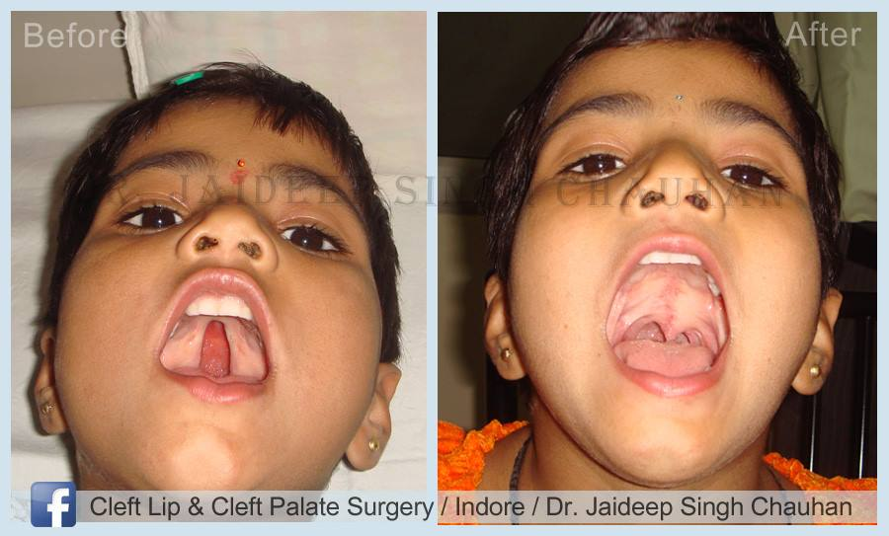
I. NATURE AND CAUSES OF CLEFT LIP AND PALATE**
Opening in the roof of the mouth
Open connection between the oral and nasal cavity
World wide, 1 in 7 babies is born with this condition

Slide 4
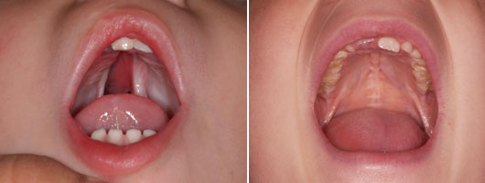
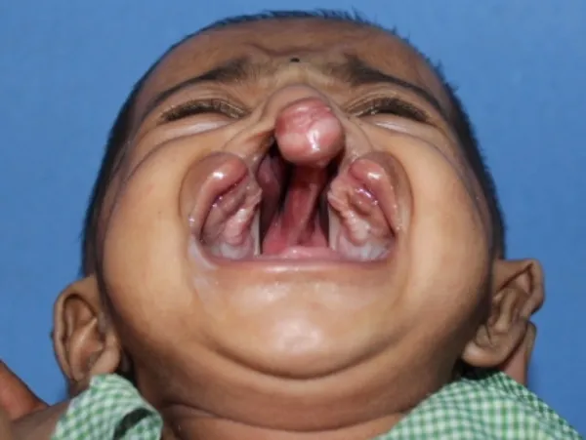
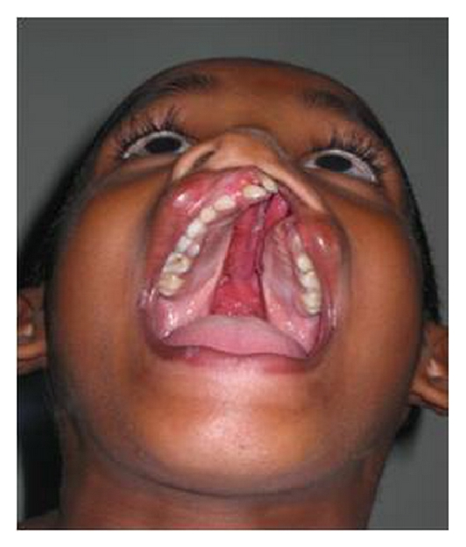

Slide 5
What causes cleft lip and/or palate?

Slide 6
There is a higher prevalence of cleft palate:**
In Latine and Asian populations
In countries where mothers cook meals over open fires, smoke exposure can increase the likelihood of cleft palate by almost 50%
In developing parts of the world—are there resources to help children?

Slide 7
The first trimester of pregnancy is a very vulnerable time for the embryo--it can be affected by:

Slide 8
II. CLEFTS OF THE LIP AND ALVEOLAR RIDGE

Slide 9
Consequences of a cleft lip include:

Slide 10
III. CLEFTS OF THE SOFT AND HARD PALATES**
A soft palate cleft can cause hypernasal speech
Velopharyngeal insufficiency (VPI) is anatomical condition that prevents adequate velopharyngeal closure—velum is too short
Velopharyngeal incompetence results from poor movement of the velum

Slide 11
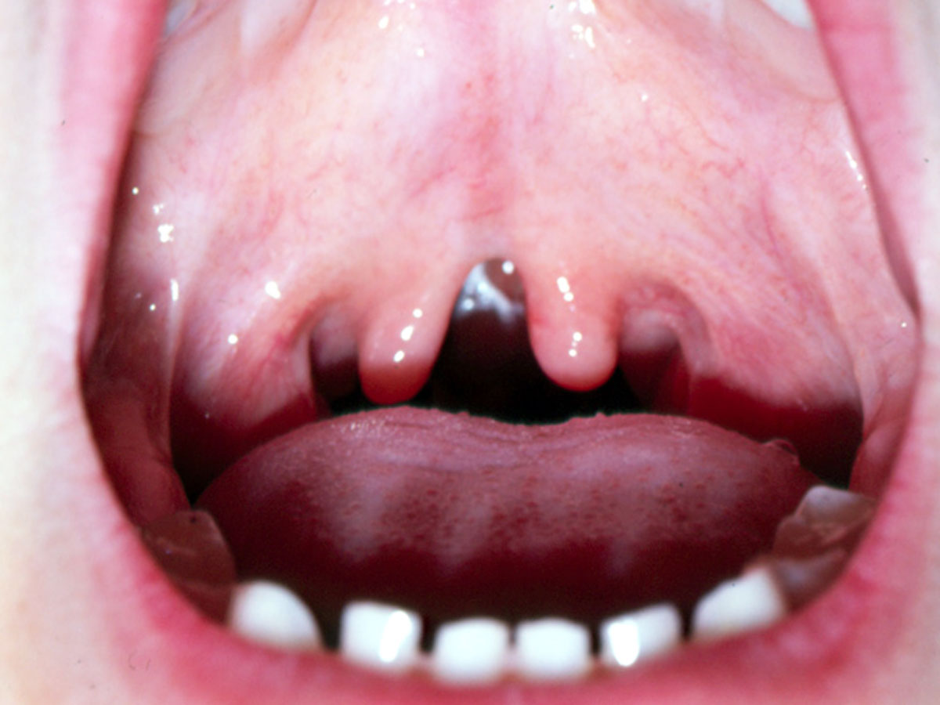
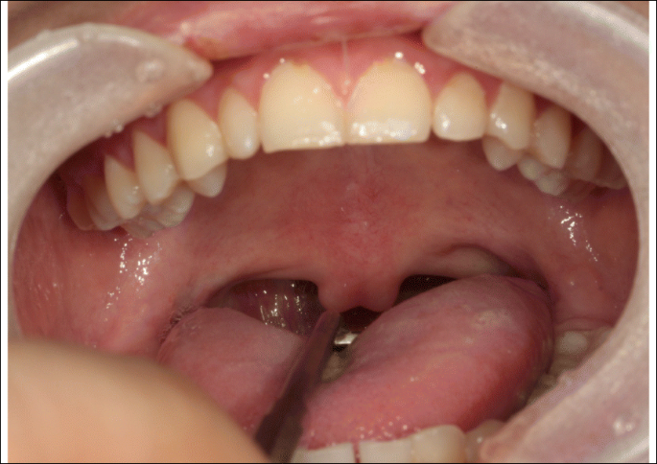
A submucous cleft

Slide 12
IV. CHALLENGES ASSOCIATED WITH CLEFT LIP AND PALATE**
A. Feeding
Very difficult and #1 concern
Surgery is necessary ASAP
Mothers can be trained to use specialized techniques

Slide 13
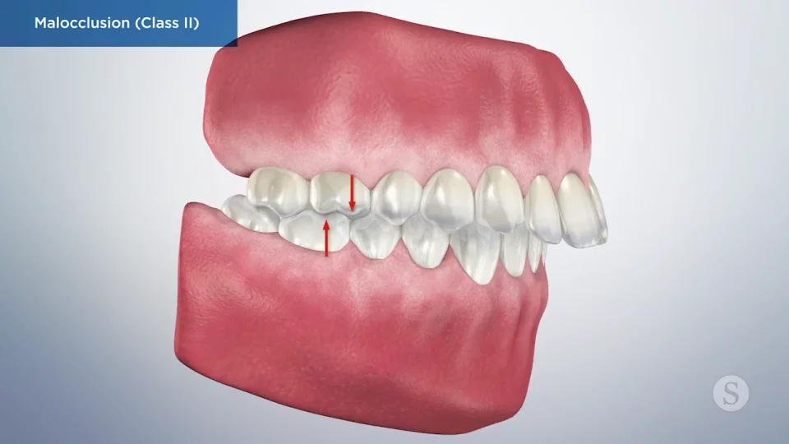
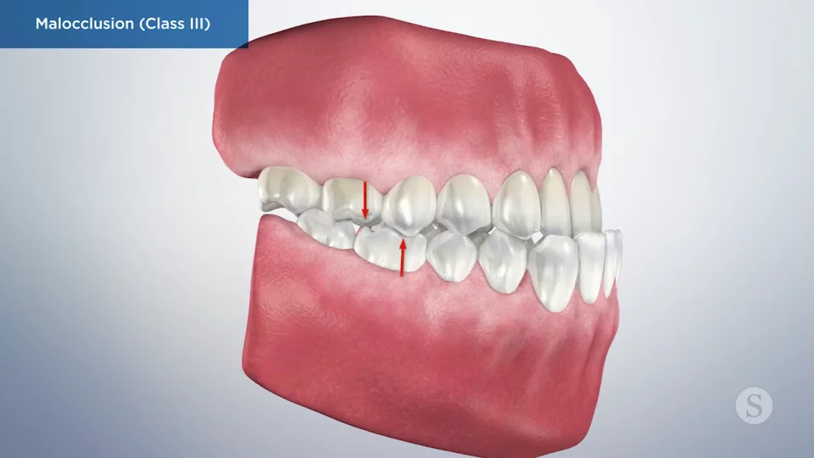
B. Dental Anomalies

Slide 14
C. Hyponasality**
Reduction in nasal resonance
Caused by partial blockage in nasopharynx or posterior entrance to nasal passages (e.g. enlarged adenoids)
Affects nasal consonants /m, m, ng/

Slide 15
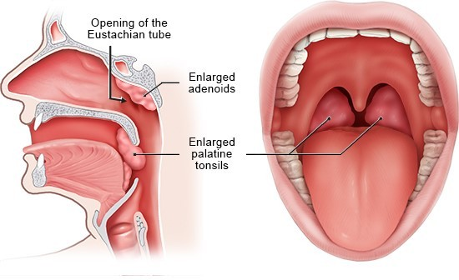
Enlarged adenoids

Slide 16
D. Hypernasality

Slide 17
Hypernasality—Jones and Bartlett Learning
https://www.youtube.com/watch?v=KWz5_fpnZYc

Slide 18
E. Language Delays and Disorders**
Reduced expressive language especially
The less intelligible the child, the lower the expressive language
Shorter, simpler sentences
Smaller vocabularies
Lower reading skills

Slide 19
F. Speech Sound Disorders**
Hypernasality affects intelligibility
Hearing problems contribute
Children may use glottal stops as a compensatory strategy because they can’t build up the intraoral breath pressure for sounds like /p, b, t, d/

Slide 20
G. Hearing

Slide 21
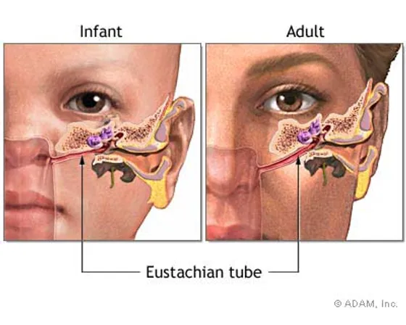
The child’s horizontal Eustachian tube can prevent proper drainage of middle ear fluid

Slide 22
V. SURGICAL MANAGEMENT OF CLEFT LIP AND PALATE**
Multidisciplinary team—plastic surgeon, SLP, orthodontist, parents, and others
Rule of 10s for primary surgical repair—1-2 hours under general anesthesia; best before 12 months old
Baby must be 10 weeks old, weigh at least 10 pounds, and have a hemoglobin count of at least 10 grams
Goal: adequate feeding; establish intact division between the oral and nasal cavities

Slide 23
Secondary surgeries follow…

Slide 24
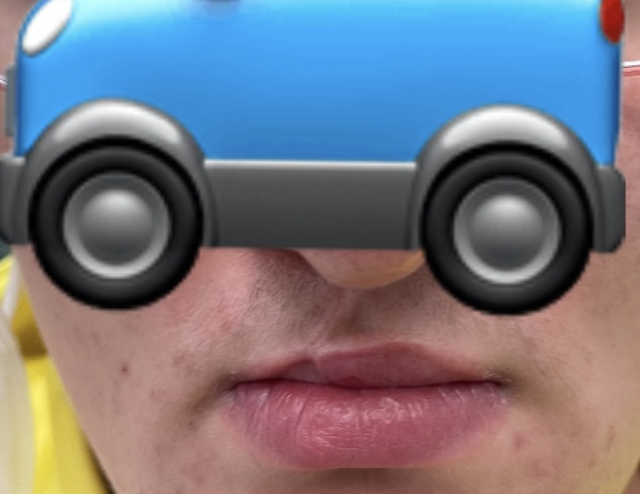
Scar tissue at age 16

Slide 25
VI. ASSESSMENT
A. Ages Birth-4

Slide 26
B. Instrumental Assessment**
1. Videofluroscopy—noninvasive Xray procedure that differentiates a short velum from an adequate velum with poor movement
2. Nasopharyngoscopy—rubber tube up the nose to allow visualization of velopharyngeal mechanism
3. Speech aerodynamics—not on exam
4. Nasometer—computerized assessment of oral-nasal resonance balance

Slide 27
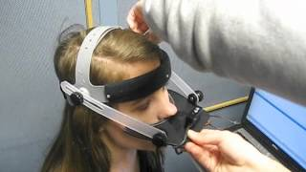
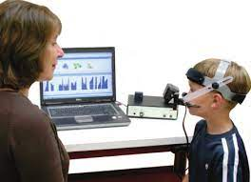
Nasometer

Slide 28
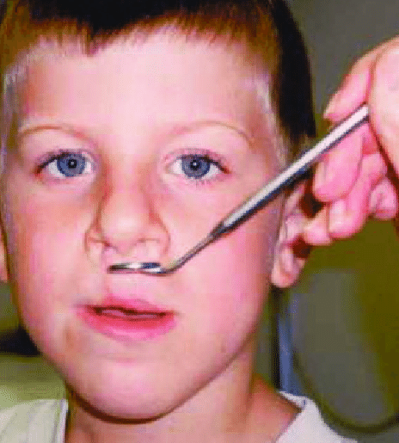
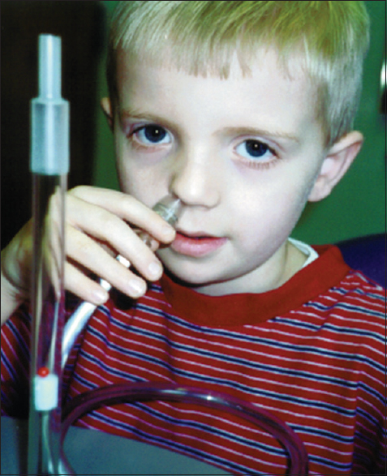
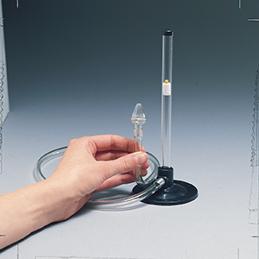
C. Noninstrumental Assessment

Slide 29
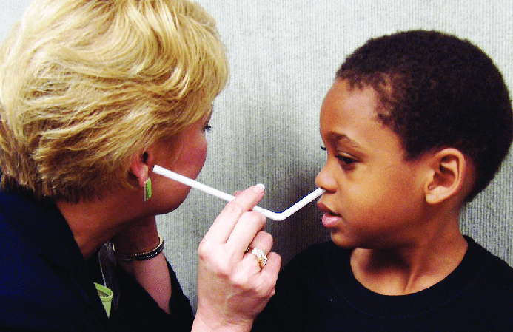
We can also use a straw for detecting nasal emission

Slide 30
VII. TREATMENT OF SPEECH, RESONANCE, AND VELOPHARYNGEAL DYSFUNCTION**
A. Introduction
Most children with cleft palate will need treatment for speech, language, or both
Speech therapy focuses on correct placement of articulators
Language therapy is especially important for expressive language

Slide 32
B. MOOSE!!

Slide 33
C. Speech Appliances and Prosthetic Devices

Slide 34
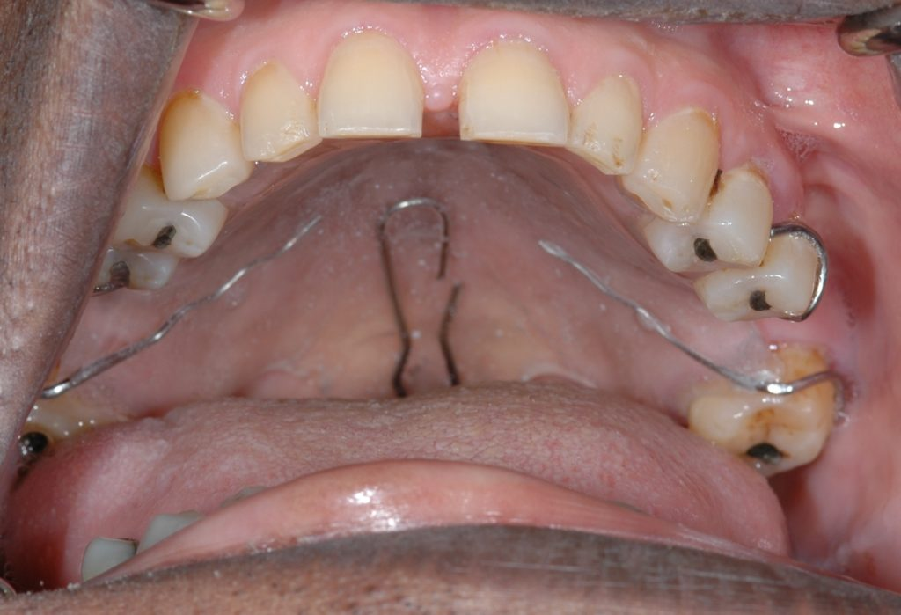
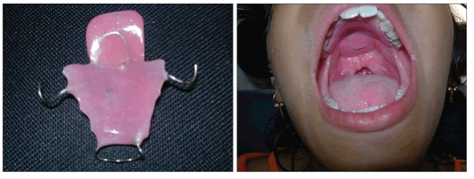

Slide 35
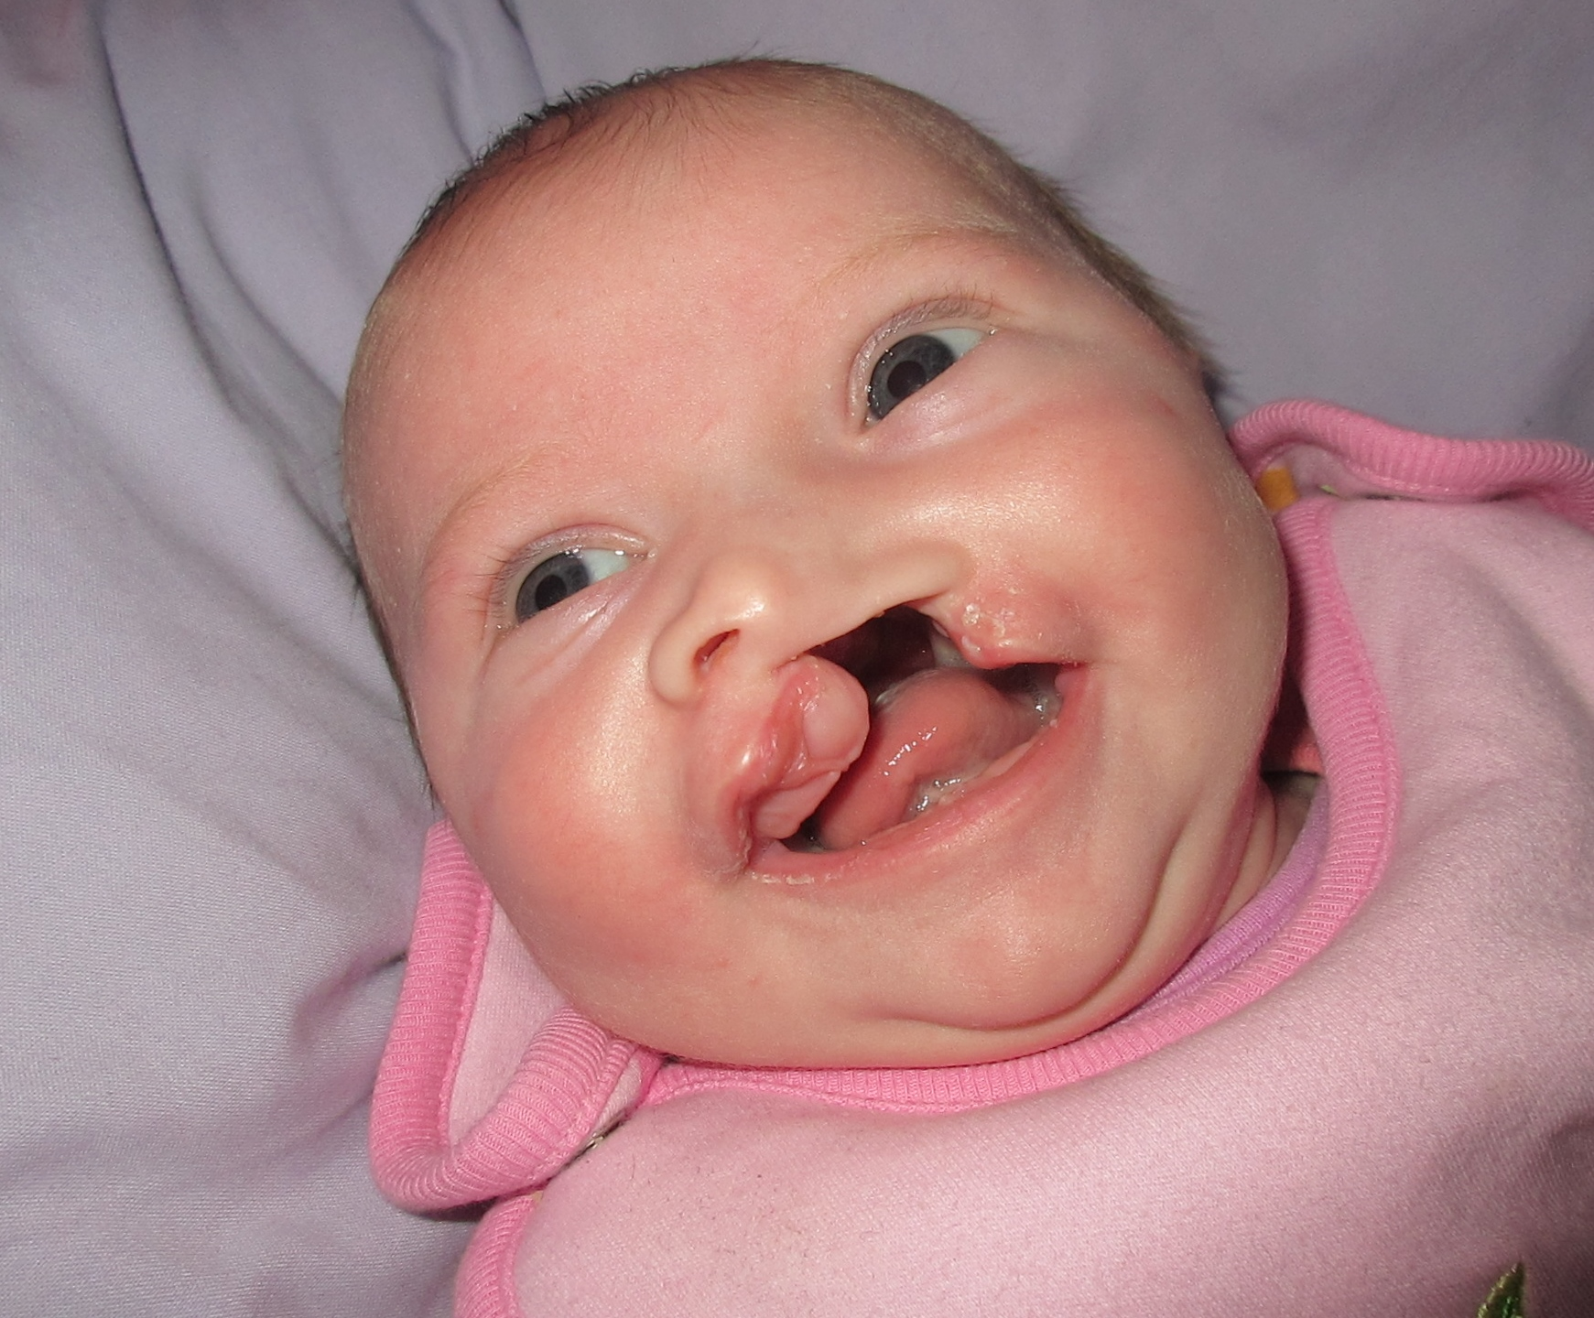
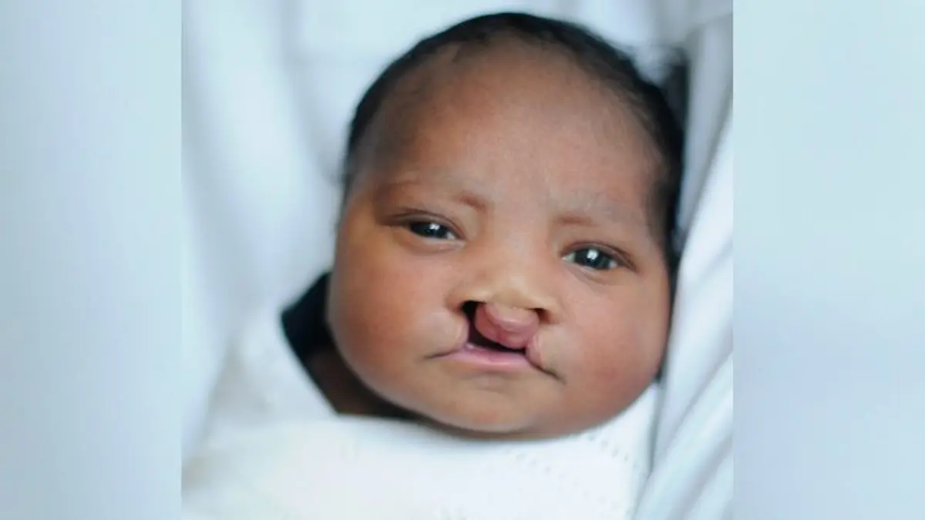
VIII. SOCIAL AND EMOTIONAL EFFECTS OF CLEFT LIP AND PALATE

Slide 36
It is very expensive, even with insurance…

Slide 37
Children’s facial appearance…**
Is strongly correlated with social acceptance and attractiveness
Research shows that children with cleft palate can feel more scared, angry, alone, and sad
Children may need special training to handle teasing and to develop good social skills
Thankfully, by kindergarten, most will look typical

Slide 38

Adolescents and adults

Slide 39
Outline
Nature and Causes of Cleft Lip and Palate
Clefts of the Lip and Alveolar Ridge
Clefts of the Soft and Hard Palates
Challenges Associated with Cleft Lip and Palate
Surgical Management of Cleft Lip and Palate
Assessment
Treatment of Speech, Resonance, and Velopharyngeal Dysfunction
Social and Emotional Effects of Cleft Lip and Palate

