Slide 1
Chapter 15
LANGUAGE DISORDERS IN ADULTS

Slide 2
You don’t need to read…
P. 381-382 Transcortical sensory aphasia
P. 382 conduction aphasia
P. 383 transcortical motor aphasia

Slide 3
Outline
I. Causes of Neurogenic Speech, Language, Swallowing, and Cognitive Disorders
II. Types of Aphasia
III. Assessment of Aphasia
IV. Treatment of Aphasia

Slide 4
I. CAUSES OF NEUROGENIC SPEECH, LANGUAGE, SWALLOWING, AND COGNITIVE DISORDERS

Slide 5
B. Toxins**
Drugs and alcohol
They poison or cause inflammation of the CNS
Wernicke-Korsakoff syndrome: present in severe alcoholics and caused by lack of thiamine--vitamin B1

Slide 6
C. Traumatic Brain Injury

Slide 7
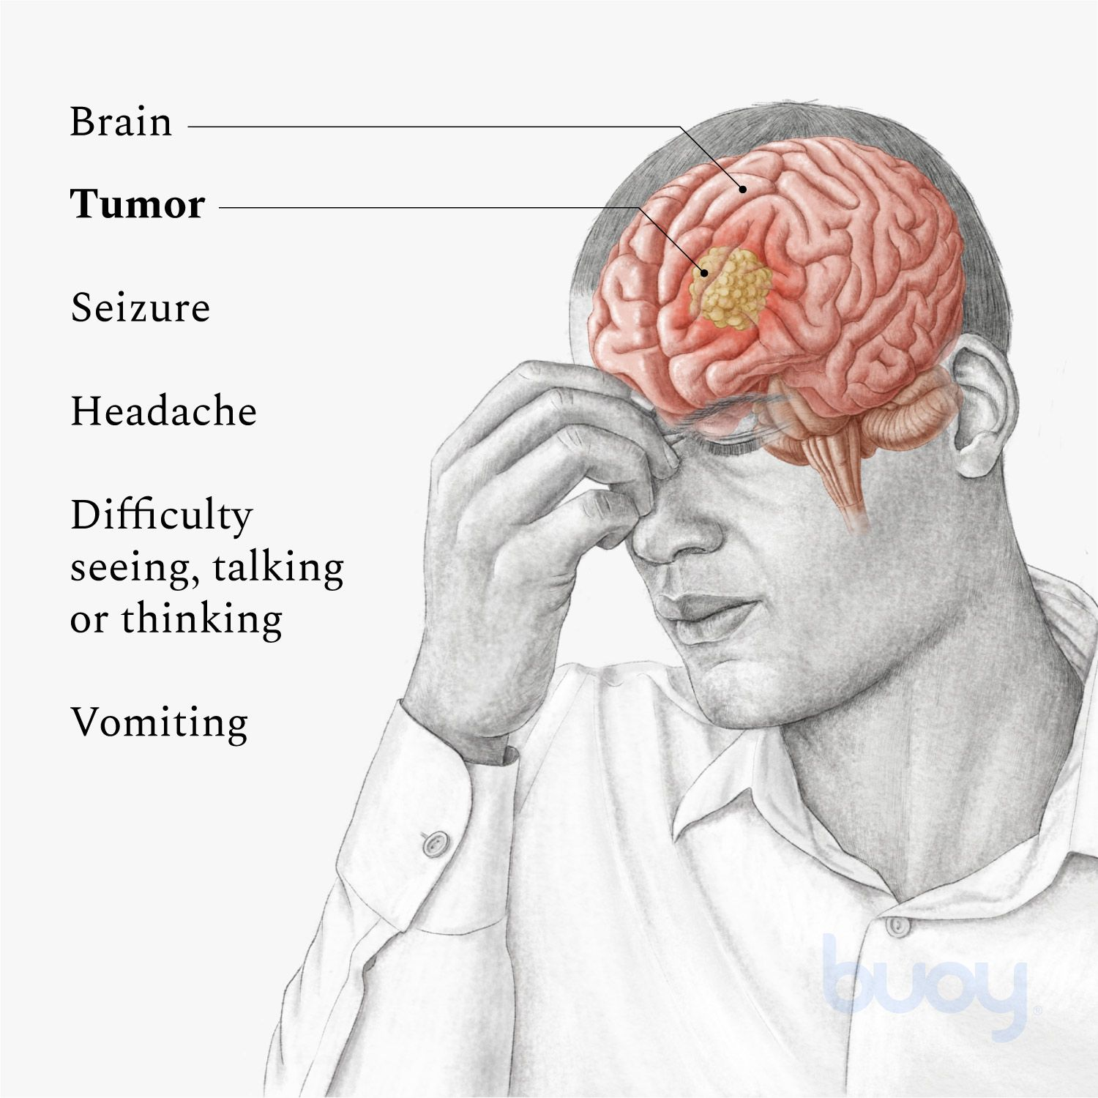
D. Brain Tumors

Slide 8
E. Strokes (Cerebrovascular Accident; Brain Attack)**
Average age--67
Risk factors: smoking, overweight, high blood pressure, aging, family history, lack of exercise
There are different types of strokes

Slide 9
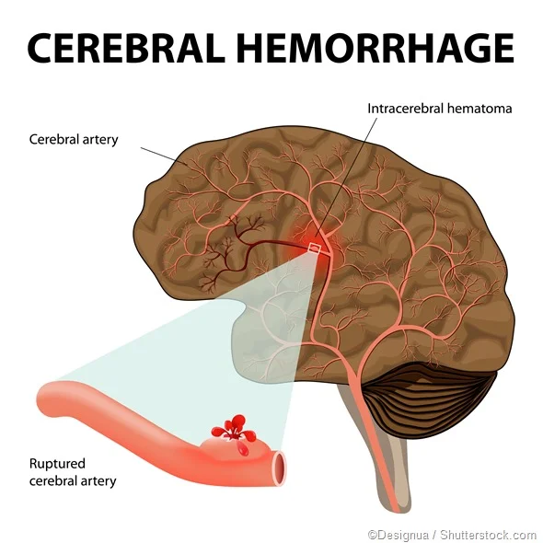
1. Cerebral Hemorrhage**
20% of all strokes—high blood pressure is a huge risk factor
Blood vessel ruptures
Blood is forced into the brain tissue
And destroys it

Slide 10
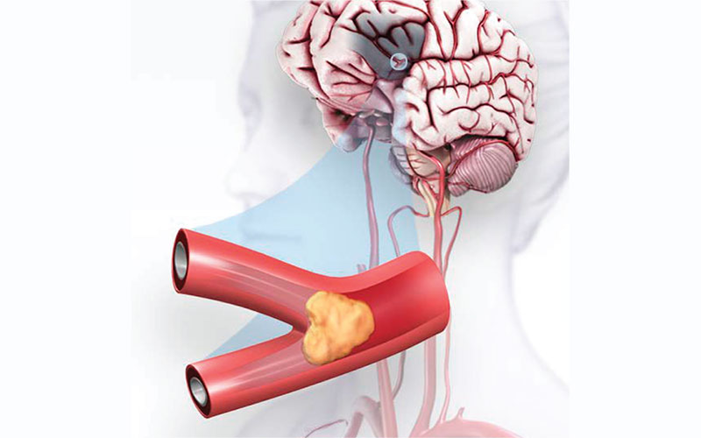
2. Occlusive (Ischemic) Strokes

Slide 11
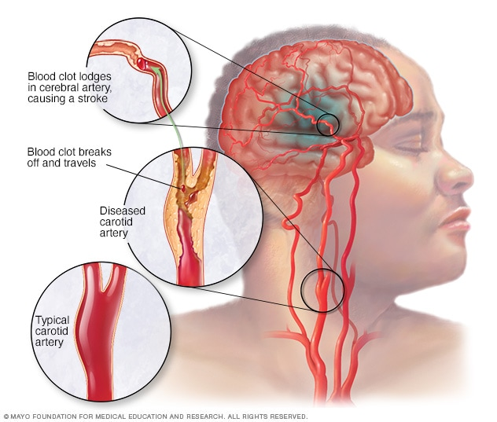
Ischemic stroke

Slide 12
Transient ischemic attacks (TIAs)

Slide 13
Cerebral Thrombosis**
The brain artery gradually becomes blocked by debris in the blood
Fatty substances accumulate on the lining of the arterial walls, leading to arteriosclerosis
50-100% of an artery may become blocked

Slide 14
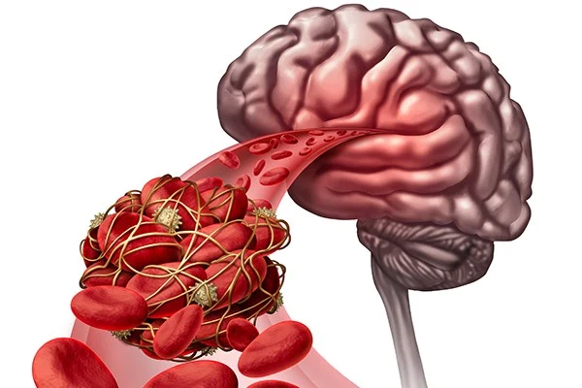
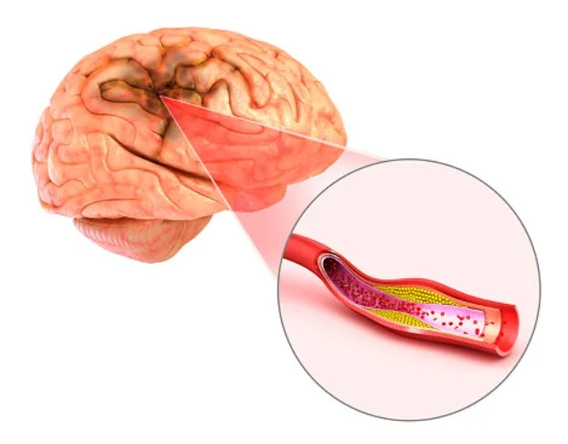

Slide 15
II. TYPES OF APHASIA
A. INTRODUCTION

Slide 16
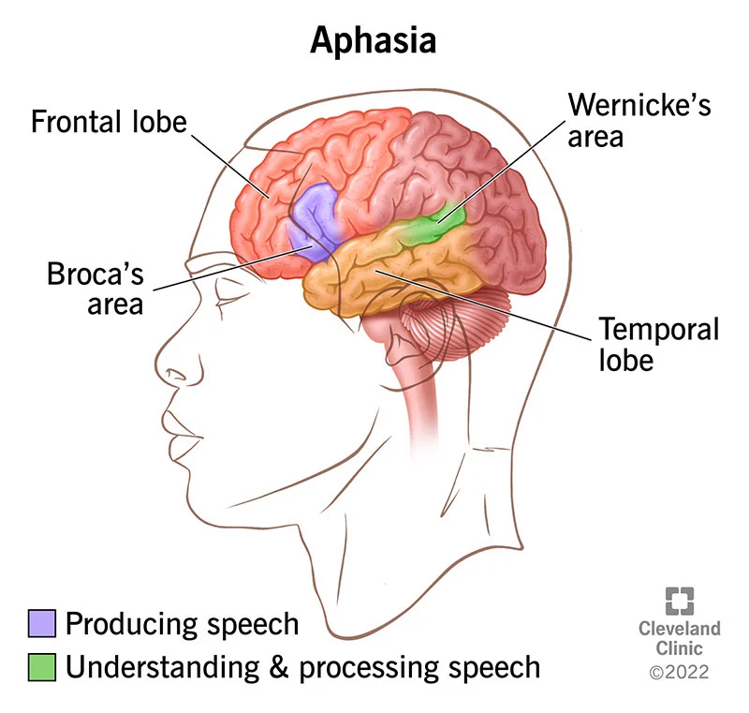
B. Wernicke’s Aphasia**
Fluent aphasia caused by damage around Wernicke’s area in superior left temporal lobe
Impaired comprehension, expression, reading, writing

Slide 17
In Wernicke’s aphasia:

Slide 18
Wernicke’s aphasia—verbal expression impairments:

Slide 19
C. Broca’s Aphasia**
Nonfluent aphasia
Impaired syntax
Still has content words
Speech is effortful, slow, groping

Slide 20
A YouTube example:
https://www.youtube.com/watch?v=RMa9BVpJkYQ
Broca’s aphasia
Notice how he struggles to get the words out

Slide 21
D. Anomic Aphasia

Slide 22
E. Global Aphasia**
Combination of fluent and nonfluent aphasia
Most severe aphasia and caused by diffuse damage
Significant receptive, expressive language and cognitive impairments
Poor prognosis

Slide 23
YouTube Global Aphasia
https://www.youtube.com/watch?v=FUutVGeoG-k
Reel example-global aphasia

Slide 24
III. ASSESSMENT OF APHASIA

Slide 25
A. Expressive Language Abilities—We Test:**
Speech systems—respiration, phonation, resonance, articulation
Confrontation naming
Fill-in-blanks
Describing pictures
Conversation/discourse skills

Slide 26
B. Receptive Language Testing—We are Evaluating:

Slide 27
C. Reading and Writing Abilities**
Silently reading a story or paragraph and answering questions about it
Writing words, letters, sentences dictated by SLP
Formulating and producing written stories
Reading aloud numbers, letters, words, phrases, sentences

Slide 28
IV. TREATMENT OF APHASIA**
A. General Principles
What does the patient’s culture believe about rehab?
Client’s age, occupation, whether they want to go back to work
Restorative approach—improving underlying processes that are impaired—e.g., teaching word recall strategies in functional situations
Compensatory approach: strategies for persistent language deficits—e.g., gestures, apps on devices

Slide 29
Therapy goals:

Slide 30
B. Receptive Skills Targeted**
Auditory comprehension!
Answering questions
Following directions
Answering questions about spoken discourse
Following conversational speech

Slide 31
C. Expressive Language Abilities

Slide 32
D. Train Communication Partners to:**
Speak slowly
Pause
Shorter utterances; avoid long, complex sentences
Augment speech with gestures and facial expressions
When person has communicated to you, paraphrase what they said to make sure you understood it

Slide 33
E. Life Participation Approach**
Increase competence and inclusion in daily life
Help patients reintegrate back into their families and communities
Strengthen their participation in activities of choice
Provide support for caregivers

Slide 34
Outline
I. Causes of Neurogenic Speech, Language, Swallowing, and Cognitive Disorders
II. Types of Aphasia
III. Assessment of Aphasia
IV. Treatment of Aphasia

