Slide 1
COGNITIVE-COMMUNICATION DISORDERS IN ADULTS
Chapter 16

Slide 2
Outline
I. Introduction
II. Right Hemisphere Disorder (RHD)
III. Foundations of Traumatic Brain Injury (TBI)
IV. Assessment of Persons with TBI
V. Intervention for Persons with TBI
VI. Dementia

Slide 3
I. INTRODUCTION**
Cognitive communication disorders are language problems that occur secondary to cognitive impairment
Impaired ability to process and use incoming information for member, reasoning, judgment, organization of information, and problem-solving
Most common etiologies: traumatic brain injury (TBI), right-hemisphere damage, dementia

Slide 4
Challenges include:

Slide 6
II. RIGHT HEMISPHERE DISORDER (RHD)**
Right hemisphere important for attention, emotions, orientation, semantic and pragmatic communication skills
Patient may have difficulties with reasoning and problem-solving, attention, memory, orientation, and executive functioning

Slide 7
RHD communication impairments can include:

Slide 8
More RHD challenges:**
Violating pragmatics rules—interrupting, changing topics, not understanding humor
Visual-spatial impairment—get lost easily
Difficulty recognizing familiar faces, even family ☹
Left side neglect

Slide 9
On page 412:**
You don’t have to know the names of the actual tests we administer

Slide 10
III. FOUNDATIONS OF TRAUMATIC BRAIN INJURY
A. Introduction

Slide 11
TBIs…**
Are a leading cause of death in people under 35
After TBI, 1 in 3 have a permanent disability
Lifelong cognitive and communication problems

Slide 12
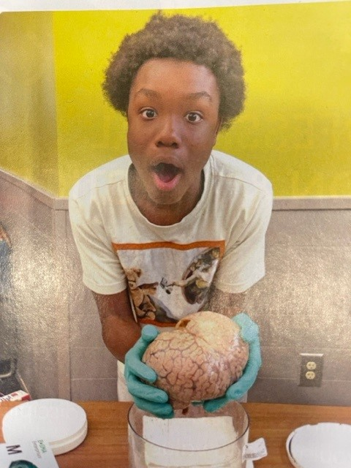
The ASHA Leader May/June 2024:**
They conducted health literacy workshops for children and teens in an at-risk area of the community—Brain Health Fair
There were brain-engagement stations
The kids loved the fair and the hands-on activities
We can think about these kinds of experiences to help prevent TBI for children and youth in high risk areas

Slide 13
B. Open Head Injury**
Results from skull and brain being penetrated by severe impact or projectiles (e.g., bullets, shrapnel from explosions)
Projectile follows a single path

Slide 14
C. Closed Head Injury

Slide 15
Sometimes there is a coup-contrecoup injury:**
Damage to the brain at the site of impact (coup)
Also the opposite side (contrecoupe)
There is tearing of axons and dendrites, hemorrhaging, etc.

Slide 16
D. Concussion/Mild Traumatic Brain Injury (MTBI)

Slide 17
MTBI can have negative impacts:**
At work
In family relationships
People may need a lot more rest than before
If frontal lobe damage, problems with memory, focus, multitasking, executive functioning
May be more irritable, anxious, depressed, unmotivated

Slide 18
E. Chronic Traumatic Encephalopathy (CTE)**
Caused by repeated mild brain traumas
Especially concussions in contact sports
CTE problems begin around 8-10 years after one experiences repeated concussions
Early symptoms are dizziness, headaches, impaired attention

Slide 19
For persons with CTE…

Slide 20
Not on Exam:**
Dr. Bennet Omalu has led the way in research on American football players with CTE
Movie: Concussion (with Will Smith)

Slide 21
E. War Wounds

Slide 22
IV. ASSESSMENT OF PERSONS WITH TBI**
A. Speech and Language Disorders
Difficulties with reading and writing, auditory comprehension, word finding
Pragmatics—social skills: difficulty interpreting others’ messages, esp. emotions, gestures, facial expressions
Saying inappropriate things, interrupting
Interpreting abstract language like making inferences
Difficulty with theory of mind—understanding another person’s perspective

Slide 23
B. Cognitive Impairments—difficulties with:**
Orientation—time, place, person, person/situation
Memory—acquiring and retaining information
Attention
Reasoning and problem-solving
Executive functioning—making and executing plans
Attention to details

Slide 25
V. INTERVENTION FOR PERSONS WITH TBI**
Team work is critical! Usually PT, OT, speech, psychologist, social worker, doctor
Must address behavioral disorders due to disinhibition
Overall goals: 1) improve physical, cognitive, and psychosocial functioning; 2) foster independence; 3) facilitate integration into community
Tx: regain lost skills, compensate for permanent damage

Slide 26
Cognitive rehabilitation:

Slide 27
VI. DEMENTIA**
A. Introduction
Syndrome caused by a progressive neurological disease
Intellectual, cognitive, communicative, behavioral, and personality deterioration
Patient shows significant decline from previous level of performance in areas like memory, language, attention, etc.
Deficits interfere with carrying out activities of daily living (ADL)

Slide 28
We won’t use the term senility ☹

Slide 29
Cognitive reserve:**
Brain’s resilience—ability to cope with increasing damage while still functioning adequately
Based on education, new learning, new experiences
Higher cognitive reserve: those with advanced education, cognitively complex and challenging professions
Someone might have Alzheimer’s but not show it because of large cognitive reserve

Slide 30
(not on exam) It’s like having a lot of money in the bank:**
If you start with lots of money, when some is withdrawn, it won’t be as noticeable
Catherine: nurse, traveled a lot, very active in her church and with her family: $500 in “brain bank”
Mary: terminated high school early, watched lots of TV all her life, not active--$200 in “brain bank”

Slide 31
B. Alzheimer’s Disease

Slide 32
Mom, Alzheimer’s, and a Conversation
https://www.youtube.com/watch?v=iJJerSu8DxE

Slide 33
Stage I: Mild Alzheimer’s:**
Disorientation
Lost while driving on familiar streets
Impaired working memory
Putting items in inappropriate places
Mood swings
May take out frustration and anger on family and colleagues

Slide 34
Stage II: Moderate-Middle Stage Alzheimer’s

Slide 35
Stage III: Severe-Late Stage Alzheimer’s**
Person needs maximal assistance for ADL
Minimal/no memory, verbal communication
Difficulty recognizing others, self (in mirror)
Difficulty chewing and swallowing
Average life span after diagnosis is 4-7 years

Slide 36
C. Communication Tips—When Interacting with Older People and Those with Dementia**
Simplify and write down instructions
Allow extra time
Minimize distractions
Speak slowly and be loud enough
Frequently summarize most important points
Stick to one topic at a time
Use short, simple words and sentences
Pause!

Slide 37
D. Assessment and Treatment**
Diagnosis made by physicians and psychologists
We evaluate language, cognition, swallowing
For the exam, no names of tests on p. 418 ☺
Goals are to 1) maximize current abilities and 2) slow down the progression of deteriorating abilities
Counseling the family is key
Helping with quality of life for patient and family

Slide 38
I’ve frequently seen that…

Slide 39
Outline
I. Introduction
II. Right Hemisphere Disorder (RHD)
III. Foundations of Traumatic Brain Injury (TBI)
IV. Assessment of Persons with TBI
V. Intervention for Persons with TBI
VI. Dementia

