Slide 1
The Professionals
Chapter 2

Slide 2
For the exam, you do not have to read:**
Starting on p. 24 with Professional Organizations
Page 25
There is nothing on the test about professional organizations except for what is on the PowerPoint ☺

Slide 3
I. PROFESSIONAL ORGANIZATIONS

Slide 4
II. Interdisciplinary Teams**
It is SO important to get along with our teams! How much they like you determines how much they cooperate with you, which has implications for the clients you serve
For example, if a teacher doesn’t like me, they might give me a lot of pushback about scheduling kids for therapy
If the school psychologist doesn’t like me, they might not show up to translate into Spanish to test children when they said they would

Slide 5
The most important people

Slide 6
Team members in schools

Slide 7
Private practice:

Slide 8
Hospital

Slide 9
Reflection--Please turn to the people next to you and spend 2-3 minutes discussing:**
How do you be likeable?☺
For example, bring food/snacks to share occasionally

Slide 10
III. SPEECH-LANGUAGE PATHOLOGISTS

Slide 11
IV. AUDIOLOGISTS

Slide 12
For audiologists, employment opportunities are growing fast:

Slide 13
https://www.theguardian.com/society/2022/nov/15/one-billion-young-people-risk-hearing-loss-from-loud-music**
More than 1 billion teenagers and young adults worldwide may be at risk of hearing loss because of their use of headphones, earphones and earbuds and attendance at loud music venues, a study suggests.
An international team of researchers estimate that 24% of 12- to 34-year-olds are listening to music on personal listening devices at an “unsafe level”.

Slide 14
V. SPEECH-LANGUAGE PATHOLOGY ASSISTANTS (SLPAs)

Slide 15
VI. IMPACTS OF A PANDEMIC

Slide 16
Not on exam:**
Right now, my greatest life mission is services for young children (primarily those in under resourced areas) impacted by the pandemic
Statistics indicate that since 2020, speech and language delays in babies and young children have more than doubled
In some areas of the world like South Africa, children’s speech and language skills are more than 3 years behind

Slide 17
This is one reason (not on exam)
That I am soooo grateful for children’s books to distribute in the U.S. and overseas

Slide 18
VII. CULTURAL COMPETENCE

Slide 19
For example—Mainstream U.S. values:

Slide 20
Other mainstream U.S. values:

Slide 21
Mainstream U.S. values:
It is OK for older people to live in separate medical facilities
When partners get together, they should move out of their parents’ home and live on their own
The most successful people are those who are very busy and work hard
More money and possessions are a sign of success

Slide 22
Values continued:

Slide 23
But in different cultures:**
Does an older person or a child with a disability come from a culture where the family believes they must do everything for them?
This family may feel uncomfortable accepting help from professionals
Does the person come from a religion where a male therapist may not be alone in a room with a female patient?
Does the client come from a religion where they don’t believe in Western medicine and they don’t want antibiotics for their child with middle ear infections?

Slide 24
Developing Cultural Competence

Slide 25
To develop cultural competence, we can also:**
Be aware of our own values and beliefs
Ask students/patients/families to share with you
Learn some basic vocabulary in other languages
Attend churches, festivals, gatherings of other cultures

Slide 26
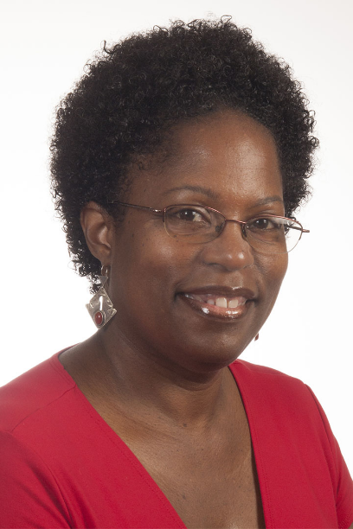
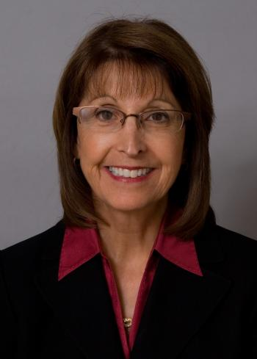
Hyter, Y.D., & Salas-Porvance, M.B. (2023). Culturally responsive practices in speech, language, and hearing sciences (2nd ed.). San Diego: Plural Publishing.

Slide 27
We will focus on providing equity and access to everyone, not just those who live in certain zip codes**

Slide 28
Equality means: (Hyter & Salas-Provance, 2023):

Slide 29
Equity means: (Hyter & Salas-Provance, 2023):

Slide 30
Hyter & Salas-Provance, 2023:**
We need to be aware of health equity as well
Health equity is the realization of the highest level of health for everyone, and we need to work hard to address health inequality (e.g., lack of health insurance)
Health disparities are often associated with social, economic, and environmental disadvantages

Slide 31
Remember intersectionality**
The acknowledgement that everyone has their own unique experience of discrimination and oppression
We must consider everything and anything that can marginalize people…gender, physical ability, race, class, socioeconomic status, etc.

Slide 32
Help clients and families…

Slide 33
In this class, we will emphasize

