Slide 1
Anatomy and Physiology of Speech and Language
Chapter 3

Slide 2
Outline
I. Introduction
II. The Respiratory System
III. The Phonatory System
IV. The Resonation System
V. The Articulation System
VI. The Nervous System

Slide 3
I. INTRODUCTION**
Anatomy: structures
Physiology: movement and function
It starts in the brain, which helps us speak automatically
When the brain is impacted with an event like a stroke or traumatic brain injury, speech becomes more effortful and conscious—and that is where therapy comes in!

Slide 4
We need to think about several processes:

Slide 6
Overview of the speaking process:
https://www.youtube.com/watch?v=JF8rlKuSoFM
How Does the Human Body Produce Voice and Speech? (4 minutes)
NIH

Slide 7
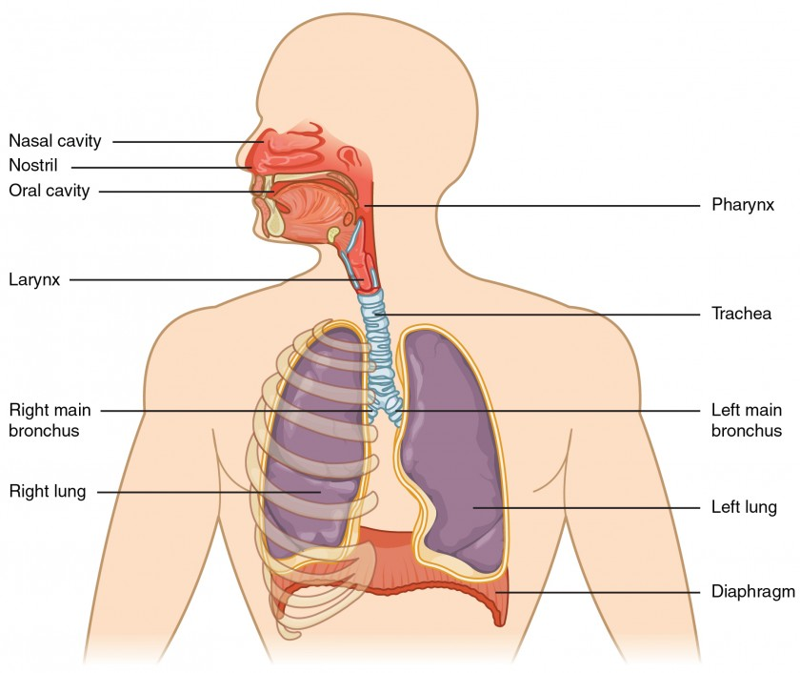
II. RESPIRATORY SYSTEM**
We inhale and exhale air
Thorax extends from the clavicle and first rib down to the 12th rib
Ribs attach to the sternum in the center of the chest and vertebral (spinal column) in the back of the chest
Diaphragm: primary muscle of respiration

Slide 8
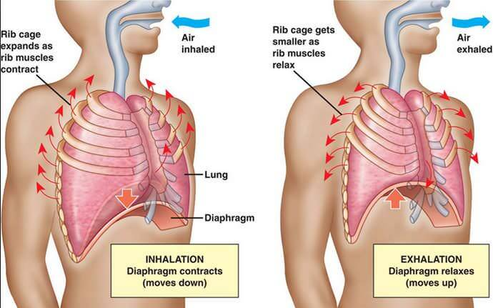

Slide 9
When we breathe:

Slide 10
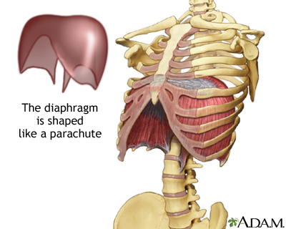
When we breathe in,** the diaphragm moves down and increases space in the thoracic cavity
When we breathe out, diaphragm moves up and decreases the volume in the thoracic cavity

Slide 11
Let’s watch a video on YouTube
https://www.youtube.com/watch?v=MPovpAXcmIU
3D Medical Mechanics of breathing L v 1 0

Slide 12
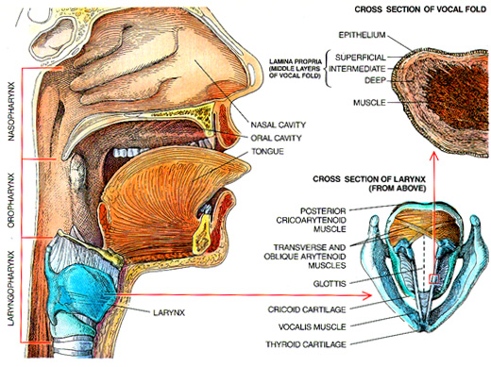
III. THE PHONATORY SYSTEM

Slide 13
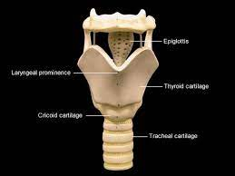
Larynx:

Slide 14
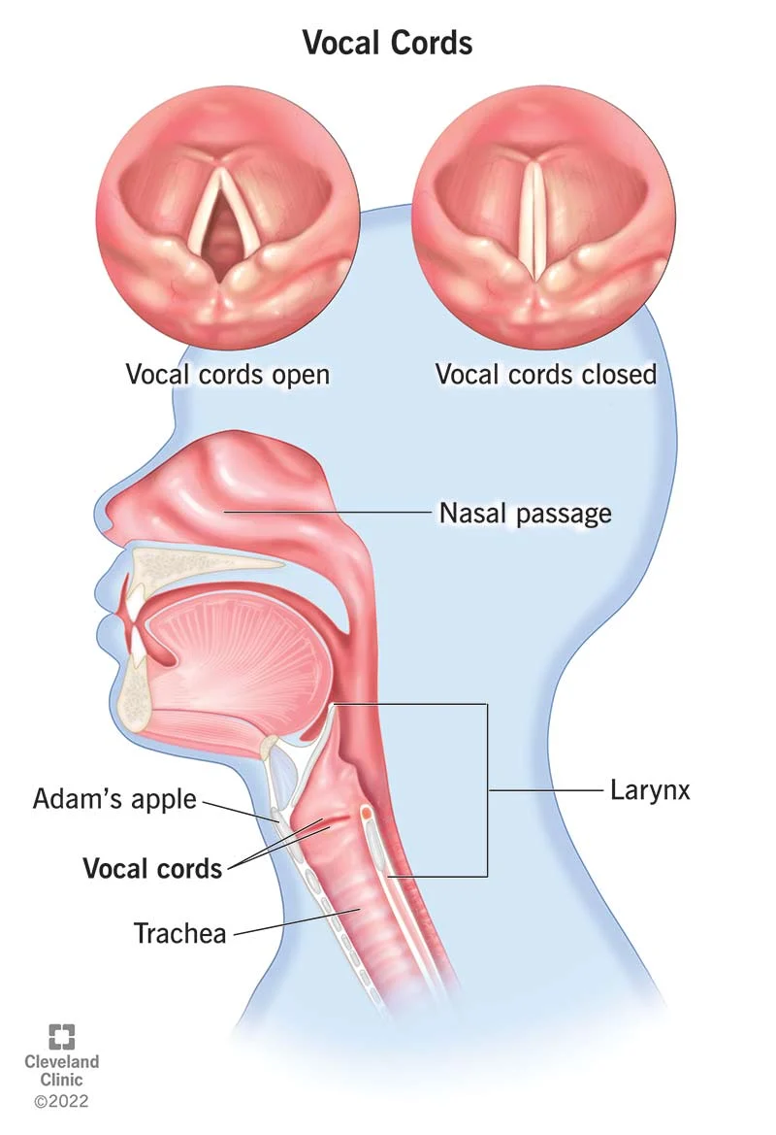
The true vocal folds**
Muscles covered with mucous membranes--look pearly white
2 functions: 1) prevent food and liquid from entering the trachea, 2) vibrate to produce voice

Slide 15
For voicing:

Slide 16
Let’s watch the process of phonation:**
https://www.youtube.com/watch?v=ecJtOaEu0aQ
AnaTomy AniMation

Slide 17
Voicing is characterized by frequency, intensity, and quality**
Frequency: pitch, or # of times the vocal folds vibrate per second
Intensity--loudness
Quality is very subjective: soothing, hoarse, etc. (not on test)

Slide 18
IV. THE RESONATION SYSTEM**
Resonance: the quality of voice that results from the vibration of sound in the vocal tract
This child has a hypernasal voice—too much air is escaping
https://www.youtube.com/watch?v=KWz5_fpnZYc
Hypernasality—Jones & Bartlett Learning

Slide 19
In hyponasality:

Slide 20
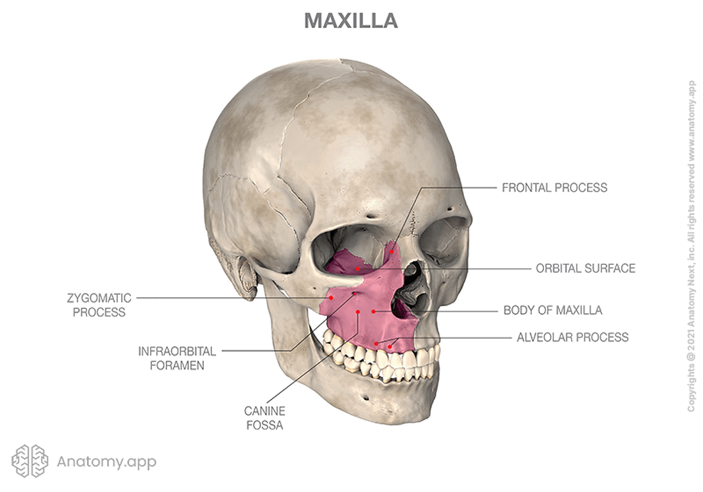
Important structures of resonation:**
Maxilla—upper jaw which contains the hard palate (roof)
Hard palate is the anterior 2/3 of the roof
Alevolar ridge surrounds the hard palate on 3 sides—covered by gums

Slide 21
Another look—the soft palate is important as well

Slide 22
Resonation—the soft palate has to move up to close off the nasal cavity

Slide 23
Another look:

Slide 24
Watch the soft palate elevate:
Speech Graphics' Simone Articulation System
https://www.youtube.com/watch?v=wYwk07QM4rc

Slide 25
V. THE ARTICULATION SYSTEM**
Sensory and motor systems of the brain are involved in movements of the articulators
When someone has a stroke, their ability to make speech sounds may be affected

Slide 26
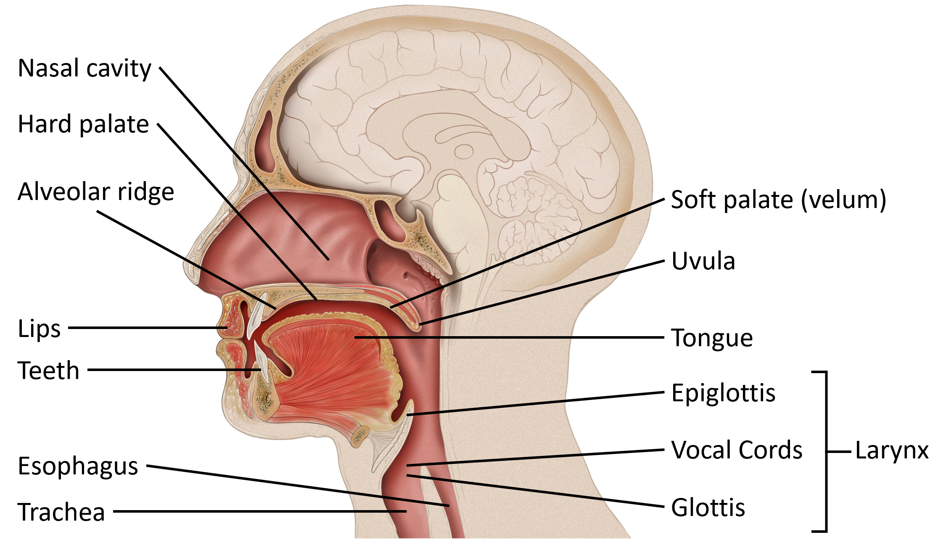
We are concerned with:

Slide 27
During articulation:**
Air comes from the larynx
Very precise and rapid movements of the mandible, lips, and tongue modify or shape the air
Say “catch, dog, bib, money, precisely, hippopotamus” and feel the movements of the articulators

Slide 28
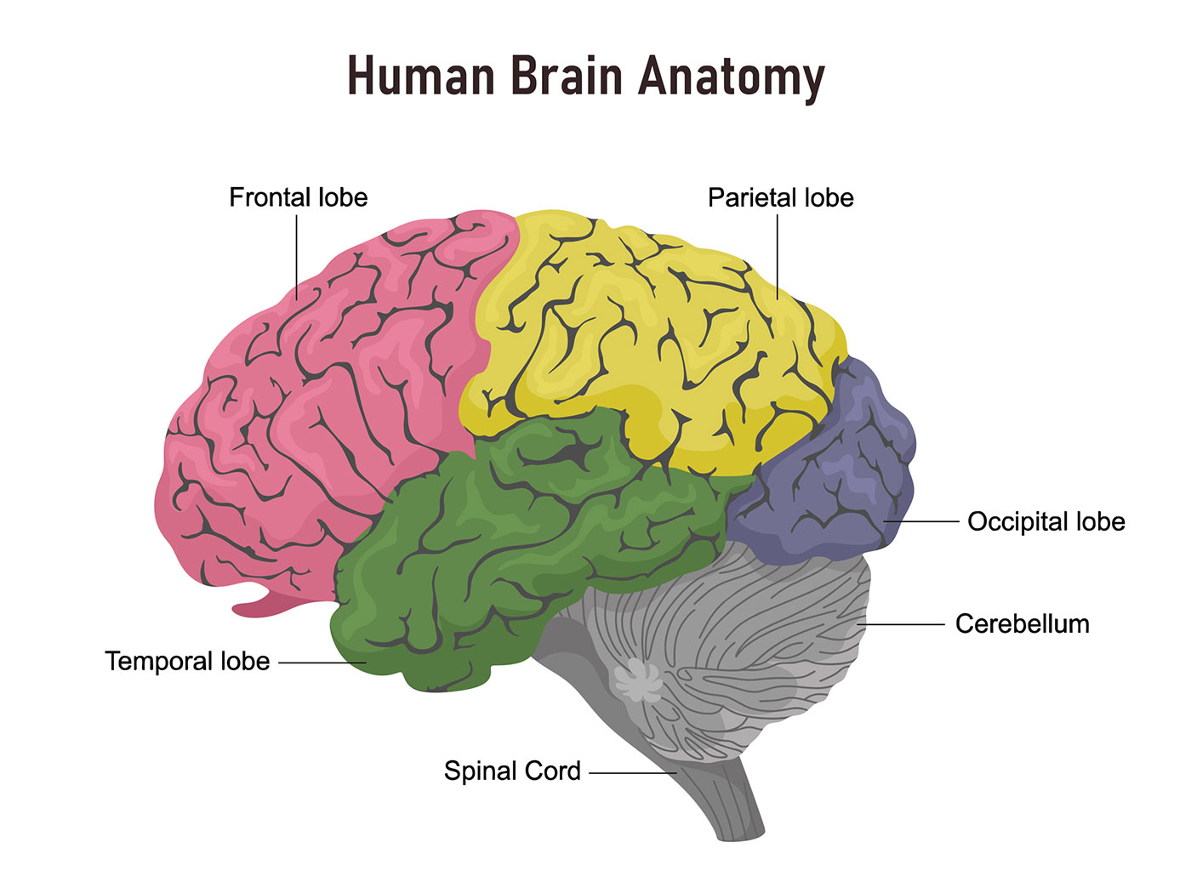
VI. THE NERVOUS SYSTEM**
A. Introduction
Brain weighs 3 pounds and has the consistency of jello
Contains 100 billion neurons or brain cells
Brain cells are connected by axons, dendrites, and synapses

Slide 30
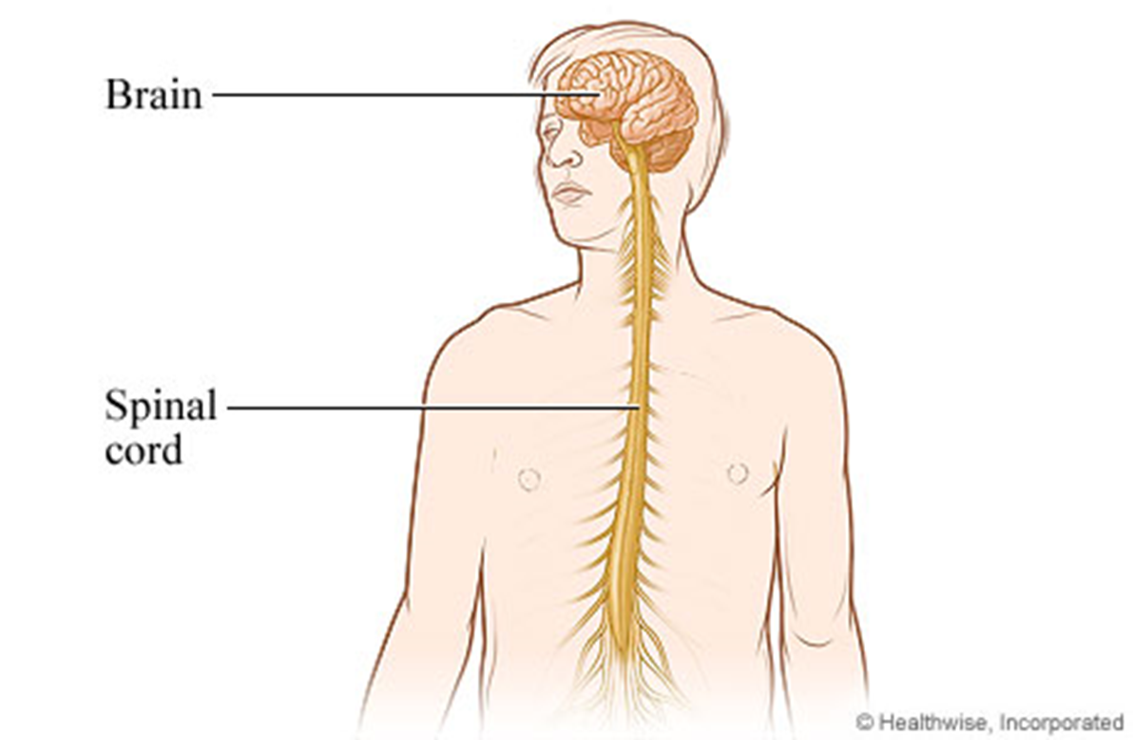
B. Central Nervous System

Slide 31
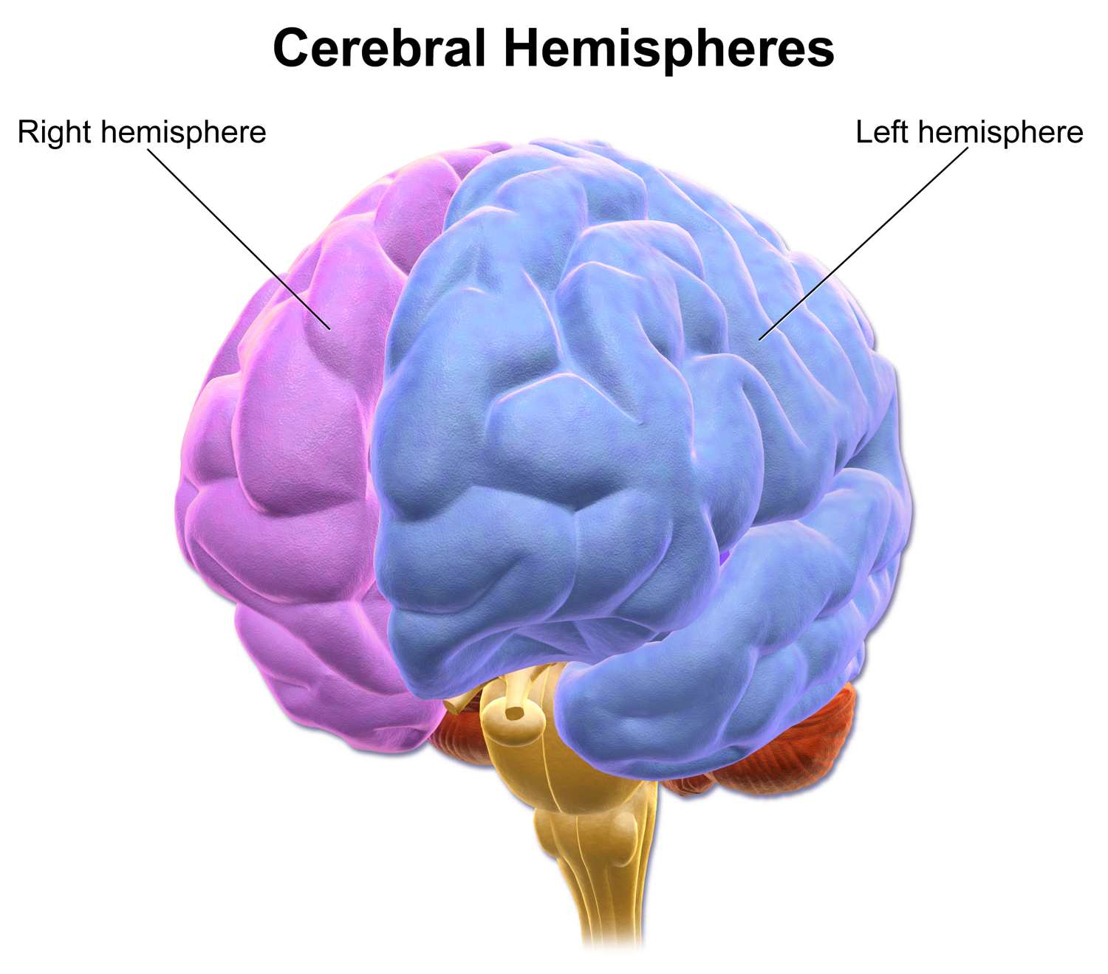
The brain is divided into the left and right hemispheres

Slide 32
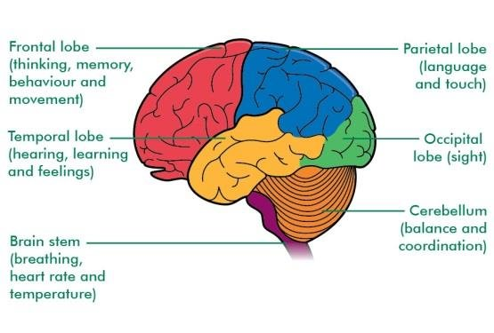
The brain is divided into several lobes: (on exam)

Slide 33
C. Peripheral Nervous System**
Cranial nerves that exit from the brainstem
Spinal nerves that exit from the spinal cord

Slide 35
Cranial nerves exiting the brainstem

Slide 36
The most important cranial nerves for speech and hearing:**
V-Trigeminal—face and jaws
VII—Facial—face and tongue
VIII—Acoustic--hearing, balance
IX—Glossopharyngeal—tongue, pharynx
X—Vagus nerve--larynx, respiration, heart, GI system
XI—accessory spinal nerve—neck and shoulders
XII—hypoglossal nerve—tongue and neck

Slide 37
Not on exam: ☺

Slide 38
Outline
I. Introduction
II. The Respiratory System
III. The Phonatory System
IV. The Resonation System
V. The Articulation System
VI. The Nervous System

Slide 39
Reflection: Not on the exam—in small groups, discuss whether you think you are mostly right brained or left brained and why**

