Slide 1
Chapter 5
SPEECH SOUND DISORDERS: ARTICULATION AND PHONOLOGY

Slide 2
Outline
I. Introduction
II. General American English
III. Consonants
IV. Etiologies of Communication Disorders
V. Speech Sound Disorders
VI. Assessment for Speech Sound Disorders
VII. Treatment for Speech Sound Disorders

Slide 3
I. INTRODUCTION**
Speech sound disorders (SSDs) are the most common communication disorders in children
They have trouble pronouncing their sounds correctly
They can be hard to understand

Slide 4
Here is a 6 year old with a speech sound disorder**
https://www.youtube.com/watch?v=FY65V1v4_Dw
Articulation Disorders Connected Speech Sample 6 y.o.
Malinda Howard
He should be 100% intelligible, but notice that you have some difficulty understanding him

Slide 5
II. GENERAL AMERICAN ENGLISH**
Used by TV and radio broadcasters
Letter: arbitrary written or printed symbol (t, w, h)
Phoneme: shortest arbirary unit of sound in a language that can be recognized as being distinct from other sounds in a language
English has 26 letters and 45 speech sounds/phonemes

Slide 6
For example:**
In H, “eitch” is the letter
The sound or phoneme is /h/
C is the letter
The sound is /s/ or /k/
The sound F varies: enough, phone, forest

Slide 7
International Phonetic Alphabet (IPA)**
We use phonetics to describe individual sounds in a language
The IPA has transcription symbols (page 94)
There are 25 consonants and 15 vowels

Slide 9
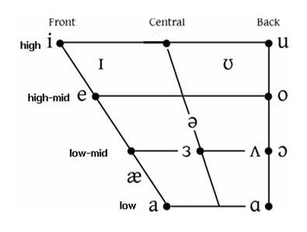
Vowels**
For the exam, just know that there is a vowel quadrilateral that describes the position of the tongue

Slide 10
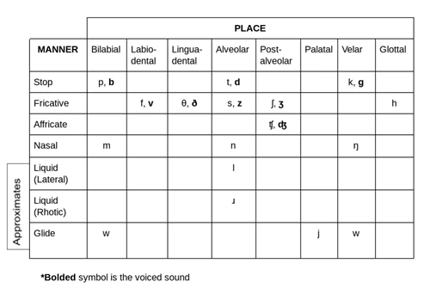
III.CONSONANTS**
They are generally described by place, voice, and manner of production

Slide 11
A. Place

Slide 12
Place continued:**
Palatal consonants—blade or body of the tongue is near the hard palate –sh, ch, j (Jane), y, r
Velar consonants—back of the tongue approaches the soft palate (k, g, ng [ring]
Glottal consonant—vocal fold level--/h/

Slide 13
B. Manner (only what is on this slide is on the exam, not the info on p. 97; stop reading p. 97 where it says “Manner”)

Slide 14
C. Voice

Slide 15
IV. ETIOLOGIES OF COMMUNICATION DISORDERS**
A. Introduction
What causes communication disorders?
For example, what causes a child to have a speech sound disorder?

Slide 16
B. Environmental Variables**
1. Prenatal Environment
During the first trimester, the embryo is most susceptible to medical complications
The mother may have diabetes, lack of folic acid, need to take medication….

Slide 17
2. Substance Abuse

Slide 18
3. Low birth weight and prematurity

Slide 19
4. Perinatal environment**
Birth complications can cause anoxia—oxygen is completely cut off
Hypoxia—oxygen is partially cut off
May have great difficulty with communication, cognition, and swallowing

Slide 20
5. Postnatal environment**
A child may be in an environment with little speech and language stimulation
This can cause delays
To review, in 2022, post-pandemic, the number of young children with speech and language delays more than doubled worldwide

Slide 21
C. Hearing Loss

Slide 22
V. SPEECH SOUND DISORDERS**
Umbrella term: problems in correctly producing speech sounds
Speech sound disorder
Phonological disorder
Articulation disorder

Slide 23
A. Articulation Disorders

Slide 24
Articulation Disorder--SODA:

Slide 25
B. Phonological Disorders**
The child has the physical ability to produce the sound
They just haven’t learned all the linguistic rules for producing and combining sounds into syllables
For example, a child can say /g/ but says do-/dog (final consonant deletion)

Slide 26
VI. ASSESSMENT FOR SPEECH SOUND DISORDERS**
A. Caregiver Questionnaire and Interview
Birth and developmental history
Speech and language development
Medical history
Hearing problems
School history

Slide 27
It’s so important to ask caregivers:

Slide 28
B. Other Areas to Assess**
Test hearing!
Oral mechanism examination—we look extensively at the lips, tongue, hard and soft palate, and teeth
In this video, Professor Haberstock demonstrates
https://www.youtube.com/watch?v=wHNj2DinbGc&t=217s

Slide 29
Teachers report that:

Slide 30
C. Connected Spontaneous Speech Sample**
We talk to the child and get them to converse with us
We ask: How intelligible are they? What percentage do we understand?
What errors do we hear?

Slide 31
D. Structured Assessment

Slide 32
Here is an example of a standardized test:
https://www.youtube.com/watch?v=fc7Vp5KTdWQ
Goldman Fristoe Test of Articulation Project Morgan Steele

Slide 33
E. Linguistic Diversity: Speech Sound Differences vs. Disorders**
In the public schools, it is illegal to treat children for speech sound patterns or differences based on the first language
A Spanish-speaking child might say “ I like berry much espeech.” This is a predictable difference, not a disorder!!

Slide 34
F. Orofacial Myofunctional Disorders—Tongue Thrust**
We must use a team approach
Usually it’s the SLP, dentist, and orthodontist
You must be very highly trained—it’s a specialty

Slide 35
Characteristics of Tongue Thrust**
During swallowing, tongue comes forward--tip in contact with lower lip
At rest, tongue is carried forward—tip is between or against anterior teeth while mandible is open

Slide 37
In the public schools….
No tx!
TT does not have an adverse impact on a child’s access to the curriculum

Slide 38
VII. TREATMENT FOR SPEECH SOUND DISORDERS**
Stage 6 Conversation
↑
Stage 5 Sentences
↑
Stage 4 Phrases
↑
Stage 3 Words
↑
Stage 2 Nonsense syllables
↑
Stage 1 Isolation

Slide 39
Articulation (phonetic) treatment:**
Focuses on the mechanics of producing the speech sounds
E.g., “Put the middle of your tongue on the roof of your mouth and say K.”

Slide 40
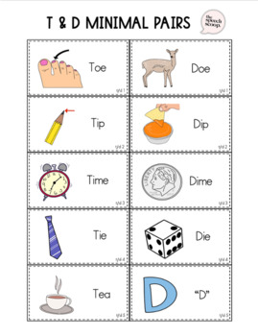
Something we commonly use:**
Minimal pair therapy

Slide 41
Therapy for children with speech sound disorders**
Is fun and rewarding!

Slide 42
Outline
I. Introduction
II. General American English
III. Consonants
IV. Etiologies of Communication Disorders
V. Speech Sound Disorders
VI. Assessment for Speech Sound Disorders
VII. Treatment for Speech Sound Disorders

