Slide 1
ANATOMY AND PHYSIOLOGY AND TYPES AND CAUSES OF HEARING LOSS
Chapter 19

Slide 2
Outline
I. Anatomy and Physiology of the Hearing Mechanism
II. General Facts About Hearing Loss
III. Conductive Hearing Loss
IV. Auditory Nervous System Impairments
V. Hearing Loss and Disorders of the Inner Ear
VI. Communication Disorders of Individuals who are D/HOH
VII. How to Protect our Hearing
VIII. Hearing Testing

Slide 3
Youtube video:
https://www.youtube.com/watch?v=PbBZjT7nuoA
Hearing loss simulation: What’s it like?

Slide 4
Rather than the term “hearing impaired”**
Deaf/Hard of Hearing DHOH

Slide 5
I. ANATOMY AND PHYSIOLOGY OF THE HEARING MECHANISM
A. Outer Ear

Slide 6
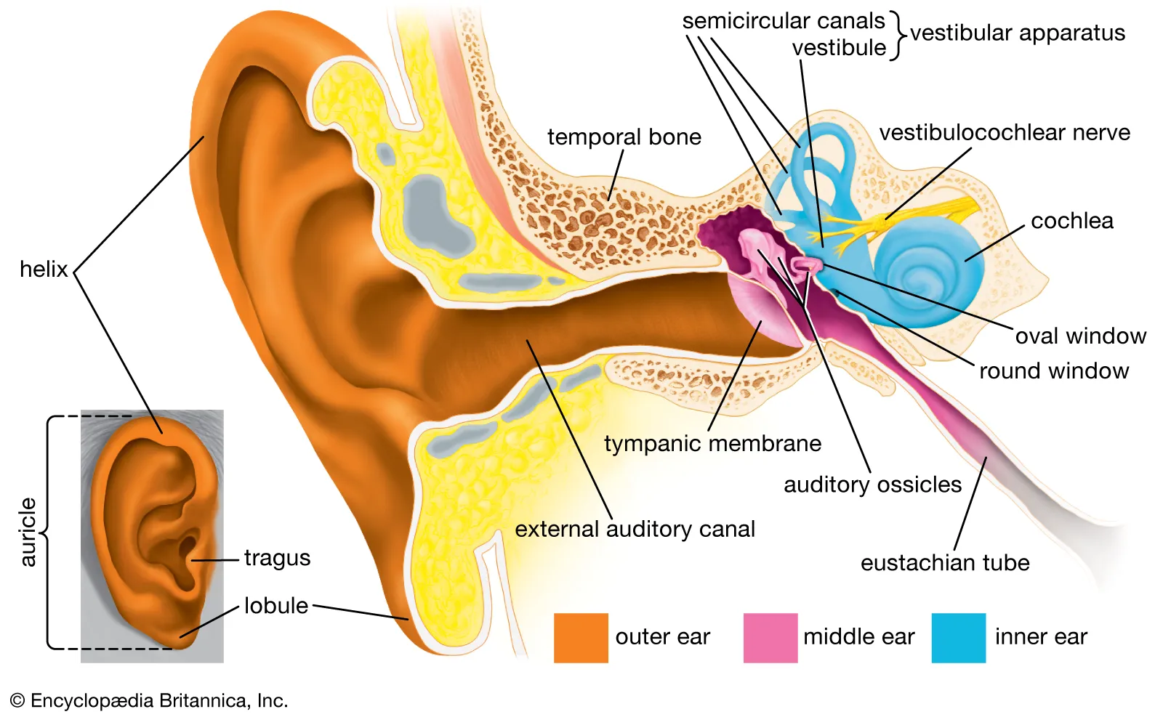
External ear canal is a narrow tube leading from an opening in the skull to the tympanic membrane (eardrum)**

Slide 7
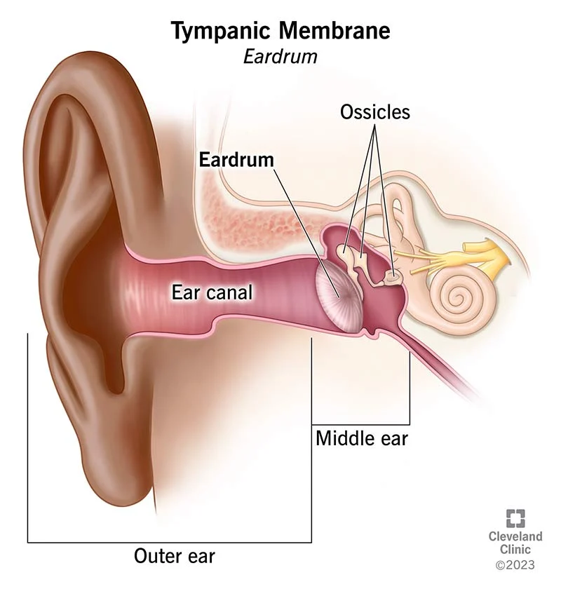
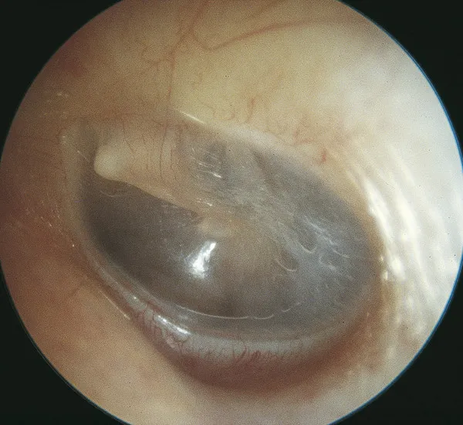
The tympanic membrane** separates the ear canal from the middle ear
It transmits sound waves or vibrations into the middle ear

Slide 8
B. Middle Ear

Slide 9
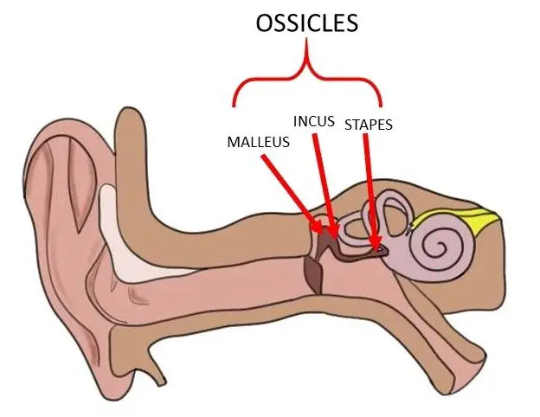
Ossicles of middle ear:

Slide 10
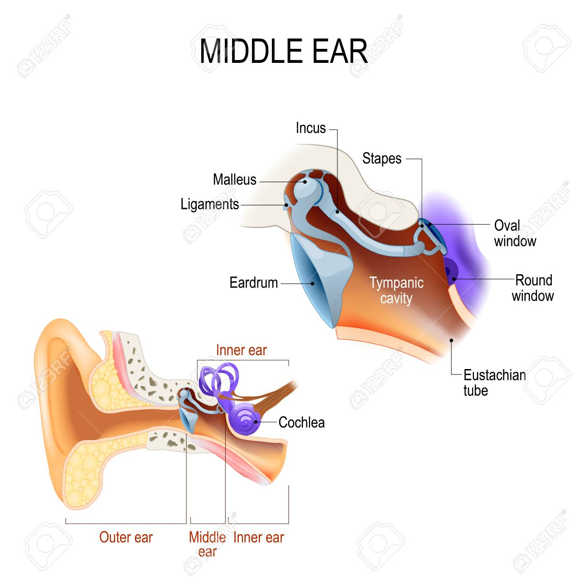
The ossicles:

Slide 11
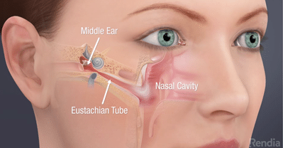
Eustachian tubes:**
Lead from the middle ear to the nasopharynx at a downward angle
Openings of ETs are normally closed at the nasopharyngeal end but remain open in babies until 6 months old
They open when we chew, swallow, yawn, and sneeze to allow air to flow into the middle ear cavity

Slide 12
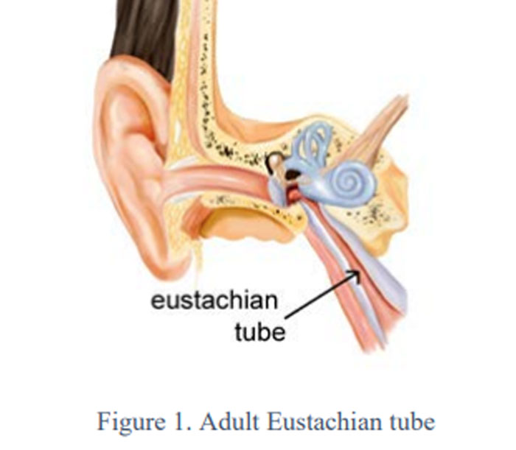
The Eustachian tubes:

Slide 13
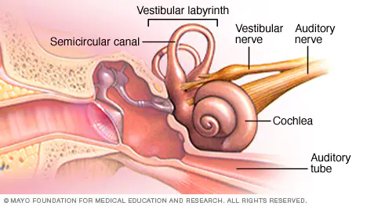
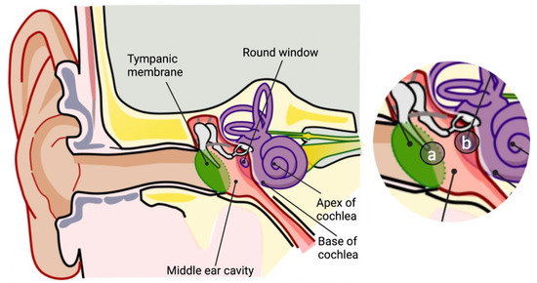
C. Inner Ear**
Cochlea and vestibular system
Cochlea is protected by being housed in the temporal bone of the skull
Cochlea has 15,000+ tiny hair cells that are stimulated by movement of the cochlear fluid in response to sound

Slide 14
Hair cells of the cochlea:

Slide 15
Process:

Slide 16
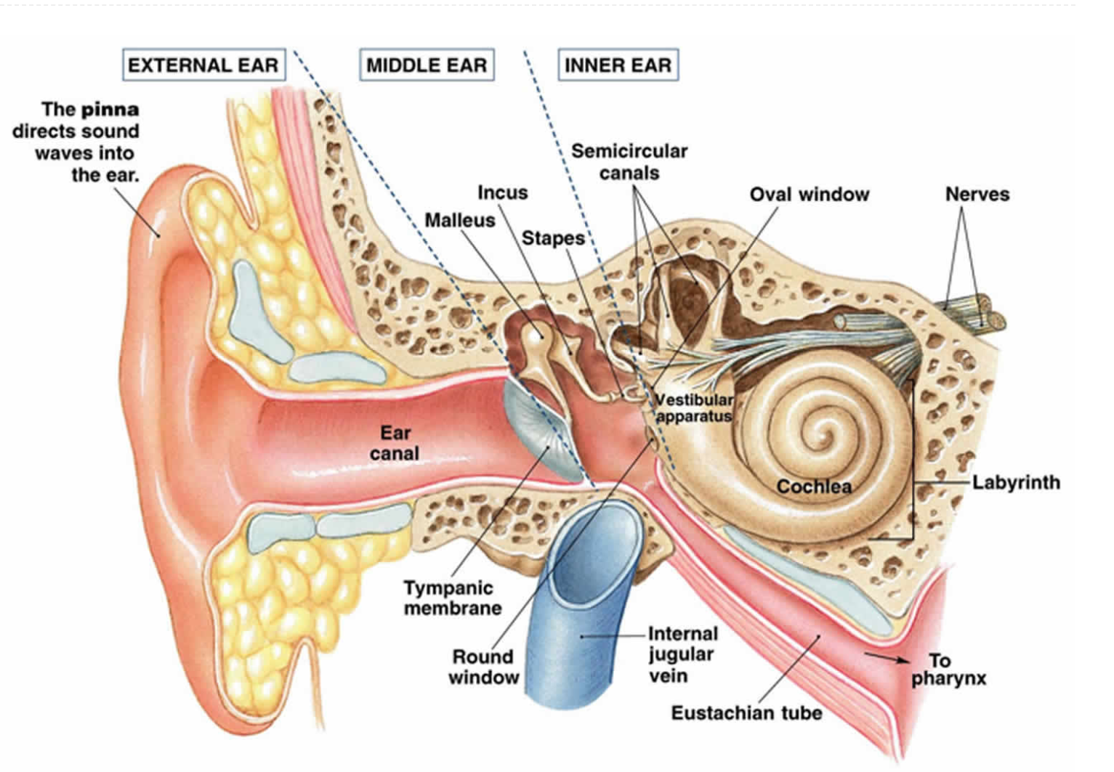
D. Vestibular Mechanism**
Acts as a motion detector
Affected by gravity and inertia
3 semicircular canals that contain fluid
As we move our head or body, fluid stimulates different portions of the semicircular canals
This sends sensation to the vestibulocochlear nerve

Slide 18
Vestibular system can become confused:

Slide 19
II. GENERAL FACTS ABOUT HEARING LOSS**
For the exam, don’t worry about the terms hearing sensitivity impairment and auditory nervous system impairment on page 467
Globally, hearing loss is the most common of all physical impairments
Adolescents have had a 5% increase in hearing loss compared to their same age group 15 years ago
Nearly ½ of those over 75 years old are HOH (hard of hearing)

Slide 20
III. CONDUCTIVE HEARING LOSS**
A. Introduction
Problem with the middle ear
Otitis media with effusion (OME) is one of the most common middle ear disorders
Any inflammation, infection, or both of the mucous membrane lining the interior of the middle ear
Organisms produce pus that results in effusion (fluid in the middle ear)

Slide 21
Middle ear infections—otitis media with effusion:

Slide 22
Middle ear infections…

Slide 23
In OME…**
The Eustachian tube is infected and swells up
Thus, it can’t ventilate the middle ear
Air inside the middle ear is trapped and begins to be absorbed by the walls of the middle ear cavity
The lining of the ear becomes inflamed, and fluid from the inflammation seeps into the middle ear cavity
This creates a conductive hearing loss—there is impeded movement of the ossicles and tympanic membrane

Slide 24
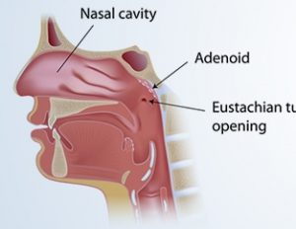
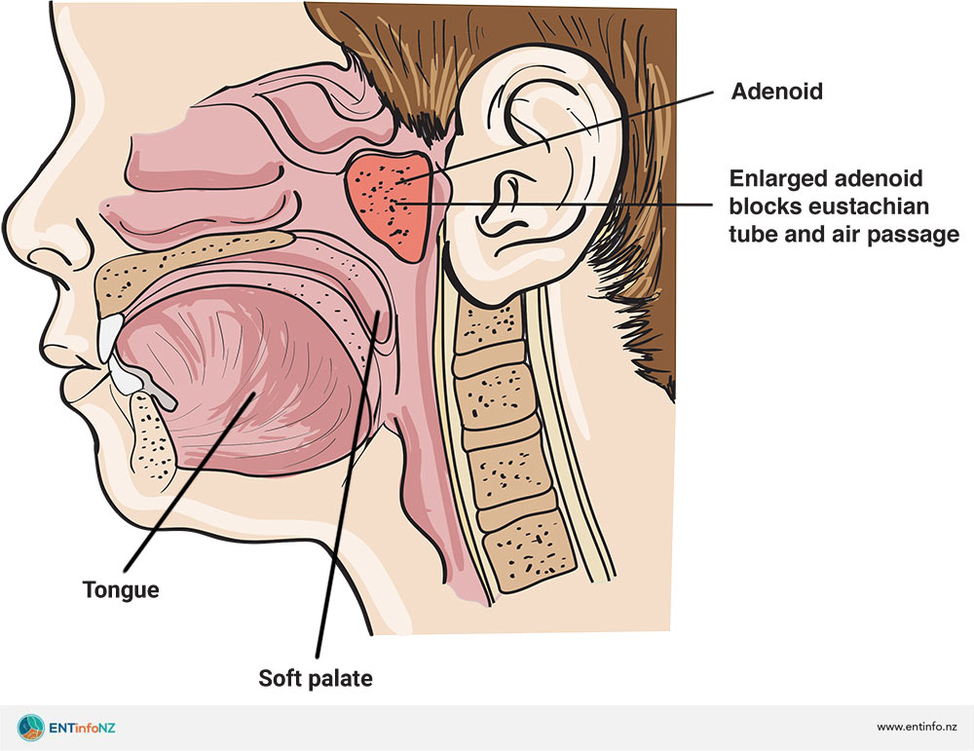
The child may…

Slide 25
With OME…

Slide 26
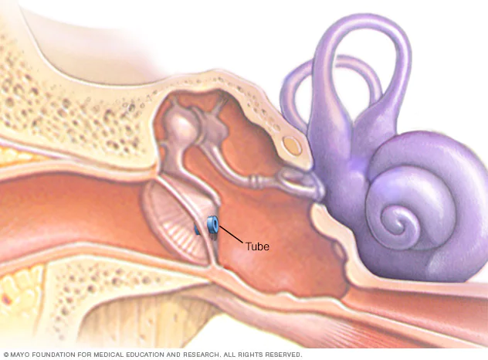
Surgical management:**
Myringotomy: a small surgical incision is made into the tympanic membrane to relieve pressure and release pus from the ear
They insert a tiny pressure equalizing tube to act as a drain and ventilate the middle ear

Slide 28
IV. AUDITORY NERVOUS SYSTEM IMPAIRMENTS**
May occur in the cochlea, auditory nerve, auditory nerve (Cranial nerve VIII) or inside the brain
An acoustic neuroma is a benign brain tumor on the auditory nerve
It can create permanent hearing loss, ringing in the ear, and balance problems

Slide 29
Acoustic neuroma:
Cerebellum

Slide 30
V. HEARING LOSS AND DISORDERS OF THE INNER EAR (cochlea)
A. Causes of Hearing Loss

Slide 31
Other causes of hearing loss include:**
Childhood diseases like measles and mumps
Head trauma
When people take ototoxic medications

Slide 32
Today:**
Newborn hearing screening is routine and compulsory in most states
They use ABR—auditory brainstem response
It’s noninvasive: electrodes are attached to a baby’s scalp

Slide 33
Noise-induced hearing loss…

Slide 34
B. Presbycusis**
Progressive hearing loss that occurs due to aging
Usually starts to set in at age 60
Difficulty hearing in noisy environments

Slide 35
Reflection
Does anyone in your life have a hearing loss? If so, what is the impact on them, their family, their friends?
If no one in your life has a hearing loss, pretend that a beloved grandparent or other relative can’t hear you any more. How would that impact their relationship with you, other family members, and their friends?

Slide 36
C. Meniere’s Disease

Slide 37
D. Tinnitus**
Ringing, roaring, swishing sound in ear
Can be a sign of otosclerosis, a form of abnormal bone growth within the middle ear that causes progressive hearing loss
May be acoustic neuroma or Meniere’s disease
Can have a widespread negative impact on a person’s life

Slide 38
VI. COMMUNICATION DISORDERS OF INDIVIDUALS WHO ARE D/HOH**
Introduction
Look at variables like age of onset, severity, and configuration of the hearing loss
Type of loss: conductive, sensorineural, mixed?

Slide 39
High frequency loss is the most common and impacts ability to hear these sounds:

Slide 40
B. Speech and Language Skills**
Many children are fluent in American Sign Language
Those who receive cochlear implants early in life often have average-superior speech and language skills
There may be speech and language delays if children don’t get support like learning ASL, getting cochlear implants, or both

Slide 41
In certain circumstances, there may be challenges with:

Slide 42
I’m deaf, but I probably speak more languages than you do: **
https://www.youtube.com/watch?v=B5P0dZfhhC4

Slide 43
VII. HOW TO PROTECT OUR HEARING**
Wear ear plugs or ear muffs—they don’t have to be ugly!

Slide 44
We can also…

Slide 45
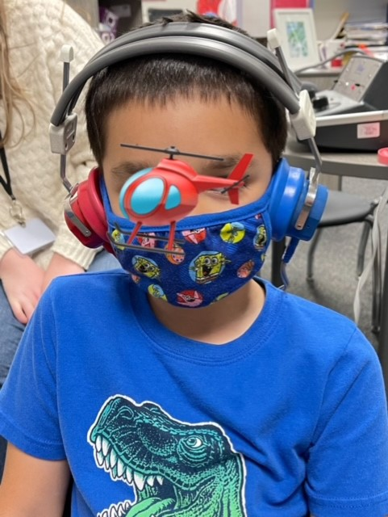
VIII. HEARING TESTING

Slide 46
For example:**
Does the child have OME and needs antibiotics? Maybe PE tubes?
Does the child need a cochlear implant?

Slide 47
In the schools…**
Frequently there is a DHOH specialist to support DHOH students
The SLP’s main role is to conduct speech and language therapy to address speech and/or language disorders

Slide 48
Outline
I. Anatomy and Physiology of the Hearing Mechanism
II. General Facts About Hearing Loss
III. Conductive Hearing Loss
IV. Auditory Nervous System Impairments
V. Hearing Loss and Disorders of the Inner Ear
VI. Communication Disorders of Individuals who are D/HOH
VII. How to Protect our Hearing
VIII. Hearing Testing

