Slide 1
ESSENTIAL COUNSELING PRINCIPLES AND SKILLS FOR SLPS AND AUDIOLOGISTS
Chapter 21

Slide 2
I. INTRODUCTION**
“I don’t do counseling. I am just an SLP/audiologist who treats speech, language, and hearing.”
My former students, especially in the hospitals: “I thought the counseling class was just fluff. But counseling is what I do every day and I wish I’d paid better attention.”

Slide 3
When a person has a communication disorder….
They and their families need support in managing the emotions that come with it
We help clients and families adjust to and cope with feelings about a disorder or situation

Slide 4
Counseling is a process of engagement between 2 people
Both will change through this process
We develop a deeper understanding of other people and ourselves

Slide 5
Our job is to:

Slide 6
We also need to:
Provide support—ideally, peer groups of people who are in the same situation
Discuss negative emotions and thoughts related to the communication disorder

Slide 7
Remember…**
You don’t have a second chance to make a good first impression
Make sure that the first contact (phone, email, F2F) is warm, professional, and genuine

Slide 8
II. POTENTIAL COUNSELING ISSUES
1. Age—the client might not respect a much younger clinician
2. Culture—e.g., an older diverse person might expect to be addressed by their title, not their first name
3. Gender—in some cultures, a female client may not be in a room alone with a male clinician. A male family member must be present

Slide 9
4. Time—some cultures are much more relaxed about time and may be late and still expect to have the full appointment
5. Religion—e.g., some clients might want naturalistic remedies rather than antibiotics for their child’s ear infections

Slide 10
III. BOUNDARIES AND SCOPE OF PRACTICE
A. Within Our Boundaries

Slide 11
Within our boundaries (continued)**
Interviewing the client and family
Presenting the diagnosis of a communication disorder
Working with the patient’s and family’s reaction to the diagnosis
Making treatment recommendations and suggestions for family carryover at home

Slide 12
B. Outside our Boundaries—Refer to Appropriate Professionals
Suicidal ideation
Chemical dependence
Abuse
Marital problems
Personality/character disorders
Legal conflicts
Chronic depression

Slide 13
IV. TYPES OF QUESTIONS**
Closed questions—usually at beginning of the interview (Where do you work? How many people are in your family?)—there is a specific answer
Open-ended questions—don’t elicit a specific response. “You shared that you don’t wear your hearing aid much. How do you feel about that?”

Slide 14
Counter questions—”How much longer does my son need to keep seeing you for speech?” Me: “Are you satisfied with his progress? What do you think?”
Clarification questions: “Your partner said __, but you’re telling me ___. Can you help me understand?”
Funneling questions go from general to specific—helpful when people are being vague and general

Slide 15
V. PERSONAL QUALITIES OF EFFECTIVE HELPERS**
1. Has unconditional positive regard for the client—be respectful, accepting, and nonjudgmental (may be challenging if they are quite different from us)
2. Shows empathetic understanding—grasping the client’s subjective perspective
3. Flexibility

Slide 16
Personal qualities of effective helpers continued:**
3. Is congruent—genuine—in touch with their own feelings
Words and body language match
An example of incongruence: smiling as we tell someone we are sorry that they had a car accident and now have TBI

Slide 17
Personal qualities:
Tolerance for ambiguity—ability to be OK with uncertainty
Continuing education to update skills
Patience
Encouraging attitude
Emotional stability

Slide 18
VI. FOUNDATIONAL COUNSELING SKILLS
Focusing—active listening
Self awareness
Gathering information
Providing information
Promoting change

Slide 19
VII. HELPING CLIENTS CHANGE THEIR THINKING TO PROMOTE CHANGE**
The cognitive-behavioral theory of Albert Ellis focuses on the fact that our thoughts are key to our feelings
The key is the meaning that we attach to an event
For example, “I stutter so I can’t attract a loving partner and will be lonely for my whole life.”
“Because of my hearing loss, I can’t go to parties and have fun any more.”

Slide 20
\
Our job: help clients identify distorted thoughts with newer and more rational thoughts that lead to behavioral changes:
1) change client’s thinking
2) change their belief system
3) change their behavior

Slide 21
“I can’t go to parties and have fun any more because of my hearing loss”**
1) help the client explore their thinking—”So it’s hard to hear at noisy parties. Does this mean you can’t have a conversation with anyone?”
2) Challenge the client to test the validity of their belief through experimentation—”Next time you go to a party, see if you can find a quiet corner and talk to someone.”

Slide 22
3) Create a change in thinking through analyzing the** data gathered through experimentation. “What happened at the party?” Client: “I actually met a really nice person and we talked for quite a while.”
4) Create a change in the behavior based on the new positive evidence. “So you can go to parties and have fun. You just have to find quiet spaces where you can hear the other person well.”

Slide 23
VIII. REACTIONS AND EMOTIONS RELATED TO COMMUNICATION DISORDERS
Shock and disbelief, especially upon initial diagnoses
Denial—people may become angry when confronted with the truth
Anger—clients and families may take it out on us
Grief—loss
Guilt—providing factual information helps
Anxiety—let people express it

Slide 24
Do not say…
I understand just how you feel
__ is a survivor. They will come out of this better than ever.
I’m sure some good will come out of this

Slide 25
IX. NORMALIZING
SO important!
It’s totally normal for you to be furious with the guy who hit your daughter and now she has TBI.
So many parents of kids with autism feel overwhelmed—you are not alone.
Helps people not be ashamed of their reactions and feelings

Slide 26
X. BE AWARE OF DEFENSE MECHANISMS
Rationalization—logical but untrue explanation
Projection—Clients attribute their own thoughts and emotions to someone else
Suppression—clients keep their thoughts and feelings highly controlled—typical in some cultures

Slide 27
Reflection:
Write down 3 ways that you can take care of yourself so you will be at your best for your clients. Provide 1 sentence of explanation about each one.
For example: exercise, going to church

Slide 28
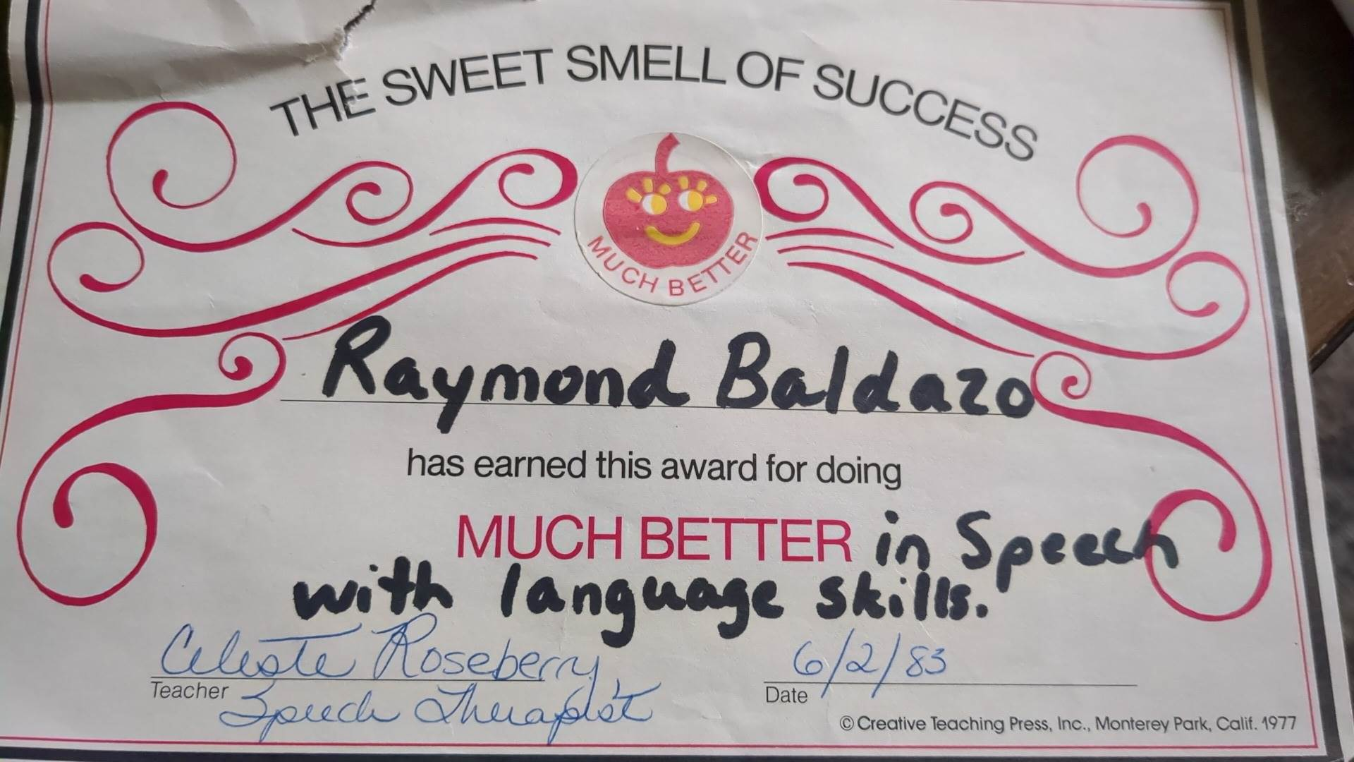
From Rogelio on Facebook…
You inspired me with your kind words and gentle soul. I wanted to thank you for the work you have done for me and my little brother. You were there to help lift us up. A true inspiration. I will always remember you….

